Slide 1
Focus on Reentry: Criminal Justice
Your Money, Your Goals for Reentry
Notes:
Training Section 1: Title slide and disclaimer
THIS PRESENTATION SUPPORTS THE JULY 2021 VERSION OF YOUR MONEY, YOUR GOALS: Focus on Reentry: Criminal Justice companion guide. This document will be referred to throughout this presentation as “the guide.”

Slide 2
Disclaimer
This presentation is being made by a Consumer Financial Protection Bureau representative on behalf of the Bureau. It does not constitute legal interpretation, guidance, or advice of the Consumer Financial Protection Bureau. Any opinions or views stated by the presenter are the presenter’s own and may not represent the Bureau’s views.
This presentation includes references to third-party resources or content that consumers may find helpful. The Bureau does not control or guarantee the accuracy of the third-party information. By listing this reference, the Bureau is not endorsing and has not vetted this third party, the views they express, or the products or services they offer. Other entities and resources also may meet your needs.

Slide 3
Disclaimer
The Consumer Financial Protection Bureau (Bureau) (consumerfinance.gov) created the Your Money, Your Goals toolkit and resources, including the training materials presented today. These materials are being presented to you by an organization. The organizations or individuals presenting these materials are not agents or employees of the Bureau, and their views do not represent the views of the Bureau. The Bureau is not responsible for the advice or actions of these individuals or entities.
This presentation includes references to third-party resources or content that consumers may find helpful. The Bureau does not control or guarantee the accuracy of the third-party information. By listing this reference, the Bureau is not endorsing and has not vetted this third party, the views they express, or the products or services they offer. Other entities and resources also may meet your needs.

Slide 4
Focus on Reentry
Overview of the training and introductions
Notes:
Training Section 2: Overview of the training and introductions

Slide 5
Training objectives
Understand the content of Focus on Reentry
  Be able to identify moments when you could introduce the tools to the people you serve
  Be able to use its tools to help people take steps to reach their financial goals
Understand how this resource complements the information and tools in the full Your Money, Your Goals toolkit and on the CFPB website
Have an increased understanding of the Consumer Financial Protection Bureau and be able to access and refer people to its resources
Notes:
Review training objectives

Slide 6
Introduction activity
Share name
Organization
“What do you expect or hope to get from this training?”
Notes:
Invite participants to introduce themselves to the group by sharing their name, their organization, and responding to: “What do you expect or hope to get from this training?”
Write their expectations or hopes on flip chart paper. Revisit these at the end of the training to check in to see whether the training met their expectations or hopes for the training.
FACILITATION TIP: Try to encourage people to be brief and avoid sharing the details of their roles and responsibilities at work as well as details about what their organization does – otherwise you will have difficulty keeping on the training schedule. It is important NOT TO SKIP introductions because you are concerned about time. Participants are accustomed to some level of introduction in convenings. This is even more important if the group represents a heterogeneous mix of participants and organizations.
Alternative Approaches to the Introductions:
Meet and Mix at the table – An alternative for large groups (more than 25 to 30 participants)
Ask participants to share their names, organizational affiliations, and training expectations with the other participants sitting at their tables.
Ask the group to find one thing all of them have in common. You can ask them to identify a common characteristic around one topic area (money) or leave it wide open to facilitate rapid sharing within the tables.
Provide teams with about 7 – 9 minutes to work in groups—share name, etc. and work to find an item they have in common.
Ask each table to share the thing they have in common.
Write these on a flip chart.
After the sharing is complete, write ”the ability to use Your Money, Your Goals with the people we serve” on the list of items they have in common and explain that they will all have this in common by the end of the training.
Vote with Your Feet – An alternative for small groups (less than 20 to 25 participants)
Develop a list of questions that each have four answers. For example:
What season does your birthday fall within? Spring, Summer, Fall, Winter
What is the most important financial empowerment topic for the people you serve? Budgeting, Credit, Debt Management, Consumer Protection
How long have you worked with your organization? I just started, Less than 1 year, 1 – 3 years, more than 3 years
You can include questions about sports teams people may support in your area, local food that is their favorite, favorite books or movie genres, the items they would want with them if stranded on a desert island, etc.
Write the answers to the questions on flip charts. Be sure that the answers to one question are written on four different flip charts. Then add one answer from the next question to each flip chart and so on.
For the activity, ask people to stand under the flip chart that best represents their answer to the question you read. Then, have the smallest grouping of individuals introduce themselves by sharing their name and organizational affiliation. Then read the next question and repeat the process. If someone is in the group introducing themselves that has already shared their information, you can skip them to ensure everyone has a chance to introduce themselves.
With the final question, be sure to have anyone who has not introduced themselves share their information whether they are in the group that is introducing themselves or not.

Slide 7
Your Money, Your Goals
Introduction to the CFPB
Notes:
Training Section 3: Introduction to the Bureau

Slide 8
Introduction to the CFPB
Consumer Financial Protection Bureau
We are a 21st century federal government agency that helps consumer finance markets work by making rules more effective, by consistently and fairly enforcing those rules, and by empowering consumers to take more control over their economic lives.
Notes:
Introduce key facts about the CFPB using information from the Introduction to the Your Money, Your Goals toolkit at https://www.consumerfinance.gov/consumer-tools/educator-tools/your-money-your-goals/toolkit/ and other areas of the website.
Share additional information about the CFPB: The CFPB is working to ensure that consumers get the information they need to make financial decisions they believe are best for themselves and their families – that prices are clear up front, that risks are visible, and that nothing is buried in fine print.
Explain that a key goal of the training is to connect frontline staff to CFPB resources, including Consumer Response.

Slide 9
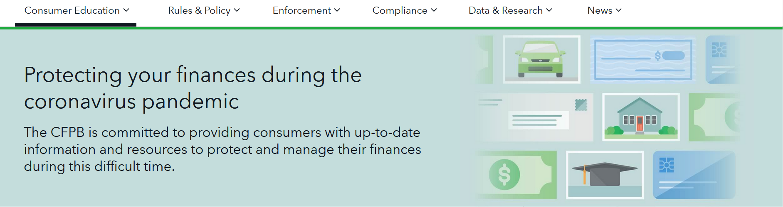
Commitment to supporting consumers
The CFPB is committed to providing consumers with up-to-date information and resources to protect and manage their finances
https://www.consumerfinance.gov
Notes:
Commitment to supporting consumers
It’s important that consumers protect and manage their finances. The CFPB is committed to providing consumers with timely and relevant information and resources to help them address situations and issues as they arise.
Checking the CFPB website frequently is a good idea so practitioners and consumers have up-to-date and relevant information. The CFPB wants to hear from you if there are issues or information you need help with.

Slide 10
CFPB Community Affairs Section
Part of the Bureau’s Division of Consumer Education and External Affairs
Serves populations who may lack full, affordable access to financial services
  Low- to moderate-incomes
  Low wealth
  Otherwise financially underserved or vulnerable
Notes:
Use the following information to explain the Bureau:
The CFPB’s Community Affairs Section serves the variety of populations who may lack full, affordable access to financial services, including people with low- to moderate-incomes; low wealth, and people who are in other ways financially excluded or vulnerable. By any measure, the numbers of consumers whose income level contributes to financial fragility constitutes a significant portion of the U.S. population.
According to 2018 data from the U.S. Census Bureau, some 38.1 million people, including children, live in households that have incomes below the federal poverty level, while another 55.5 million live between 100 and 200 percent of the poverty threshold.
The Bureau created Your Money, Your Goals to reach these consumers by empowering those that serve them: frontline nonprofit or tribal social service staff, community volunteers, staff in legal aid organizations, and faith-based organizations. By providing people like you with high quality information, organizations have the tools and resources to start the financial conversation with the people they already serve. This training is designed to provide you with the confidence to use these tools and resources.

Slide 11
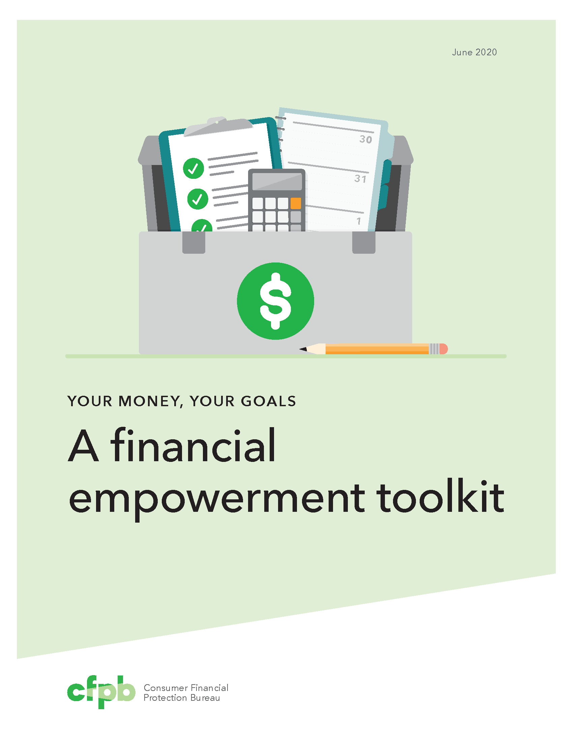
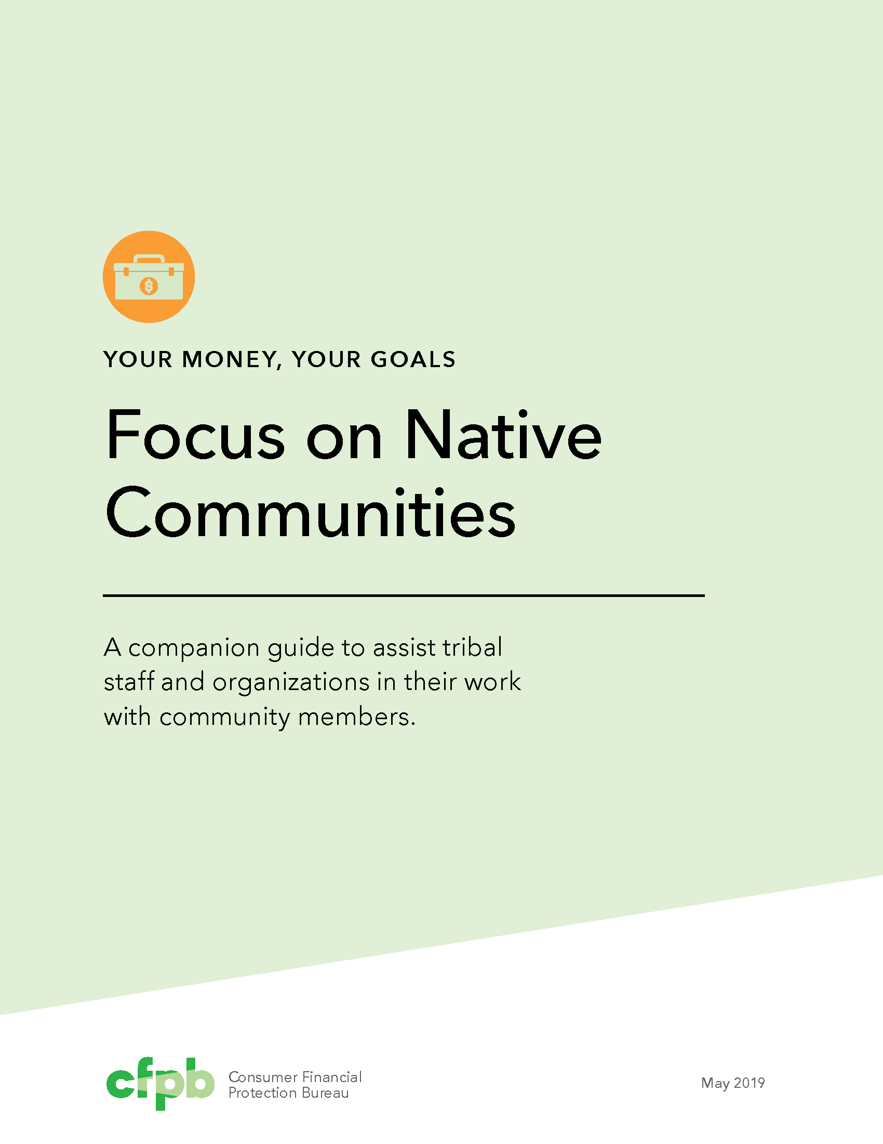
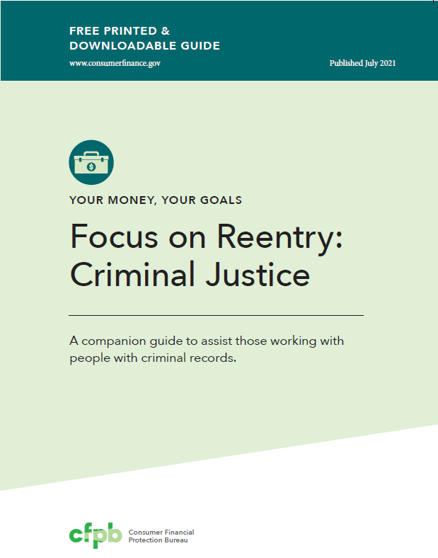
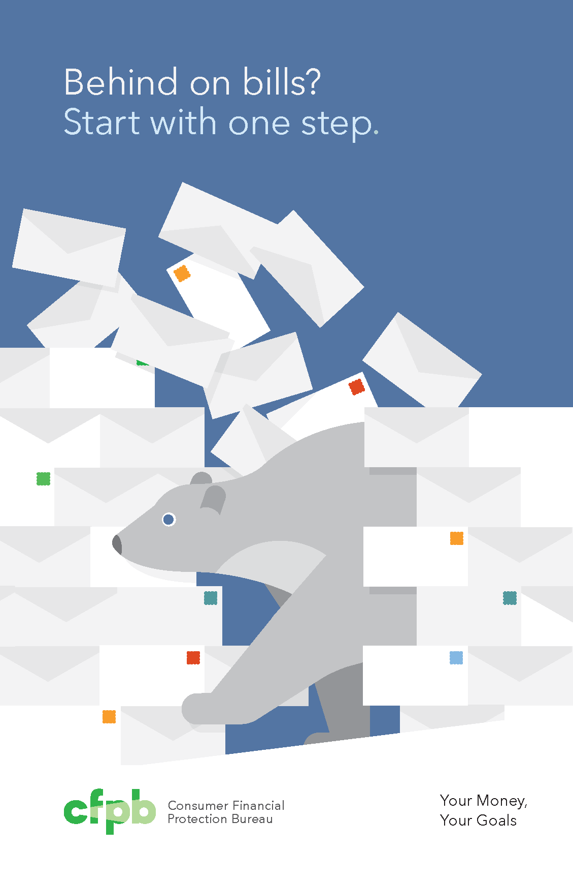
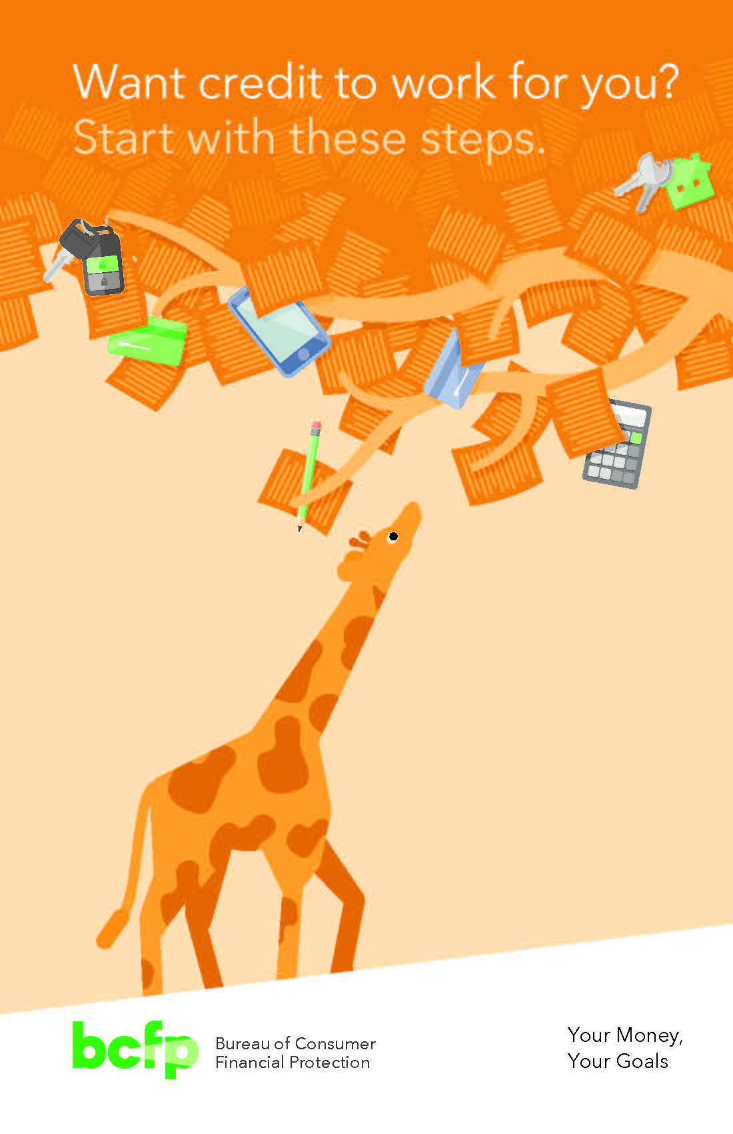
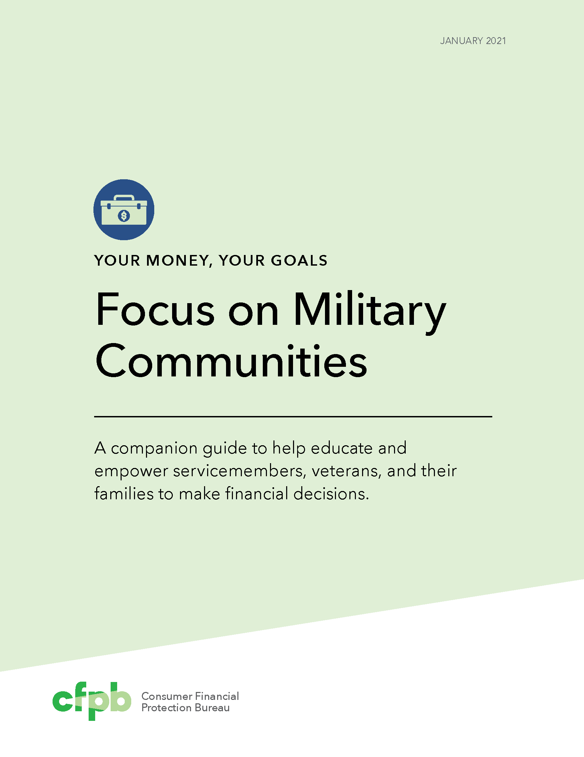
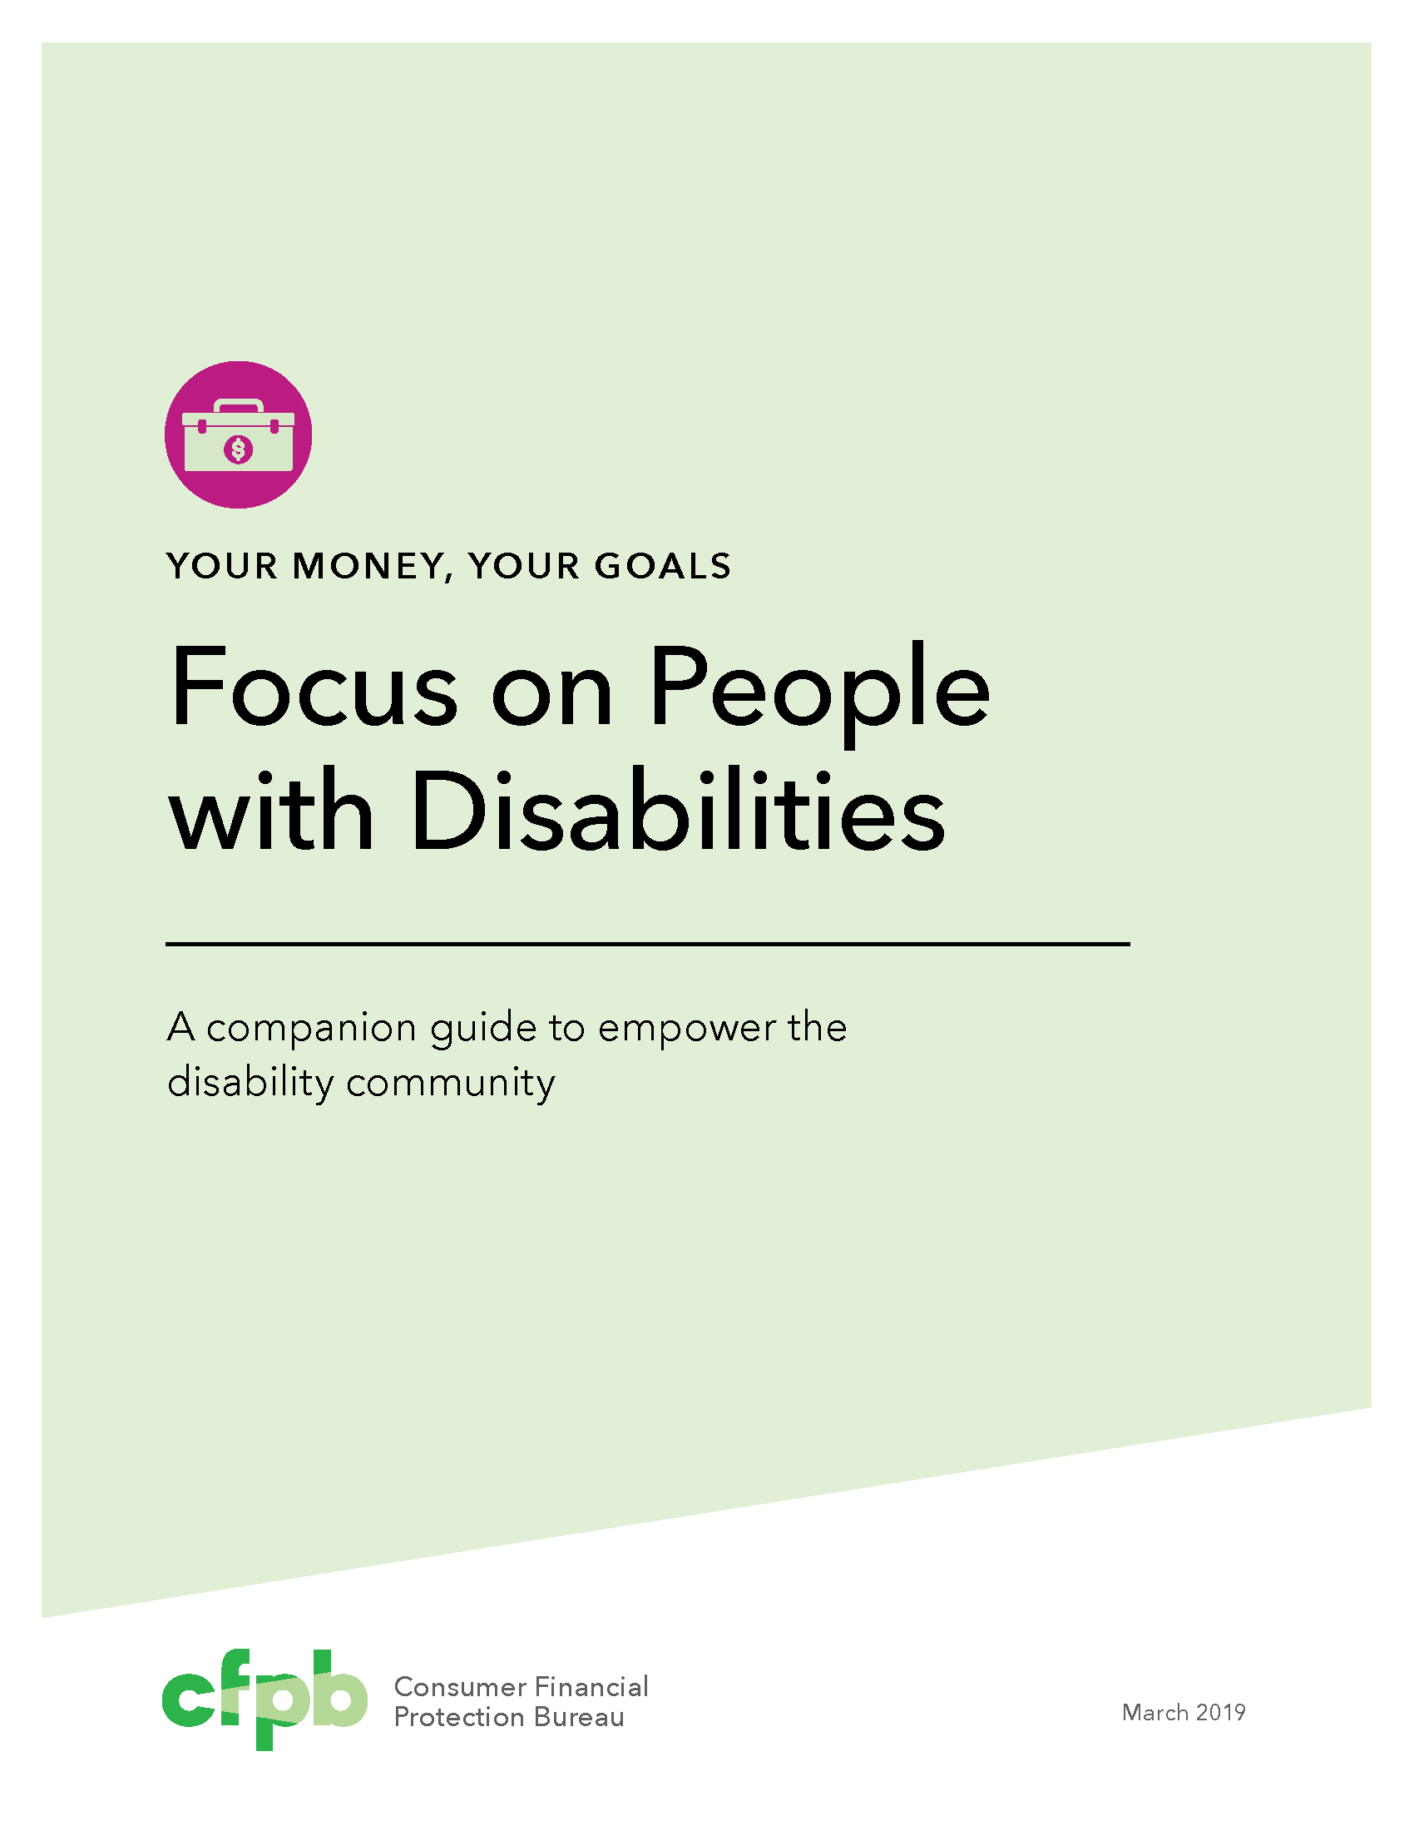

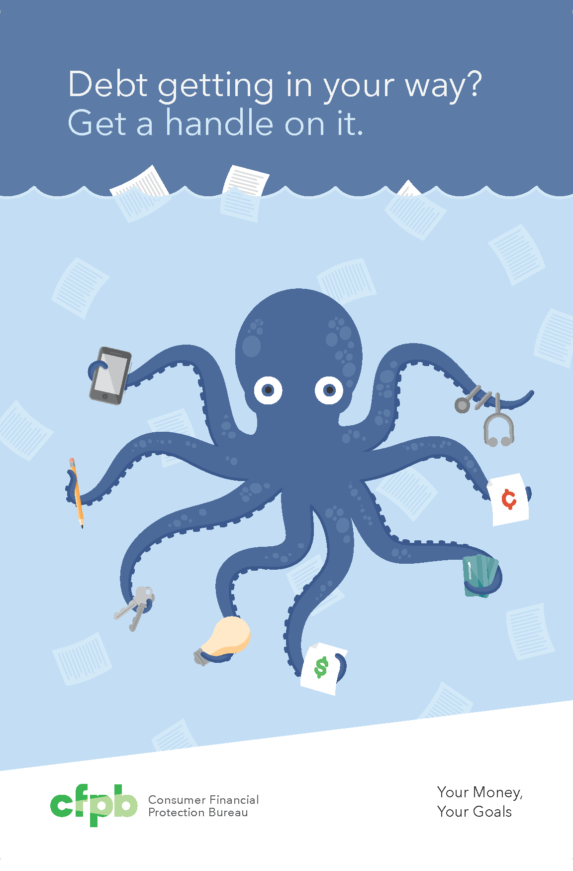
Your Money, Your Goals: Resources
One Toolkit
Comprehensive information for practitioners.
Four Companion Guides
Help practitioners contextualize the money conversation to the unique needs of specific populations.
Four Booklets
Actionable, compact booklets on bills, credit, debt and saving.
For in-person use.
All Available at: https://www.consumerfinance.gov/your-money-your-goals/
Selected materials available in Spanish.
Notes:
Training Section 4: Additional resources
Your Money, Your Goals includes a variety of resources:
Toolkit: This is not a curriculum. Use what tools work for the person you are working with in that moment.
Online resources: Online information and PDF tools make it easy to access information on-the-go or remotely.
Companion guides: Companion guides help you address the unique needs of Native communities, people with criminal records, people with disabilities, and the military community.
Booklets: There are four colorful booklets than can help you address being behind on bills, debt, credit, and savings. Behind on bills? and Want credit to work for you? are also available in Spanish.

Slide 12
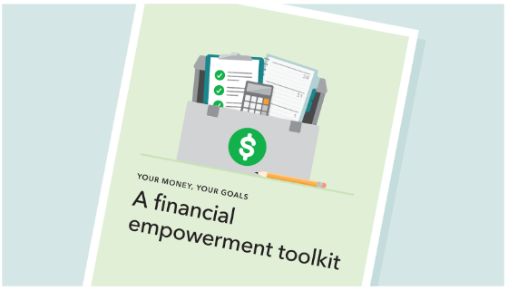
Your Money, Your Goals Toolkit
The toolkit has information that helps you have money conversations with the people you serve.
The toolkit includes:
  43 tools and handouts
  Easy-to-follow directions so you can use tools confidently
  Recommendations on which tools to use based on the situation and time available
https://www.consumerfinance.gov/consumer-tools/educator-tools/your-money-your-goals/toolkit/
Notes:
The toolkit has information that helps you have the money conversation with the people you serve. Use the tools to help achieve goals and work through challenges. The Focus on Reentry guide is meant to be a stand-alone resource but the toolkit provides more in-depth information on topics and additional tools that supplement the Focus on Reentry resource. Always remember to check and search the website as well if there is information you can’t find in these resources.
You can use the toolkit to help people:
Make spending decisions that can help them reach their goals
Order and fix credit reports
Make decisions about repaying debts and taking on new debt
Keep track of their income and bills
And much more!
The toolkit includes:
43 tools and handouts
Easy-to-follow directions so you can use tools confidently
Recommendations on which tools to use based on the situation and time available
The toolkit is available for download in English, Spanish, and Chinese.
You can also order free printed copies in English and Spanish.
Access the website to access individual tools in the toolkit as fillable PDFs.

Slide 13
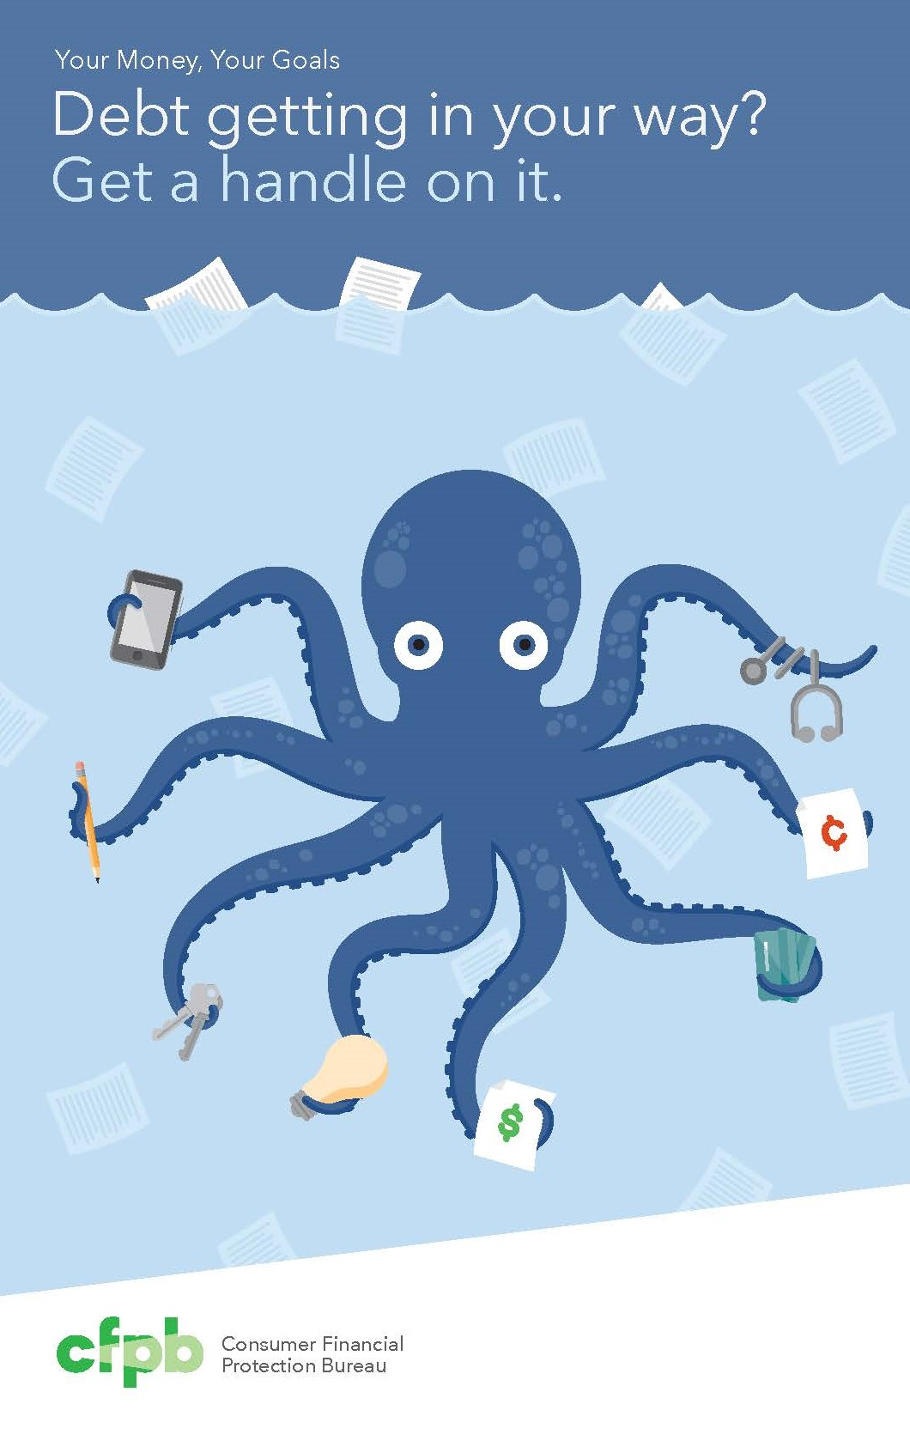


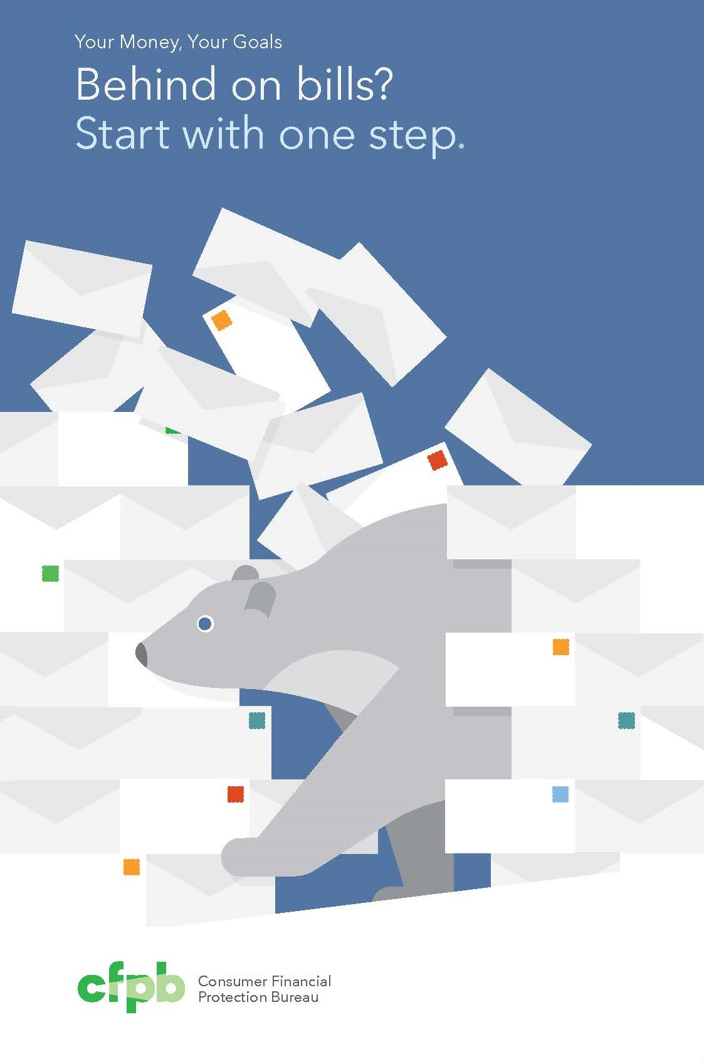
Booklets to Help Talk About Money
These colorful, compact booklets can help you talk with people about money topics that are important to them.
Four booklets for different situations:
  Behind on bills? Start with one step.
  Debt getting in your way? Get a handle on it.
  Want credit to work for you? Start with these steps.
  Building your savings? Start with small goals.
Notes:
These colorful, compact booklets can help you talk with the people about money topics that are important to them.
Four booklets for different situations:
Behind on bills? Start with one step.
(Available in English and Spanish)
Debt getting in your way? Get a handle on it.
Want credit to work for you? Start with these steps.
(Available in English and Spanish)
Building your savings? Start with small goals.
Each booklet has 8 tools.
Booklets are meant to be used in-person, there is not an online version.

Slide 14
Behind on bills? Start with one step.
Create an action plan
Track and manage income and spending
Prioritize bills and expenses
Available in English and Spanish
Correctional Facilities: https://pueblo.gpo.gov/CFPBPubs/CFPBPubs.php?NavCode=XB&Sub2ID=269&CatID=36
Notes:
Behind on bills? Start with one step.
Create an action plan
Track and manage income and spending
Prioritize bills and expenses
Understand rights and responsibilities when contacted by debt collectors
Available for order in English and Spanish.
The version for correctional facilities comes without the wire binding.

Slide 15

Want credit to work for you? Start with these steps.
Order and review credit reports, dispute any errors that are found
Plan how to establish or build credit
Respond to identity theft
Available in English and Spanish
Correctional Facilities: https://pueblo.gpo.gov/CFPBPubs/CFPBPubs.php?NavCode=XB&Sub2ID=269&CatID=36
Notes:
Want credit to work for you? Start with these steps.
Order and review credit reports, dispute any errors that are found
Plan how to establish or build credit
Respond to identity theft
Available for order in English and Spanish.
The version for correctional facilities comes without the wire binding.

Slide 16

Debt getting in your way? Get a handle on it.
Get a full picture of existing debt
Order a credit report
Prioritize debts and set repayment goals
Plan how to avoid additional debt
Correctional Facilities: https://pueblo.gpo.gov/CFPBPubs/CFPBPubs.php?NavCode=XB&Sub2ID=269&CatID=36
Notes:
Debt getting in your way? Get a handle on it.
Get a full picture of existing debt
Order a credit report
Prioritize debts and set repayment goals
Plan how to avoid additional debt
Available for order in English.
The version for correctional facilities comes without the wire binding.

Slide 17
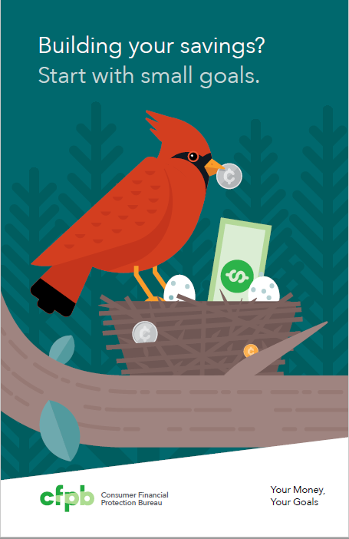
Building your savings? Start with small goals.
Prioritize and set savings goals
Prepare for unexpected expenses
Find a place for savings
Make the most of a tax refund
Correctional Facilities format:
Not yet available.
Notes:
Building your savings? Start with small goals.
Prioritize and set savings goals
Prepare for unexpected expenses
Find a place for savings
Make the most of a tax refund
Available for order in English.
There is not a version of Building your savings? for correctional facilities.

Slide 18
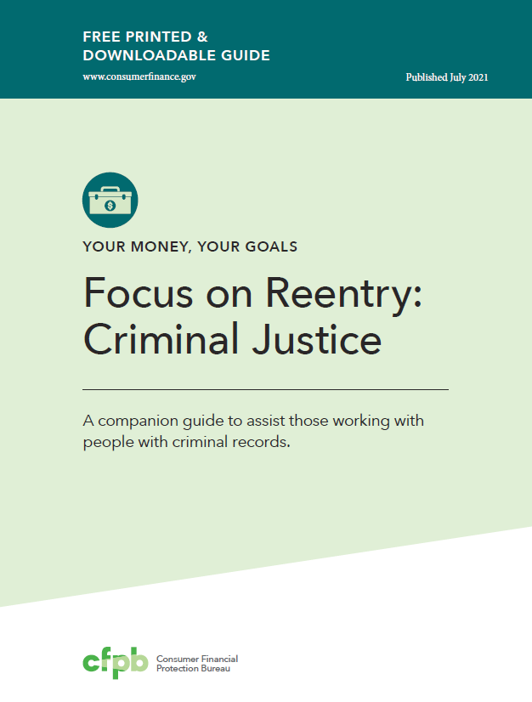
Focus on Reentry
Purpose:
The guide helps frontline staff and volunteers working with individuals with criminal
records address some of the specific financial challenges they may face.
Available at: https://www.consumerfinance.gov/consumer-tools/educator-tools/your-money-your-goals/companion-guides/

Slide 19
What’s inside Focus on Reentry
Module 1: Setting Goals
Module 2: Saving
Module 3: Tracking Income and Benefits
Module 4: Paying Bills
Module 5: Getting through the Month
Module 6: Dealing with Debt
Module 7: Understanding Credit Reports and Scores
Module 8: Choosing Financial Products and Services
Module 9: Protecting your Money
Module 10: Understanding Background Screening Reports
Notes:
Review organization of the guide using the slide and information in the table of contents, on pages 6-7 in the guide.
Highlight the following key points:
Do not treat the guide like a curriculum.
Provide the right content and tools at the right time.
Use individual discussions or assessments to figure out where to start.

Slide 20
Why Reentry?
More than 70 million individuals with criminal records
  Impact on access to employment and housing
Financial challenges
  Background screening reports and employment
  Consumer and criminal justice debt
Notes:
Training Section 5: Why reentry?
More than 70 million individuals with criminal records.
Note on source: 2018 data reports more than 112 individual criminal records, but there are individuals that have more than one; conservative estimate is more than 70 million individuals. (Source: SEARCH, The National Consortium for Justice Information and Statistics using federal funding provided by the Bureau of Justice Statistics
https://www.ojp.gov/pdffiles1/bjs/grants/255651.pdf)
Impact on access to employment and housing
Financial challenges
Background screening reports and employment
Consumer and criminal justice debt

Slide 21
Your Money, Your Goals for people with criminal records
In 2019, jails reported more than 10 million admissions
Every year, more than 600,000 individuals are released from prison
Black and Hispanic individuals are disproportionately represented in prison and jail populations
  As of 2019, for every 100,000 residents in the United States in each group, there were 1,096 Black residents in prison, 525 Hispanic residents, and 214 White residents.
Notes:
If the following information is useful to the audience, you may find it helpful to share some of these items from pages 4-5 in the guide.
This is information about the numbers of people involved in the criminal justice system to get a sense of the size of the audience for these resources and to sensitize people to the impact of incarceration or other involvement in the criminal justice system.
In 2019, jails reported more than 10 million (U.S. Department of Justice, Bureau of Justice Statistics, Jail Inmates in 2019 (March 2021) available at https://www.bjs.gov/content/pub/pdf/ji19.pdfadmissions).
Every year, more than 600,000 are released from prison. (U.S. Department of Justice, Bureau of Justice Statistics, Prisoners in 2019 (Oct.2020) available at https://www.bjs.gov/content/pub/pdf/p19.pdf).
Blacks and Hispanics are disproportionately represented in prison and jail populations. For example, as of 2019 for every 100,000 residents in the United States in each group, there were 1,096 Black residents in prison, 525 Hispanic residents, and 214 White residents.
As noted in a CFPB report: "Because of demographic differences in incarceration rates among races, the difficulty of formerly incarcerated individuals in accessing the banking system upon release also reinforces racial disparities in access to financial products.“ CFPB, Taskforce on Federal Consumer Financial Law Report, Volume I, p. 556 available at https://files.consumerfinance.gov/f/documents/cfpb_taskforce-federal-consumer-financial-law_report-volume-1_2021-01.pdf
Many of these justice-involved individuals face barriers to successful reentry. Many barriers to accessing jobs, housing, education, and other key reintegration outcomes have financial challenges attached to them.

Slide 22
Using the information and tools
You can use the information and tools to help people with criminal records:
  Identify financial challenges to successful transition
  Obtain documents related to identification to help ease the transition process
  Develop a cash flow budget by tracking income and spending
  Identify and prioritize debt—both debt arising from involvement in the criminal justice system (criminal justice debt) and consumer debt
  Access and review credit reports
  Understand the background screening process and individual rights when applying for jobs
Notes:
Review following information from the guide, page 7:
You can use the information and tools to help people with criminal records:
Identify financial challenges to successful transition
Obtain documents related to identification to help ease the transition process
Develop a cash flow budget by tracking income and spending
Identify and prioritize debt—both debt arising from involvement in the criminal justice system (criminal justice debt) and consumer debt
Access and review credit reports
Understand the background screening process and individual rights when applying for jobs
You can use the guide in one-on-one or small group settings. Each person’s needs are unique and often complex.
Even when there are multiple issues to address, you shouldn’t try to cover all the information and tools with everyone you serve.
Covering all the tools at once, or even a few tools at one time, would be overwhelming for most people.
Only review one or two tools at a time, beginning with a key topic and the tools that make the most sense for their situation.

Slide 23

What is financial well-being?
A state of being reflecting a person’s ability to meet current and ongoing financial obligations, feel secure in their financial future, and make choices that allow enjoyment of life.
Present
Future
Control over your
day-to-day, month-to-month finances
Capacity to absorb a
financial shock
Security
Freedom of choice
Financial freedom to make choices to enjoy life
On track to meet your financial goals
Notes:
Training Section 6: Financial well-being
What is the goal of financially empowering the people you serve?
The ultimate goal of this work is to help people improve their financial well-being.
To learn what financial well-being means to people, the CFPB conducted open ended, one-on-one interviews, with a broadly diverse group of adults around the United States.
From these interviews the CFPB developed a definition shown in this slide. It is a state of being that reflects a person’s ability to meet current and ongoing financial obligations, feel secure in their financial future, and make choices that allow enjoyment of life.
This definition was built using people’s own words. And as seen here, it has an element of financial freedom and financial security in the present and the future.
Financial well-being is not completely determined by factors like income, education level, or previous financial experiences. People with the same income and education level can experience different levels of financial well-being.

Slide 24
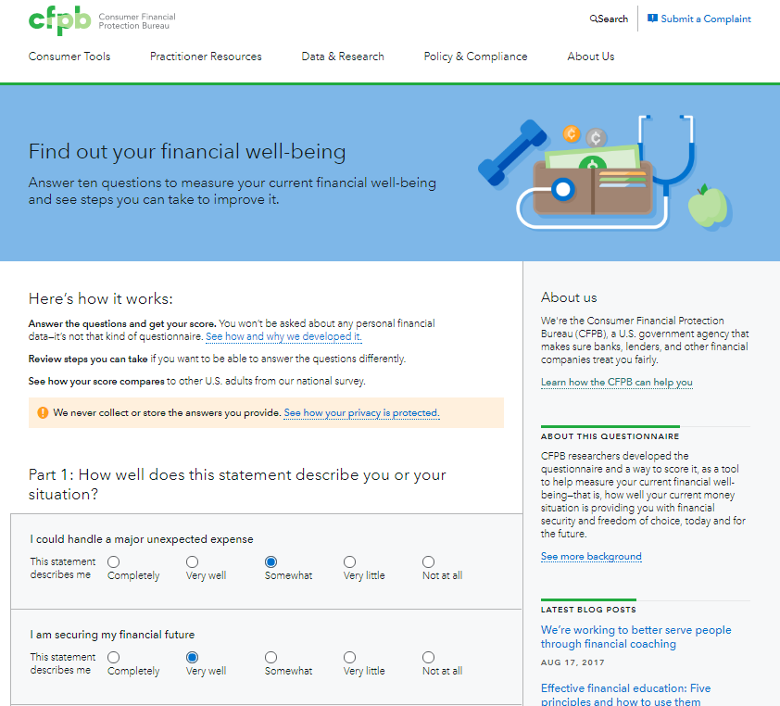
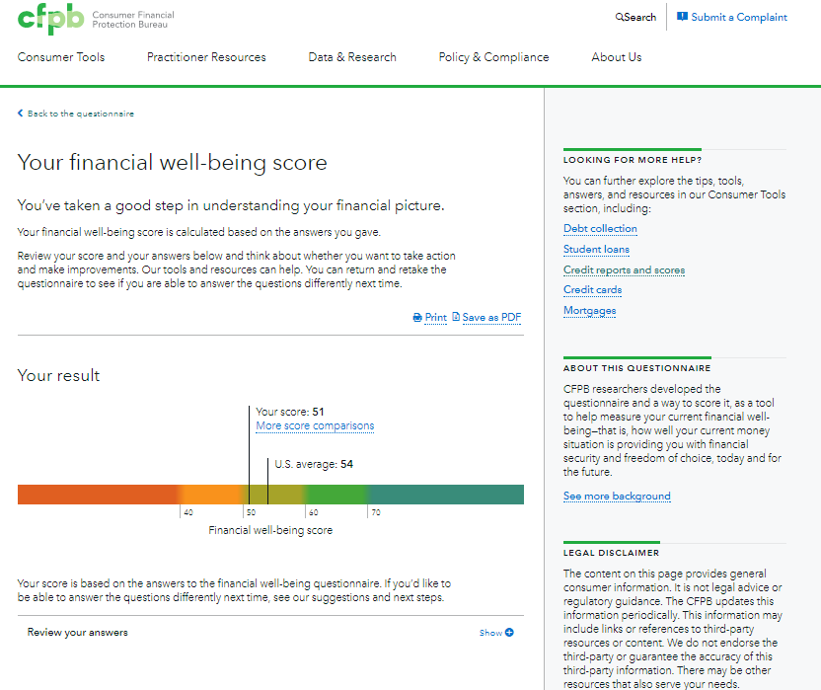
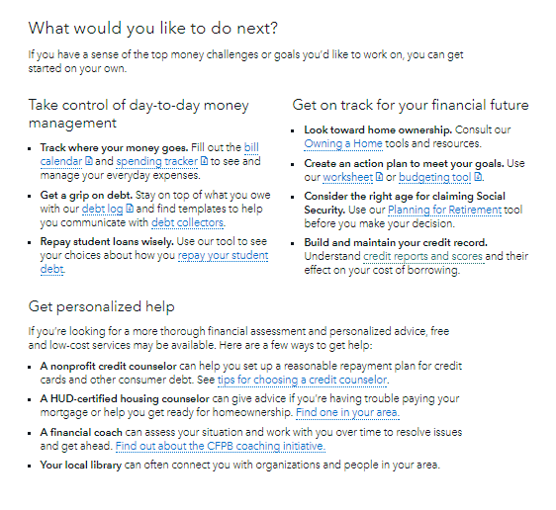
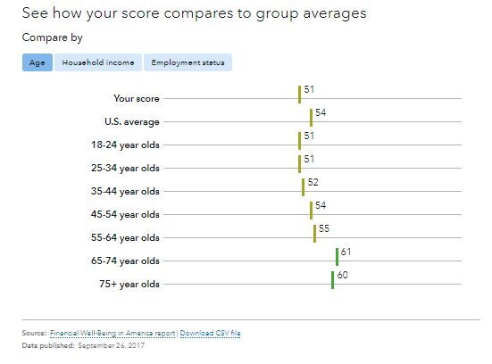
Online questionnaire
consumerfinance.gov/consumer-tools/financial-well-being/
Notes:
These are four screen shots from the CFPB website to show people how the scale works online.
The scale includes a questionnaire and scoring process.
People can get their scores immediately on the website – on a laptop or on a mobile device.
This slide shows how you can access the financial well-being questionnaire at the CFPB website. It takes little time to fill it out (first screen shot) and you can see your score (second screen shot). The online tool also shows you how you compare to others in similar age, income, education, and other categories.

Slide 25
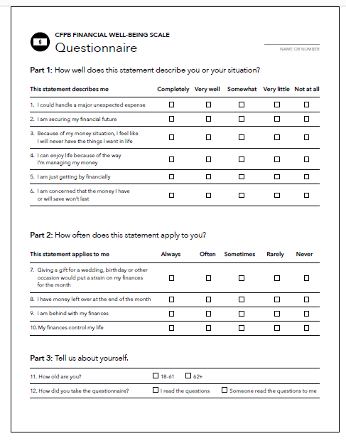
Paper version of the questionnaire
Download it here:
www.consumerfinance.gov/practitioner-resources/financial-well-being-resources/measure-and-score/
Notes:
You can also download a paper version, or use the one in the Focus on Reentry guide (p. 15).

Slide 26
The financial well-being scale
The scale has two parts:
The questionnaire: The questionnaire contains 10 questions that capture how individuals feel about their financial security and freedom of choice; plus:
  Question about age (18-61 or 62+)
  Question about mode of administration (self-administered or administered by someone else)
Scoring worksheet: Responses to the questions can be converted into an overall financial well-being score between 0 and 100.
Using the questionnaire and scoring sheet, you can measure financial well-being in three steps.
Notes:
Review the following information in the guide, pages 13-17:
To help you administer the scale, here is a description of the questionnaire and scoring worksheet – both included in the Reentry guide section on financial well-being, starting at page 13.

Slide 27
Step 1: Collect responses to the questionnaire
Be sure to:
Test out the scale. If you are concerned about how the people you serve might react, test it out on one or two of your clients before adopting it more widely in your practice.
Allow people to interpret the questions for themselves. Don’t reword or tell people what questions mean. The design and validation of the scale is based on allowing people to determine what the questions mean for themselves.
Give people the choice to complete the questionnaire and assure them their responses will be kept confidential. This will help people feel more comfortable responding honestly to the statements on the scale.
Try the online version. You can complete the online questionnaire with people you serve or ask them to complete it independently and receive a score instantly.
Notes:
Here are the steps for collecting the responses to the questionnaire and some ideas for how you might do it.

Slide 28
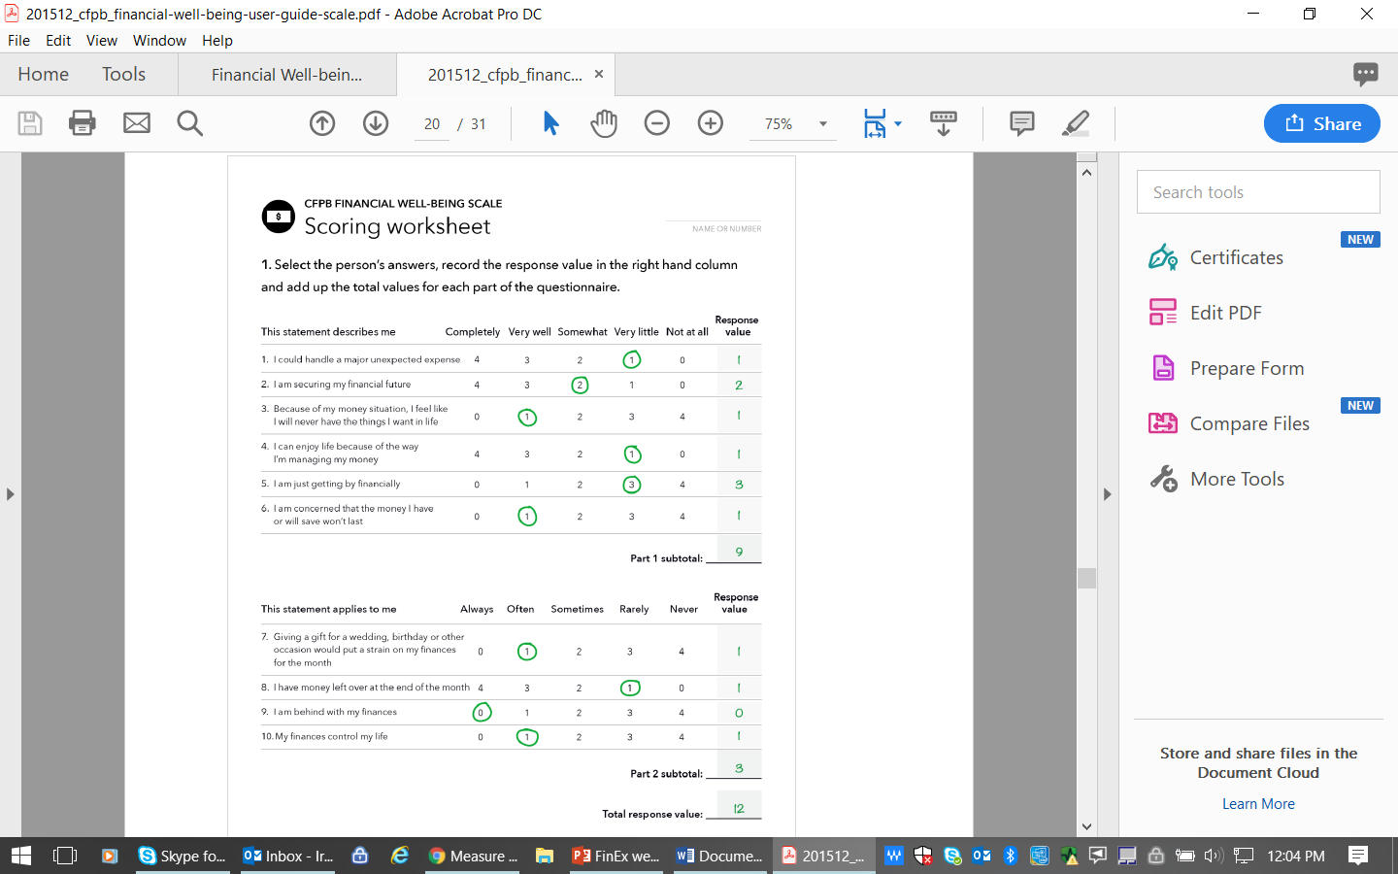
Step 2. Calculate the total response value
Using the first page of the scoring worksheet, for each question, enter the response value (the number from 0-4 that corresponds to the client’s response) into the right-hand column.
Add up these response numbers to get a total response value.
This is only the total response value. It is not the financial well-being score.
Individuals must answer all of the questions to get a score.
Notes:
Here is how you calculate the total response value, which you need to get the scores.

Slide 29
Step 3. Convert the total response value to a financial well-being scale score
Using the second page of the scoring worksheet, locate your client’s total response value in the first column.
Follow that row across to the appropriate column based on your client’s age group, and whether was self-administered or administered by someone else.
This will give you the respondent’s financial well-being score.
Notes:
Here is how you calculate the score from the total response value.
For more information on the process and the scores, visit www.consumerfinance.gov/practitioner-resources/financial-well-being-resources/measure-and-score/.

Slide 30
Your Money, Your Goals
Opening activity
Notes:
Training Section 7: Opening activity
Having an activity prior to introductions is intentional in the design of the training. Having participants reflect on attitudes and feeling about money and emotional and cultural influences on financial decisions makes them more open to understanding those decision-making influences on the people they serve. In addition, they may become more open to applying Your Money, Your Goals and financial empowerment to their own lives.
FACILITATION TIP: If you have another activity that is participatory and helps uncover emotional and cultural influences on financial decisions, feel welcome to substitute that activity for the one described in this training.

Slide 31
Money and me: Opening activity
List all of the words, phrases, sayings, songs, or other associations you have with the word money.
Notes:
Instruct participants to work in small groups.
Give each group a flip chart and marker.
Instruct them to brainstorm all of the associations they have with money per the PowerPoint slide on their flip chart paper.
Tell them the winning group is the one with the most associations.
Give them 2.5 to 3 minutes.
Call time and ask groups to count the total items listed and write the number on their flip charts.
Congratulate winning team.
Hang up their flip chart.
Ask other teams to add items they feel are missing from the list.
Go through many of the ideas (not all) and ask the large group to indicate whether the association is positive or negative with a thumbs up or thumbs down, respectively.
Based on majority vote, write “+” or “-” next to each entry on the flip chart.
If there is a lot of disagreement about an entry, facilitate a short discussion about the disagreement and write “?” next to those about which there does not seem to be agreement.
Webinar facilitation: Throughout the speaker notes you will see activity instructions for the facilitator. If you are facilitating virtually, use the chat, break out rooms, a poll, or another tool supported by your web-based platform to facilitate a modified activity.

Slide 32
Money and me: Opening activity
money
any generally accepted medium
of exchange
Notes:
Show and read the definition of “money.”
Contrast the definition of money to the list of associations generated by the team by asking: “How did we get from this simple definition of money to all of these positive and negative associations?”

Slide 33
Money – what does it mean?
Where do associations about money come from?
How do these associations reflect attitudes and feelings about money?
How are attitudes and feelings related to behaviors and actions?
What does this mean when we are working with the people we serve?
Notes:
Ask some or all of the questions listed to facilitate a discussion.
Where do associations about money come from?
Be sure to add the following if not contributed by participants: family, peers, school, media, government, businesses, communities of faith, social and service organizations. Ask people for specificity including examples of how family or peers or media, for example, may create lasting associations about money for people.
How do these associations reflect attitudes and feelings about money?
Be sure to add the following if not contributed by participants: Our attitudes and feelings about money may be rooted in some of these associations.
How are attitudes and feelings related to behaviors and actions?
Be sure to add the following if not contributed by participants: Our behaviors and actions are often driven by our attitudes and feelings. This is part of the reason our knowledge—what we know is good practice with money—and our actions do not line up.
So what does this mean when we are working with the people we serve?
Be sure to add the following if not contributed by participants: While it’s easy to think about financial empowerment as providing people with information and opportunities to develop financial management knowledge and skills, financial empowerment must also consider and help people understand some of the underlying attitudes and feelings about money and how these impact practices and behaviors today. Attitudes and feelings may drive practices and actions. Understanding the origins of attitudes and feelings about money can help people understand the reasons behind some of their actions and makes changes if they want to make changes.
Be sure to highlight cultural differences based on socio-economic status, ethnicity, region, and age. You can discuss how these may arise or present themselves with reentry population, inside correctional facilities or in the community, or unique issue you may have experiences working with individuals in reentry.
Summarize by sharing:
Attitudes and beliefs about money may drive behavior. Understanding origins of these attitudes and beliefs can help you better understand what influences some productive and unproductive money practices. It is also important to understand your own attitudes or biases around money and financial issues—this can help ensure you do not judge someone for their:
Financial situations
Current financial practices
Past financial decisions
Their current financial goals

Slide 34
Having the Money Conversation
Notes:
Training Section 8: Having the money conversation

Slide 35
Having the money conversation: At a glance
These tools can help you start the money conversation with people facing difficult choices.
  My money picture
  Preparing your money situation before or during incarceration
  Getting documents and identification
The tools in this Module can help you:
  Protect money before or during incarceration
  Discuss values around money
  Learn what documents are needed while transitioning from incarceration
Notes:
Review the following information, pages 18-19 in the guide:
Understanding how incarceration can affect personal finances is the first step in empowering the people you serve
These tools can help you start the money conversation with people facing difficult choices.
Preparing your money situation before or during incarceration
My money picture
Getting documents and identification
Often, people who are in the criminal justice system - before, during or after incarceration - struggle with money or financial issues.
Depending on the setting and where the person is in the transition process, there are different approaches you can use with them to reflect on their goals and values.
The tools in this Module can help you:
Protect money before or during incarceration
Discuss values around money
Learn what documents are needed while transitioning from incarceration

Slide 36
Tool: My money picture worksheet
Help the individual reflect on their own values around money
The tool is designed to help the individual with the reentry process
Depending on the situation, you may want to ask the person to include members of their family
Notes:
Tool: My money picture worksheet, starting on page 20 in the guide.
This tool helps the individual build a picture of where they are and where they want to go financially. This can help point to the next step in this guide based on the answers of the individual.
Values and money decisions can be sensitive and challenging for people transitioning from incarceration or facing challenges due to their criminal record.
The tool is meant to help people reflect on their own values around money. Individuals may not want to discuss or share their responses. That’s okay. What is important is that they are honest with themselves, and they understand the tool is designed to help them with the reentry process.
You can use the method that you think works best with each individual and depending on the setting, for example:
Print out the page and give it to the individual to complete.
Read the questions and fill in the person's responses, in the PDF or on the printed copy.
Weave the questions into a conversation with the person and note the responses in the PDF or on the printed copy.
Depending on the situation, you may want to ask the person to include members of their family. Discussing money goals together, or pooling resources, may help with transition.

Slide 37
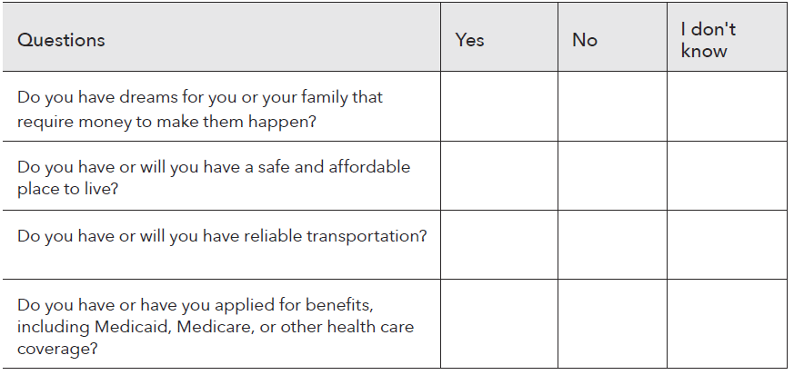
My money picture worksheet: Questions
Notes:
Review the My money picture worksheet, on pages 20-22 in the guide.

Slide 38
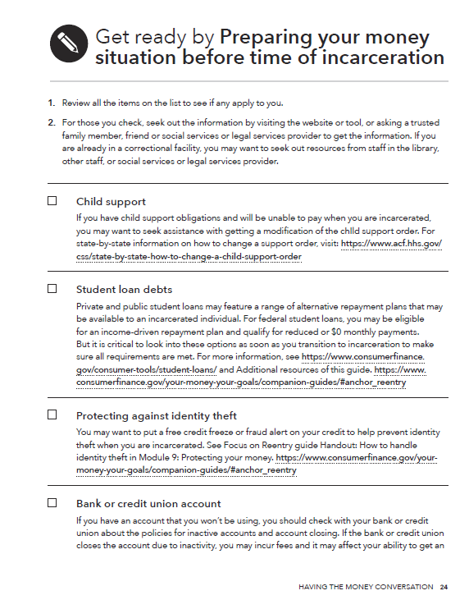
Tool: Preparing your money situation before time of incarceration
Use this checklist prior to or soon after incarceration to:
  Identify any of the issues that apply and take action to address them
  Use the websites and the “Additional resources”
Notes:
Tool: Preparing your money situations before time of incarceration, pages 23-25 in the guide.
Incarceration poses many challenges, including accessing and maintaining finances.
This tool is to help an individual identify and take action before or soon after incarceration to minimize some of their exposure to financial harm.
For example, if an individual, or someone on their behalf, places a freeze on their credit report while in prison, that may help prevent identify theft. Or, if an individual has federal student loans, they may be able to get into a zero dollar-income-based repayment plan.
This checklist can be used prior to or soon after incarceration.
Identify any of the issues that apply. It is important to highlight that there are actions a person can take to protect themselves from loss, even when they are incarcerated.
Use the websites and the "Additional resources" provided to access the appropriate tools or information to address the issue.
If you work with people in jail or prison, you can print the tools and information in advance.

Slide 39
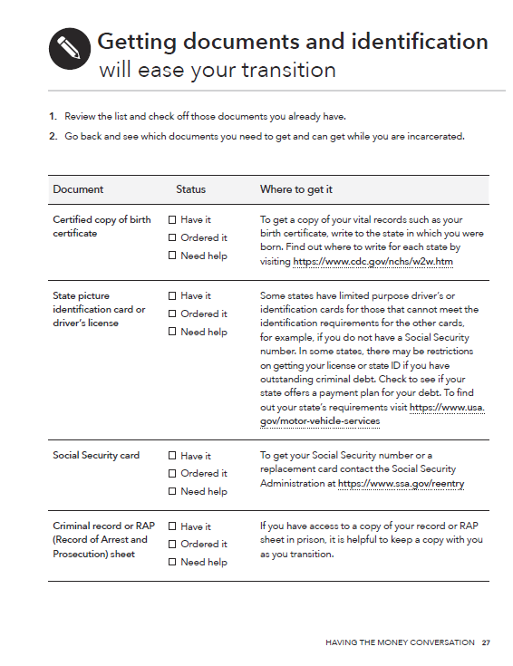
Tool: Getting documents and identification
Applying for a job or benefits, opening a bank account, and many other activities require identification documents
Help the individual identify sources for identification documents and possible barriers to getting them
Notes:
Tool: Getting documents and identification, pages 26-28 in the guide.
Review the tool.
This tool can be found at https://www.consumerfinance.gov/consumer-tools/educator-tools/your-money-your-goals/companion-guides/#anchor_reentry.
This tool will help an individual identify the documents and types of forms of identification they need when they transition to the community.
If an individual is transitioning from incarceration, they may need help with getting or renewing identification documents.
Applying for a job or benefits or housing, opening a bank account, and many other activities require documentation of identity.
Working to resolve identification and secure documents before release will make it easier for an individual to achieve goals such as securing housing or benefits.
To obtain a driver’s license or identification cards, an individual will have to complete an application and pay an application fee, although some states may provide identification cards for a reduced fee or for free.
What to do with the people you serve. Ask them to:
Go through the list to see which documents you do and do not have.
Get copies of the documents you don’t have. If you are incarcerated, it is important to find out what the facility's process is for getting documents such as a replacement Social Security card.
Store your documents in a safe place. If you are incarcerated, check with staff at the facility to find out how to store and protect your documents.

Slide 40
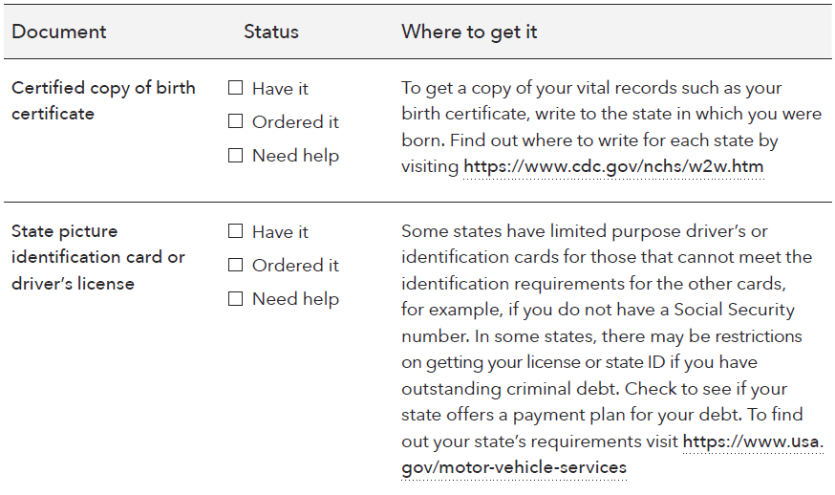
Getting documents and identification: Review the list
Notes:
Tool (continued): Getting documents and identification, pages 26-28 in the guide.

Slide 41
Focus on Reentry
Module 1: Setting Goals
Notes:
Note: Training sections for content modules are labeled by their module number (ex: Module 1), rather than by training section number.
Module 1: Setting Goals

Slide 42
SMART goals
Specific
Measurable
Achievable
Relevant
Time bound
Notes:
Review the information on pages 29-33 in the guide.
Specific
When setting a goal, ask yourself the questions: Who? What? Why?
A specific goal has a much greater chance of being met than a general goal.
Measurable
You should be able to track your progress toward meeting the goal.
Ask yourself questions like: How much? How many? How will I know when it is done?
Achievable
Is this goal something that you can actually reach?
You might want to get rid of credit card debt tomorrow or become a millionaire in a year, but for most of us, that's a totally impossible goal!
That doesn't mean that your goals should be easy. Your goal may be a stretch for you, but it should not be extreme or impossible.
Relevant
Set goals that matter to you and are a priority in your life.
Ask yourself the questions: Is this something that I really want? Is now the right time to do this?
Time bound
Goals should have a clearly defined timeframe, including a target or deadline date.

Slide 43
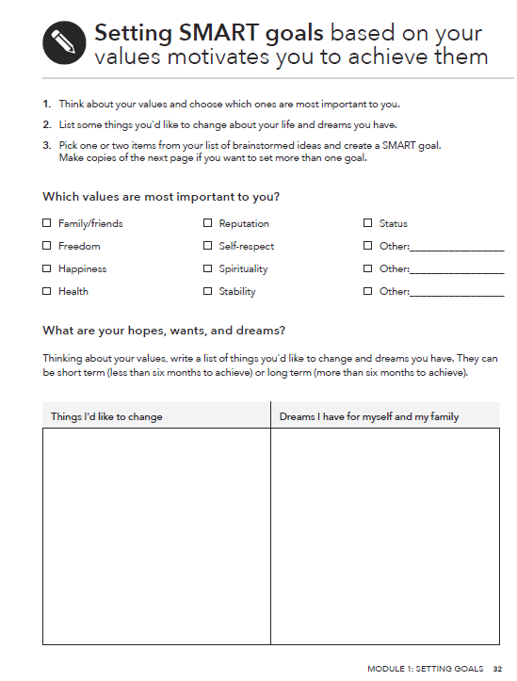
Tool: Setting SMART goals
Help people set SMART goals
Define the steps to achieve them
These goals may be short
term or longer term
Notes:
Tool: Setting SMART goals, pages 30-33 in the guide.
Review the following information from the tool.
This tool can be found at https://www.consumerfinance.gov/consumer-tools/educator-tools/your-money-your-goals/companion-guides/#anchor_reentry.
SMART goals provide an easy-to-follow structure for creating goals. This helps an individual really break down what they want into a format that makes it simpler to plan for, track, and ultimately achieve their goals.
To create goals, first think about values. When goals match up with the values that are important to an individual and their family, they are more likely to prioritize achieving them.
If an individual is not sure what their goals are, they can think about what they want to change in their life. See if there’s a goal they can create that would help bring about that change.
It’s likely there are many things an individual wants to achieve. Focusing on one or two priorities that align with values will result in a better chance of reaching a goal.
What to do with the people you work with. Ask them to:
List your values to help you think about what is important to you and your family.
Brainstorm a list of dreams and goals. Remember, dreams are aspirational and usually vague. Goals are specific things you can achieve to help you reach your dreams.
Create a SMART goal from one or two items on your list of goals. Write down what makes this goal specific, measurable, achievable, relevant, and time bound.

Slide 44
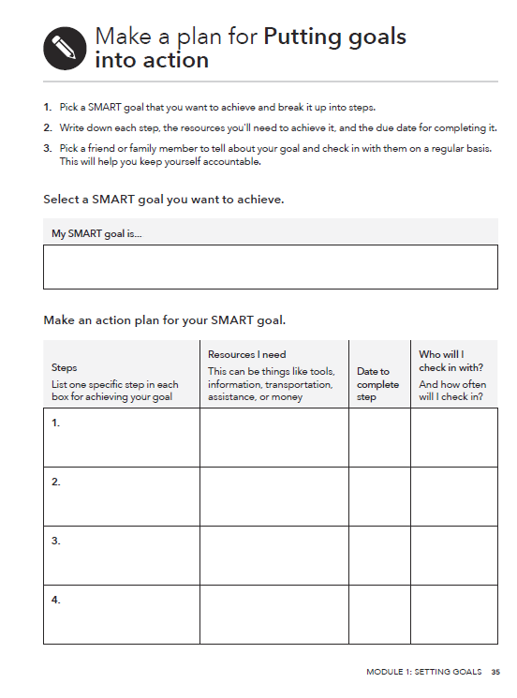
Tool: Putting goals into action
What to do:
Break up your goal into small, actionable steps. Write each step in a separate box.
Consider what resources you will need to take each step and write them next to that step.
Set a deadline for each step’s completion.
Think about sharing your progress with a friend or family member. Add their name next to the step and how often you will check in with them. This can help keep you motivated.
Notes:
Tool: Putting goals into action, pages 34-35 in the guide.
Review the following information from the guide:
Before an individual can accomplish a goal, they need a plan for how to achieve it. This tool helps an individual turn their SMART goals into an easy-to-follow action plan.
All goals take time and commitment to achieve. One of the most effective ways to accomplish goals is to create an action plan outlining the steps to take.
Many goals also require external resources to achieve. These resources could include information, tools, transportation, or even a professional financial coach or counselor to help an individual. These kinds of resources should be added to an action plan.
Research shows that people who write down specific goals are much more likely to reach their goals than if they don’t write them down. Sharing those goals with a friend and checking in with them regularly about progress also increases the chances that an individual will reach their goals.
What to do with the people you work with.
Break up your goal into small, actionable steps. Write each step in a separate box.
Consider what resources you will need to take each step and write them next to that step.
Set a deadline for each step’s completion.
Think about sharing your progress with a friend or family member. Add their name next to the step and how often you will check in with them. This can help keep you motivated.

Slide 45
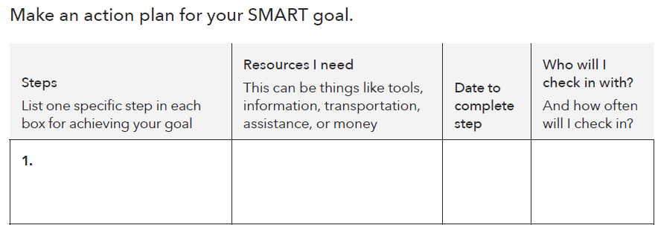
Putting goals into action: Make an action plan
Notes:
Tool: Putting goals into action, pages 34-35 in the guide.

Slide 46
Focus on Reentry
Module 2: Saving
Notes:
Module 2: Saving

Slide 47
Saving and reentry
Savings is money you set aside today to use in the future
Saving may not be a person’s first priority if they are transitioning from incarceration and without a job
If someone can include savings among their goals, identifying easy ways to save even very small amounts is worth it
Notes:
Review the following information from pages 36-42 in the guide:
Savings is money you set aside today to use in the future.
People save for many reasons:
Unexpected expenses and emergencies.
A bill they know will be due every few months, like car insurance.
Annual expenses like children’s school supplies.
To pay for future purchases or life events, like a new TV, appliances, assistive devices, a car, a home, or retirement.
Saving may not be a person’s first priority if they are transitioning from incarceration and without a job.
If someone can include savings among their goals, identifying easy ways to save even very small amounts is worth it.

Slide 48
Savings goals to consider
Some things an individual can think about saving for include:
  Security deposit for an apartment
  Transportation
  Food
  Housing
  Criminal debt
Notes:
Slide refers to pages 36-42 in the guide.
Some things an individual can think about saving for include:
Saving for immediate needs such as a security deposit for an apartment, and basic expenses like transportation, food, and housing.
If someone has any criminal debt, they may want to prioritize saving to pay that debt because it may prevent them from getting a license or place them at risk of violating parole or probation.
If someone receives benefits payments, they may face restrictions that limit options for saving money. Because savings are an asset, there may be "asset limits" associated with the public benefits they receive. Review the Asset limit tool to see if benefits are affected.
If someone is disabled, there are savings options that do not impact the asset limits associated with SSI, Medicaid, or other benefits. For more information, see Focus on Disabilities companion guide, Module 2, Tool: Setting up an ABLE account (https://www.consumerfinance.gov/your-money-your-goals/companion-guides/).

Slide 49
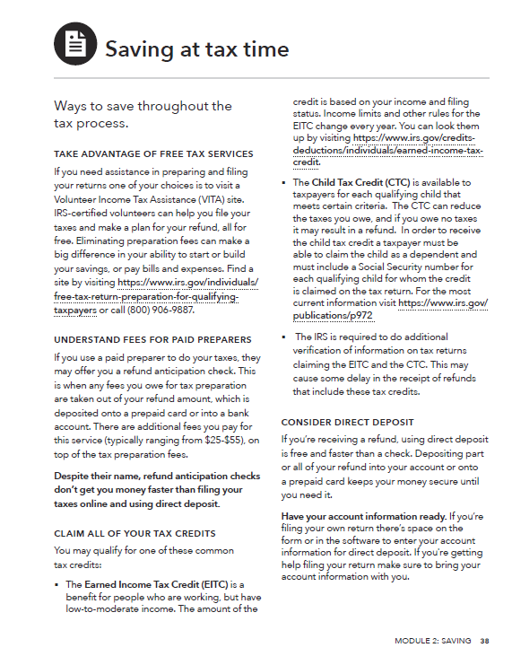
Handout: Saving at tax time
The IRS is required to do additional verification of information on tax returns claiming the Earned Income Tax Credit and the Child Tax Credit. This may cause some delay in the receipt of refunds that include these tax credits.
For more information go to https://www.irs.gov/individuals/refund-timing
Notes:
Handout: Saving at tax time, pages 38-39 in the guide.
Use the information in the Saving at tax time handout to review:
Availability of free tax preparation services. Ask participants to name organizations in their area that provide IRS-sponsored Volunteer Income Tax Assistance (VITA) services. Talk about the advantages of using VITA.
Key points of the federal earned income tax credit (EITC):
Benefit for working people who have low to moderate income.
Reduces the amount of federal income tax owed and may result in a refund.
A state or city EITC may also be available, depending on where a person lives.
Tax refund is based on income and filing status.
Other tax credits may also be available, such as the Child Tax Credit (CTC). Please check the IRS and CFPB websites for updated information about the Child Tax Credit.
Benefits of using your tax refund to kick start your emergency savings.

Slide 50
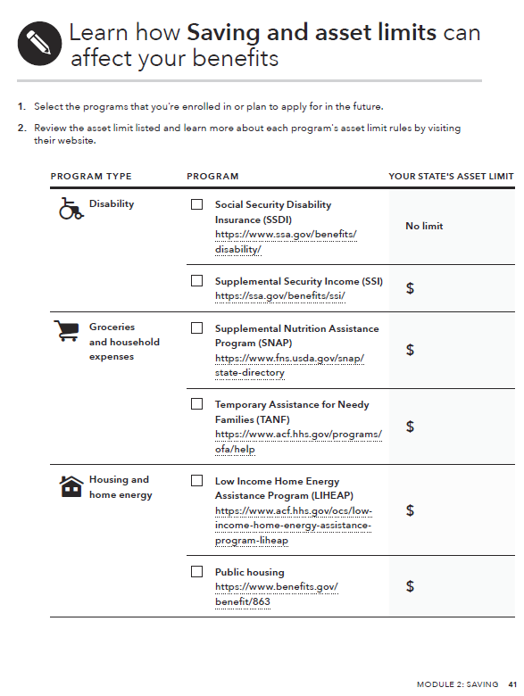
Tool: Saving and asset limits
What are the reasons this tool is included?
Notes:
Tool: Saving and asset limits, pages 40-42 in the guide.
Review tool, by asking: “What are the reasons this tool is included?”
If there is time, complete the tool as much as possible with the group based on their own knowledge and experience.
You may also complete the tool with your state’s information, make copies, and share it with the group.
FACILITATION TIP: Prior to training, make a copy of the tool or download the fillable tool from the Bureau’s website. Use flip charts to fill in the tool with the group during the training or bring up the tool on your computer and type directly into it while you display it on a screen. Following the training, check the information. When the tool is completed, be sure to recognize the contributions of the group in a footnote.

Slide 51
Focus on Reentry
Module 3: Tracking Income and Benefits
Notes:
Module 3: Tracking Income and Benefits

Slide 52
Income and benefits
Income
Money an individual receives from part-time or full-time work, including in prison or jail, self-employment and investments.
Benefits
Payments an individual may receive from the government to help them pay for necessities.
Notes:
Review the following information from pages 43-44 in the guide:
Income is the money an individual receives from part-time or full-time work, including in prison or jail, self-employment and investments.
Income is used to pay for the things an individual needs and wants or can save to spend toward one of their goals.
Money can also come from things like tax refunds and gifts from family, which can also be spent or saved like income.
Public benefits are payments you may receive from the government to help pay for necessities.
Most benefit payments have restrictions on how they can be spent. While these payments help increase your spending power, they aren’t as flexible as income earned from a job.

Slide 53
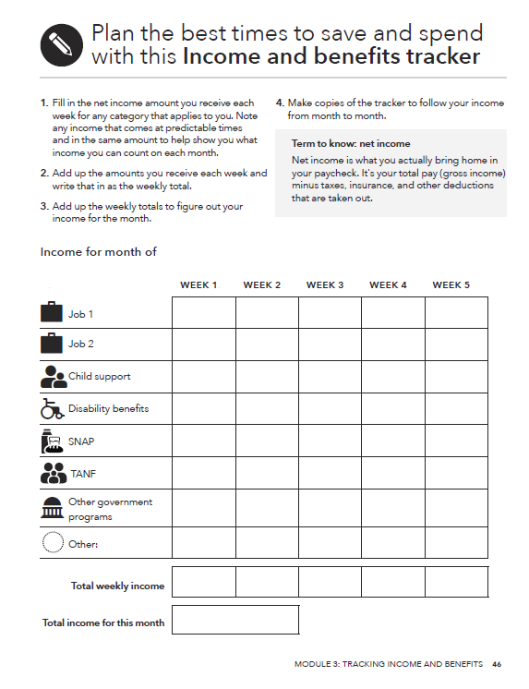
Tool: Income and benefits tracker
What to do:
Gather all of your pay stubs, benefits statements, and records of electronic payments.
Enter the amount of income or benefits you receive next to the correct category in the appropriate week of the month.
Notes:
Tool: Income and benefits tracker, pages 45-46 in the guide.
Explain how to use the “Income and benefits tracker” in the guide:
Review the categories included.
Distinguish between income and benefits. While income (like from a job) can be used to pay for anything, some benefits can only be used for a particular purpose, like food or medical costs.
Define “net income” using the information in the grey call-out box in the tool (page 46).
Net income is what you actually bring home in your paycheck. It's your total pay (gross income) minus taxes, insurance, and other deductions that are taken out.
Explain that users should record net income, not gross income, in the tracker.
Ask participants if they feel there are major categories missing. (Explain the tradeoff between many categories and utility of the form.)
FACILITATION TIP: Download this tool from the CFPB website in advance of your training and demonstrate the automatic calculation feature.

Slide 54
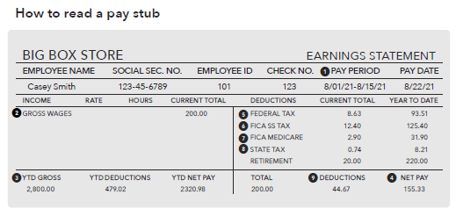
Tool: Understanding your pay stub
Notes:
Tool: Understanding your pay stub, pages 47-50 in the guide.
Review the following information from the guide: This tool helps an individual understand what is in, and taken out of, their paycheck. It helps the people you serve figure out what they will take home in pay, which will help them create a budget and manage their money.
For many in transition, their first job brings their first paycheck, and the terms and the amounts on the pay stub are not always easy to understand. Income tax and employee benefit programs can seem like abstract concepts. When you see how your total hourly or yearly pay amount is reduced by taxes and deductions to the “net” or “take-home” pay amount, you can think more realistically about how much money is available for spending and saving.
What to do with the people you serve. You can present tool to them and suggest that:
This tool helps you see the difference between gross pay and net pay. You can go over all the entries and deductions on the same pay stub. Then, fill in the form with the information from your pay stub. Based on what you discover through this activity, consider ways to keep the conversation going. For example, you could:
Look at the deductions on the W-4 form to see how much is being withheld.
Think about how you can use this information on your take-home pay. For example, you could think about a realistic budget for ongoing expenses like rent or start to save up for something in the future, like a car.
When you receive your W-2 at tax time, you can see how these deductions are listed. The W-2 form is what you will typically need to file your taxes.

Slide 55
Focus on Reentry
Module 4: Paying Bills
Notes:
Module 4: Paying Bills

Slide 56
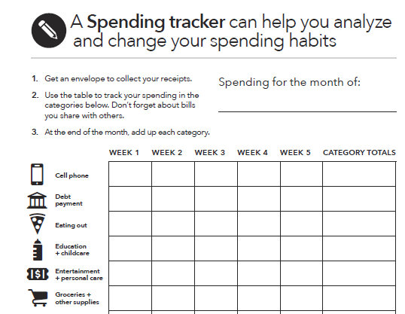
Tool: Spending tracker
Notes:
Tool: Spending tracker, pages 53-56 in the guide.
Review the list of categories and corresponding icons on the back of the Getting Started page (page 53).
ASK: Why is “cell phone” first?
The categories in this tool, and all the tools in the toolkit, are listed in alphabetical order. This sets a judgement-free tone for the conversation on tracking spending. The important part is to track.
Demonstrate the auto-calculation feature of the tool. Be sure to download the tool in advance.

Slide 57
Focus on Reentry
Module 5: Getting through the Month
Notes:
Module 5: Getting through the Month

Slide 58
Cash flow
What is a cash flow budget?
How is it different from a regular budget?
What do you think may be the benefit of this approach?
Notes:
Explore what participants know about cash flow by asking: “What is a cash flow budget?”
After participants offer some ideas, share definition: A cash flow budget projects what money you expect to come in and how much you think you’ll spend each week and when you expect the expenses to occur.
Contrast cash flow to regular budget by asking: “How is a cash flow budget different from a regular budget?”
After participants offer some ideas, share definition: A cash flow budget tracks the timing of income and spending. This is key.
ASK: What do you think may be the benefit of this approach?

Slide 59
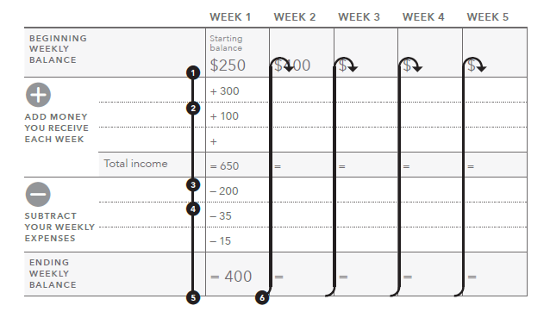
Tool: Creating a cash flow budget
Notes:
Tool: Creating a cash flow budget, pages 58-60 in the guide.
Review the components of a cash flow budget (pp. 58-60) by explaining each step in the process and pointing out where that step is recorded on the tool:
Enter your starting balance for the month under Week 1. This is the total amount of money available to you from cash on-hand, prepaid cards, and checking and saving accounts.
Write down the amounts you receive during Week 1 from the categories listed. If you have income from other categories, add them together and write them under "Other."
Add up all your income for Week 1 and enter under "Total income."
Write down the amounts you spend during Week 1. If you have expenses from other categories, add them together and write them under "Other."
Subtract all the expenses for Week 1 from the "Total income" for Week 1. Write this amount in "Ending weekly balance."
Copy the amount from "Ending weekly balance" from Week 1 into the "Starting balance" for Week 2. Repeat steps 2 through 5 for the remaining weeks in the month.
FACILITATION TIP: Consider going through these instructions with the actual tool pulled up on the screen, typing in sample information in each section and showing the automatic calculation feature.

Slide 60
Managing cash flow: Scenario overview
Rafael is a single parent with two children.
He is often late with his rent and other bills, because he does not have the money when he needs it.
After tracking his spending, he developed a cash flow budget with an educator at a parenting class he takes through Cooperative Extension in his community.
Using the cash flow budget tool, make some recommendations to Rafael so he can make ends meet.
Notes:
Instruct participants to get into groups of three.
Review the facts of the scenario they will analyze.

Slide 61
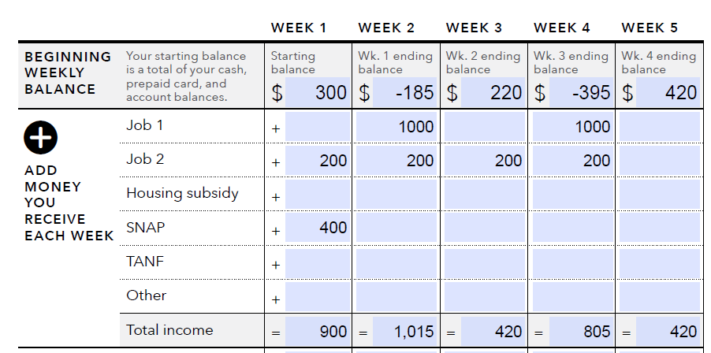
Managing cash flow scenario
whi
Notes:
Tool: Creating a cash flow budget, pages 58-60 in the guide.
Instructions for facilitator:
Make copies of this slide and distribute or transfer the information from this slide into the “Creating a cash flow budget” tool, print the third page, and distribute.
Income information
Rafael earns $14.65/hour and works 40 hours per week; he is paid every other week. His net pay is rounded to $1,000 for the purposes of this scenario.
Income from part-time job: $200/week
SNAP: $400/month
Consider opening the tool and filling it out with the group.

Slide 62
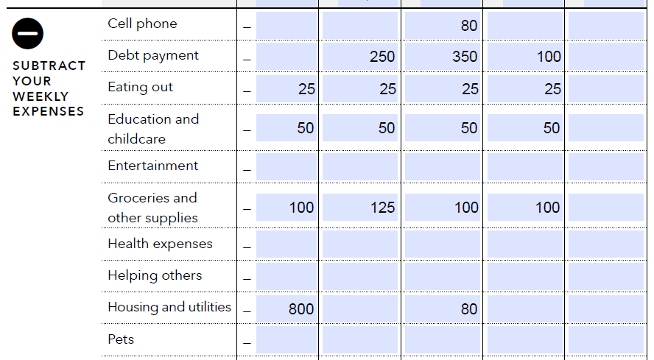
Managing cash flow scenario
whi
Notes:
Tool: Creating a cash flow budget, pages 58-60 in the guide.
Expenses- part 1
Cell phone- $80 due in week 3
Debt payment- $250 for student loan is due in week 2, $250 for car payment in week 3, $100 credit card minimum payment in week 3, and $100 in week 4 to grandmother for a personal loan
Eating out- $25 per week
Childcare- $50 per week, provided by a family member at a big discount
Groceries and other supplies- $100 per week for groceries, and $25 in week 2 for supplies
Housing and utilities- $800 for rent which includes electric, gas, water, sewer, and garbage in week 1; $20 for internet in week 3; and $60 for TV in week 3

Slide 63
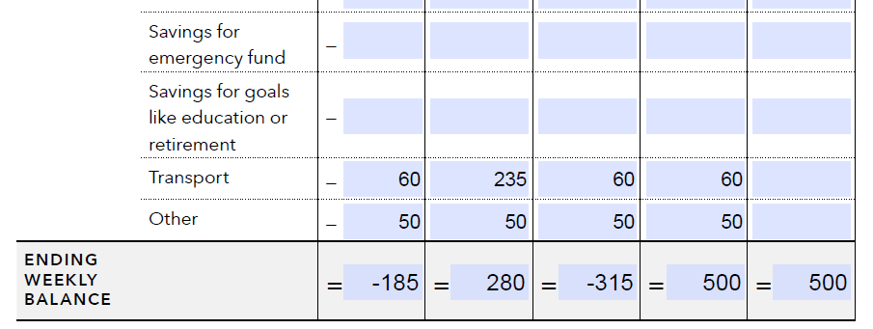
Managing cash flow scenario
whi
Notes:
Tool: Creating a cash flow budget, pages 58-60 in the guide.
Expenses- part 2
Transport- gas $60 per week, and $175 for auto insurance in week 2
Other- $50 per week for a family membership to the YMCA and swimming lessons

Slide 64
Cash flow analysis
When does Rafael run out of money?
What can he do (or try to do) to better match the timing of his income and his expenses? Develop a prioritized list.
How does the SNAP benefit factor into the cash flow?
The next month is not included in the example. What will Rafael’s situation be at the beginning of next month? How much cash will he have? What bills will he have? What should he do now to prepare for the following month?
Notes:
Instruct participants to analyze the cash flow and answer the first three questions above.
After 5 minutes, reveal the fourth question and instruct them to answer this within their groups.
Process as a large group:
When does Rafael run out of money? Answer: At the end of the first week.
What can he do (or try to do) to better match the timing of his income and his expenses? Develop a prioritized list. Possible answers:
See if landlord will accept rent payment the second week instead of the first.
See if the landlord will take half of the payment the first week of the month and half the third week of the month.
See if student loan payment can be moved to final week of the month. Explore other payment plans depending on type of loan such as Income Based Repayment.
See if auto loan payment can be moved.
How does the SNAP benefit factor into the cash flow? Answer: SNAP is important because it covers food. However, it makes it look like he has more cash during the first week than he actually does because SNAP can only be used for food.
The next month is not included in the example. What will Rafael’s situation be at the beginning of next month? How much cash will he have? What bills will he have? What should he do now to prepare for the following month?
Possible answers:
His situation will be the same next month. He needs to get more income.
First, he should make sure he is getting all of the benefits he and his family qualify for. Once this is done, he needs to consider getting more income from another part-time job.
ASK: Would a regular monthly budget highlight the shortfalls in cash?
Answer: No
Reason: Total income and benefits not including the starting cash balance is $3,200 for the month. Total expenses for the month $2,920. While the budget is tight, a typical static monthly budget would show that everything is covered with a surplus of $280. This is the problem with a regular, static monthly budget.
Be sure to ask participants:
What do you think about this approach to budgeting versus the traditional approach? Be sure to discuss the week-by-week nature of this tool rather than the overall static monthly approach that might be presented by some financial educators.
What do you think are the potential benefits of using this approach with people? For yourself?
How did your opinion of this approach change after the case study?
What additional information do you need to feel comfortable with this approach to budgeting?

Slide 65
Focus on Reentry
Module 6: Dealing with Debt
Notes:
Module 6: Dealing with Debt

Slide 66
Dealing with debt
Debt
  Money you owe to another person or business
Individuals involved with the justice system may have debts related to their:
  Arrest
  Sentencing
  Incarceration
  Supervision
Notes:
Review the following information from pages 61-62 in the guide:
What is debt? Debt is money you owe to another person or business. Whether someone took out a loan, used a credit card, or got behind on a bill payment, that’s debt.
Debt can be hard to face when it feels like a barrier to a goal, but it’s important to remember that there are resources you can use to help you take control of your debt. Even small steps toward paying down debt can make a big difference in making it feel more manageable.
Understanding debt, how to manage it, and how to reduce or get rid of it are important components of financial empowerment. Debt, however, is a current reality for many people transitioning from incarceration or facing the challenges of having a criminal record.
When talking to individuals transitioning to the community, it is important to ask them whether they owe consumer debt and the amount they owe.
But it is also important to determine whether they owe criminal justice debt, or legal financial obligations. Failure to pay criminal justice debt can carry serious consequences such as returning to prison or jail.
You may owe various fees, fines, and restitutions because of your arrest, conviction, and incarceration. These vary from state to state and may be called by different names. Types of debt you may owe as a result of incarceration include:
Pre-conviction fees, such as jail fees for pretrial incarceration or fees for electronic monitoring devices.
Sentencing fees, such as restitution to compensate victims and public defender or prosecution reimbursement fees. Incarceration fees, such as fees for room and board while in jail or prison, or health care and medication fees.
Probation and parole supervision fees, such as drug testing or vehicle interlock device fees.
Mandatory treatment fees.
Other fees.

Slide 67
Good debt, bad debt
Loan from friend or family member
Auto loan
Student loan
Payday loan
Mortgage (loan for a home)
Auto title loan
Pawn shop loan
Notes:
Explain that some people think of some debt as good debt and some debt as bad debt.
Explain that as each type of debt appears on the screen, they should stand up if they think the debt is bad debt and stay seated if they think it is good debt.
Facilitate a discussion about the reasons people think the debt is good or bad.
FACILITATION TIP: Be sure to challenge participants a bit around “conventional wisdom.” For example, people have long believed student loan debt is “good debt.” Is this always the case? The same was true with mortgages in the past. Are pawn shop loans always bad? If someone is short of money, given a payday loan versus a pawn shop loan, do they think one is a better option than the other?
Use the following points to augment the discussion:
Loan from friend or family member
GOOD—Likely to have flexible terms; may be low or no interest; missed payments not reported to credit reporting agencies
BAD—Can create family conflict; cannot be used to build credit history
Auto loan:
GOOD—Can help you get needed transportation for job, school, life; secured with the car so will likely not need additional collateral; regular payment can help build credit history
BAD—Depending on loan, terms can be unfavorable; borrowing full value of car can lead to being upside down in loan (owing more than the car is worth); missed payment can result in repossession—no transportation for job and negative entry on credit reports
Student loan:
GOOD—Can help you access postsecondary education or training, which can lead to a higher paying job; federal student loans have repayment options; regular payment can help build credit history
BAD—Borrowing more to pay for education than likely wages within career can support in terms of repayment; borrowing for education but not completing degree (created a liability without the benefit of a potentially higher paying job); terms and conditions misunderstood (allowing interest to accrue); likely to not be forgiven even in bankruptcy except under extreme circumstances
Payday loan:
GOOD—Can help you get needed cash quickly and with little hassle
BAD—short-term, small-dollar; may not to be able to pay in full within initial term (generally 14 days) and may need to renew; often leads to repeat loans; if renewal not paid, post-dated check will be cashed and can deplete your accounts and/or overdraft them and lead to overdraft charges
Mortgage (loan for a home):
GOOD—Can help you get a home of your own; currently, interest rates are low, so the loan is less expensive than in decades past; secured with the house so will likely not need additional collateral; regular payment can help build credit history
BAD—Depending on loan, terms can be unfavorable; if you borrow the full value of the home and home values decrease, you could be upside down in the loan (owing more than the home is worth); missed payments can result in foreclosure—no home and negative entry on credit reports; selling the home can be difficult depending on the market and the condition of the home
Auto title loan:
GOOD—Can help you get needed cash quickly and with little hassle
BAD—Can lead to loss of your car title if the loan not paid as agreed
Pawn shop loan:
GOOD—Can help you get needed cash quickly and with little hassle
BAD—Can lead to loss of asset pawned if loan not paid as agreed

Slide 68
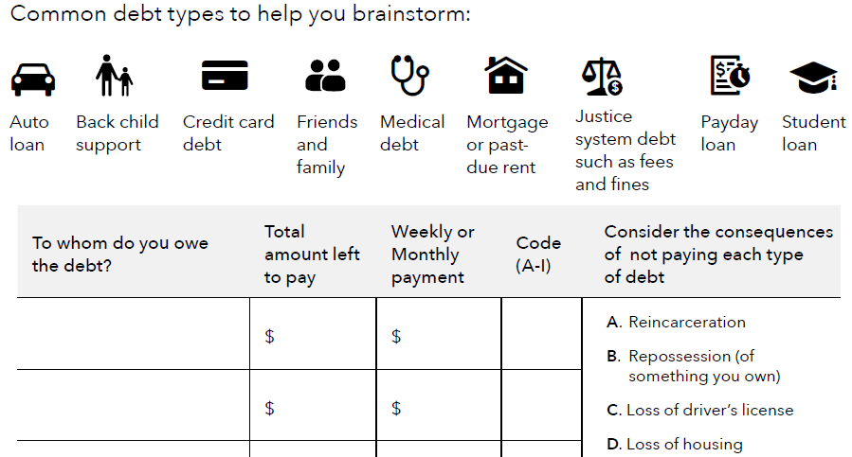
Tool: Reentry debt log
Track debt
List potential consequences
Notes:
Tool: Reentry debt log, pages 63-64 in the guide.
This tool gives an individual a clearer picture of their debt.
Those who have been involved with the criminal justice system may have criminal justice debt. The consequences of not paying this debt may affect their terms of supervision or create a risk of reincarceration, so it’s important for them to find out which debts would have the worst consequences if they couldn’t pay them. Identifying and tracking criminal justice debt, along with other debt, can help individuals prioritize debt payments.
When working with the people you serve. Ask them to:
Write down to whom you owe the debt, how much is owed in total, and how much you can afford to pay.
For each debt list the potential consequences of delaying payment.
You can check your state's law or resources to find out if there are protections you may have regarding the criminal debt.

Slide 69
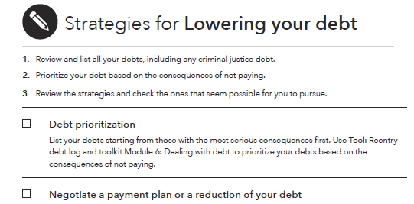
Tool: Lowering your debt
Notes:
Tool: Lowering your debt, pages 65-67 in the guide.
Review the following information from the guide:
This tool will help an individual think of strategies to help them manage their debt.
Before selecting strategies to help manage debt, an individual needs to think about which debts are the most important to pay down right now. Some debts, especially those that are criminal justice-related, have worse consequences than others when payments are missed or delayed. Prioritize debts using the Reentry debt log tool before completing this tool.
It is important to highlight that for court-related debts, it is good to explore payment plans, reductions, and waivers.
Payment plans involve creating an installment plan of the amount owed where an individual will make regular payments on the debt. Reductions are a lessening of the amount owed. Waivers are a setting aside of the fee or fine.
Also good for you and the people you serve to check with your state or locality to see if there are any programs or protections in place related to criminal debt.
What to do with the people you serve. Ask them to:
Show your checklist to the counselor you are working with and ask that person which strategies might be helpful.
Work with the counselor to check off the strategies that can help you.

Slide 70
Focus on Reentry
Module 7: Understanding Credit Reports and Scores
Notes:
Module 7: Understanding Credit Reports and Scores

Slide 71
What is credit?
Use of credit
Creates credit history
Compiled into credit reports
Used to calculate credit scores
Notes:
Review the following information from pages 68-70 in the guide:
Credit is the ability to borrow money and repay it later.
Debt is the money that you have to repay when you’ve used credit.
You can have credit available to use without having debt.
Explain the following:
When you take out a credit card or other loan, you create (or add to) your credit history. Sometimes when people talk about their financial situation, they say they have “good credit” or “bad credit.” This usually refers to their credit history.
Credit reporting companies gather information from your credit history into a credit report. A credit report may show some of your bill payment history, along with some public record information and a record of how often you have applied for credit.
A credit report may also show how much available credit you have, how much of your available credit you’re using, whether you have made your payments on time, and whether debt collectors have reported that they’re attempting to collect debt that you owe.
The information in your credit report is used to create credit scores. Many lenders use credit scores to decide how much money they can lend you and how much interest to charge. In general, the higher your credit score, the better the loan terms may be.

Slide 72
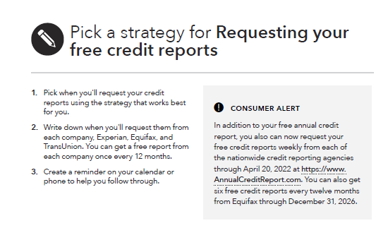
Tool: Requesting your free credit reports
Notes:
Tool: Requesting your free credit reports, pages 71-74 in the guide.
Review the following information from the guide:
You are entitled to one free credit report every 12 months from each of the three nationwide credit reporting companies.
In addition to your free annual credit report, you can also now request your free credit reports weekly from each of the nationwide credit reporting agencies through April 20, 2022. You can also get six free credit reports every twelve months from Equifax through December 31, 2026.
You can get all three reports at the same time
This is good if you're buying something big soon, that requires new credit, so you can correct errors right away.
Or you can get a report from one of the three credit reporting companies every four months.
Staggering them can help you see if anything is changing throughout the year or if any fraud has occurred.
It is a good idea to create a reminder on your calendar or phone to help you follow through.
Explain the other times you can get an additional free report. IF:
You’re unemployed and plan to look for a job in the next 60 days.
You receive public assistance.
You believe that your credit file is inaccurate due to fraud.
Your report has recently been changed due to a disputed error.
You had a consumer reporting company place an initial fraud alert on your credit file.
You had a consumer reporting company place an extended fraud alert on your credit file.
You’ve been denied things like credit, employment, or insurance because of information in your credit report—in this case, you have 60 days to request your report from when you get the notice.
BUT, you must request these reports. They don’t just show up for you.

Slide 73
Handout: Requesting your free credit reports by mail from a correctional facility
The credit reporting companies request the following information for mail requests from prisons or jails:
  Consumer’s first, middle, and last names, plus any suffix used
  A prisoner identification number
  Current address
  Address(es) during the two years preceding incarceration
  Social Security number
  Date of birth
  The name of the correctional institution as the return address and the prisoner identification number on the envelope used to mail the request.
Notes:
Handout: Requesting your free credit reports by mail from a correctional facility, page 75 in the guide.
Review the following information from the handout in the guide:
Incarcerated individuals who may not have access to the internet or phone can opt to request a free credit report by mailing a letter. In your letter, you can request credit reports from all three credit reporting companies: TransUnion, Equifax, and Experian.
The credit reporting companies request the following information for mail requests from prisons or jails:
Consumer’s first, middle, and last names, plus any suffix used.
A prisoner identification number.
Current address.
Address(es) during the two years preceding incarceration.
Social Security number.
Date of birth.
The name of the correctional institution as the return address and the prisoner identification number on the envelope used to mail the request.
Correctional facilities have different rules related to retaining personal information. Check with the correctional facility to determine how to keep copies of your credit report.
If there are barriers to requests for credit reports from prison or jail, individuals can submit a complaint to the CFPB.

Slide 74
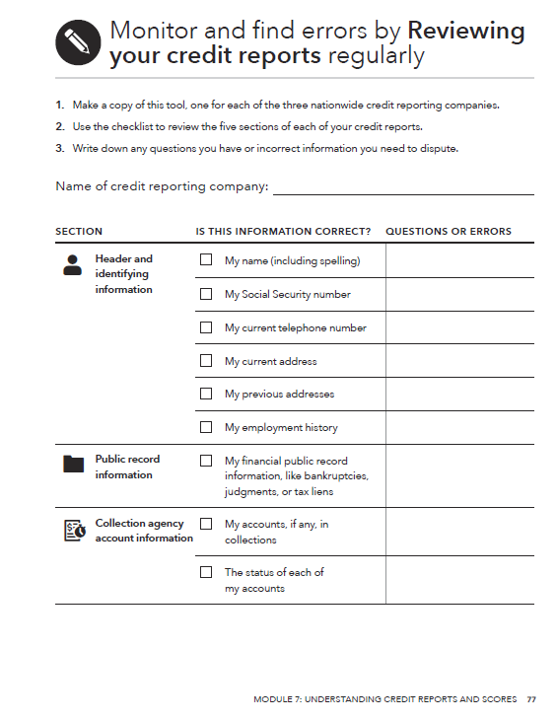
Tool: Reviewing your credit reports
What to do:
Start by getting free copies of your credit reports. Use the “Requesting your free credit reports” tool to find out how.
Read through each credit report carefully, using the checklist as a guide for what errors to look for.
Notes:
Tool: Reviewing your credit reports, pages 76-78 in the guide.
Review the following information from the guide:
Errors on your credit reports can negatively affect your credit scores and ability to get a loan. Reviewing your reports on a regular basis can also help you monitor for things like identity theft and fraud.
Sometimes your information isn’t reported to all three nationwide credit reporting companies. As a result, some things may not be listed on all three reports, especially information about older accounts, accounts you’ve closed, or some of your older jobs or addresses.
This can cause inconsistencies among your credit reports. It’s most important to make sure that the information that is listed on each report is correct.

Slide 75
Handout: Disputing errors on your credit reports
To correct errors, it can help to contact both the credit reporting company and the source of the mistake.
You may file your dispute online, by phone, or by mail.
Explain the error and what you want changed.
  Clearly identify each mistake separately, state the facts, explain why you are disputing the information, and request that it be removed or corrected.
If you mail your dispute letter, send it by certified mail, return receipt requested.
Enclose a copy of the portion of your report that contains the disputed items and circle or highlight the disputed items.
Notes:
Handout: Disputing errors on your credit reports, pages 79-81 in the guide.
Review the information on pages 79- 81 in the guide. Highlight the dispute letter template on page 81. Demonstrate that you can fill it out on the computer.
Some of the credit reporting companies provide a dispute form you can use. You’ll also want to send a letter explaining the mistake(s).
Make sure you also include copies of all of your supporting documentation. Keep your originals.
Point out the URLs, phone numbers, and mailing addresses for filing disputes at the three nationwide credit reporting companies, on page 80 of the guide.

Slide 76
Focus on Reentry
Module 8: Choosing Financial Products and Services
Notes:
Module 8: Choosing Financial Products and Services

Slide 77
Tool: Opening a checking or savings account
Gather your documents
  Picture ID
  Second form of ID (Social Security card, birth certificate, or bill with name and address)
  Social Security number or ITIN for interest-bearing accounts
Bring the required amount of money to open the account
Get all the facts
Notes:
Tool: Opening a checking or savings account, pages 84-87 in the guide.
FACILITATION TIP: Have a flip chart set up before you start this portion of your presentation.
Review the identification documents needed to open an account:
A picture ID issued by a state, or the U.S. or foreign government (check which types of foreign identifications your bank or credit union accepts)
One of these second forms of identification:
Social Security card.
Birth certificate.
Bill with your name and address on it.
Your Social Security number or ITIN. If you don't have one, you may be able to open only a no-interest account
Savings accounts generally pay interest, which is considered income. If you earn interest, you may have to pay taxes on it. In order to open an account that pays interest, you must have a Social Security number or an Individual Taxpayer Identification Number (ITIN).
Some banks and credit unions have developed no-interest savings accounts that may fit your needs if you don’t have a Social Security number or ITIN or if your beliefs don’t allow you to receive interest.
Review the difference between opening balance and minimum balance requirement:
Be sure to find out how much you must keep in the account to avoid fees. This is called the “minimum balance requirement.”
A minimum balance requirement may not be the same amount of money you need to open the account.
ASK: What kinds of questions should you ask your bank or credit union before opening an account?
Write suggested questions on flip chart
Then instruct participants to review the list of questions in the tool (on pages 85-86).
Ask participants if they read anything that is missing from your flip chart list.
Add those missing questions to the flip chart.

Slide 78
Tool: Evaluating your prepaid or payroll card
Review the definitions of common prepaid card fees so you know what they are
Find the terms and fees for your prepaid or payroll card. These are usually on the back or inside of the card packaging
Get all the facts. Make sure you have all the answers about how the card works and what fees are involved. Consider researching prepaid cards online, so you can read about all the features before you buy it
Notes:
Tool: Evaluating your prepaid or payroll card, pages 88-92 in the guide.
Review the following information on pages 88-92 in the guide:
Each prepaid and payroll card has its own set of rules and fees.
Before you use your card, it’s important to understand the fees you’ll pay to maintain your account, make purchases, and withdraw money.
After adding up the fees, you can compare cards and also compare the cost of a card to the costs of a bank or credit union account.
Most prepaid cards have their own policies about loss, theft, and errors. Information about these policies can be found in the cardholder agreement.
Most prepaid cards also offer details about terms and fees on their website, so you can look online if you want to compare cards before buying one.
Point out the list of definitions for common prepaid card fees in the Evaluating your prepaid or payroll card tool, on pages 89-92.

Slide 79
Handout: Knowing your prepaid card rights
YOU'LL HAVE THE MOST PROTECTION IF YOU REGISTER YOUR PREPAID CARD
Notes:
Handout: Knowing your prepaid card rights, page 93 in the guide.
Review the following information from page 93 in the guide:
You have protections in case of an unauthorized transaction or other error if:
You are paid through a payroll card arranged by your employer
You receive certain types of government benefits through a government-arranged card, or
You receive any payments from the federal government onto your own prepaid card.
You generally can’t be held responsible for unauthorized charges or other errors on these cards if you report them promptly.
Depending on your card, you may also have some protections in case of an unauthorized transaction or other error in your account. Check your cardholder agreement to find out about your specific card’s terms and conditions.

Slide 80
Focus on Reentry
Module 9: Protecting your Money
Notes:
Module 9: Protecting your Money

Slide 81
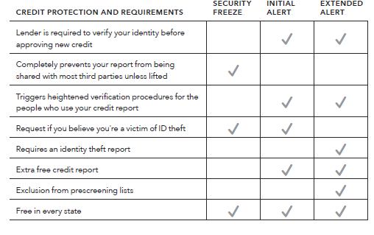
Handout: How to handle identity theft
Notes:
Handout: How to handle identity theft, pages 96-97 in the guide.
Review the following information from the guide:
Review primary strategies for dealing with identity theft using the list below and information from the handout, if they did not come up during the previous activity.
Order your credit reports from all three nationwide credit reporting companies.
Create an identity theft report through the Federal Trade Commission.
Consider a credit protection tool.
Review the differences between a security freeze, an initial fraud alert, and an extended fraud alert using the chart in the slide and the following information:
Security freeze – A freeze on your credit report generally helps prevent new credit accounts from being opened in your name. Usually, third-party-access to your credit file is blocked from new users without your express authorization.
There are several exceptions including for creditors of accounts you already hold, certain government entities like child support agencies, companies you hire for credit monitoring, and lenders making prescreened solicitations for new credit.
A freeze helps prevent identity thieves from opening fraudulent accounts in your name. This also means you won’t be able to apply for credit as easily if you were planning to open a new account or apply for a loan.
You must contact each of the credit reporting companies to freeze your credit report. You will have to contact them to lift the freeze before a third-party can access your credit report.
Initial fraud alert - An initial fraud alert requires creditors to verify your identity before opening a new account, issuing an additional card, or increasing the credit limit on an existing account. This is a good first step if you’re worried that your identity may be stolen, like after a data breach. The alert lasts for one year. After one year the initial fraud alert will expire and be removed but you have the option to place another initial fraud alert at that time.
Extended fraud alert - An extended fraud alert requires creditors to contact you before approving credit and lasts for seven years. It also requires credit reporting companies to remove you from lists prepared for pre-screen offers of credit or insurance for five years. This is available if you've filed an identity theft report with one of the three nationwide credit reporting companies.
Be aware of your credit. Check your credit reports regularly and consider freezing your credit reports during incarceration. Make sure that someone you trust is taking care of your money.

Slide 82
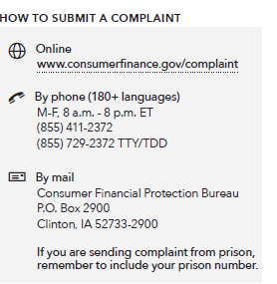
Handout: Submitting a complaint
HOW TO SUBMIT A COMPLAINT
Notes:
Handout: Submitting a complaint, page 98 in the guide.
Refer participants to the Bureau complaint contact information on slide and on page 98 in the guide.
Explain the following:
An empowered consumer understands their rights. When you know you have rights, you can take steps to protect yourself. There are many laws that protect your rights when it comes to financial products and services. It is the Bureau’s job to enforce these laws and handle consumers’ complaints about financial products and services.
The Bureau has already handled over 3 million consumer complaints about:
Credit cards
Mortgages
Bank accounts and services
Student loans
Vehicle loans or leases
Payday loans
Other consumer loans (including installment loans, pawn loans, and title loans)
Debt collection
Money transfers or virtual currency
Credit reporting
Prepaid cards
Other financial services (including check cashing, money orders, cashier’s checks, credit repair, debt settlement, refund anticipation loans, foreign currency exchange, and traveler’s checks)
Every complaint the Bureau receives gives them insights into problems that people are experiencing in the marketplace and helps them to identify and prioritize problems for potential action.
Explain that you can submit a complaint on behalf of someone else following the directions on the site.
Explain that you can also submit a complaint over the phone by calling the Bureau at 855-411-Bureau (2372), toll free. U.S.-based call centers can help you in over 180 languages and can also take calls from consumers who are deaf, have hearing loss, or have speech disabilities. Live operators in Spanish are available.
For those who are incarcerated:
If you are sending complaint from prison, remember to include your prison number.

Slide 83
Focus on Reentry
Module 10: Understanding Background Screening Reports
Notes:
Module 10: Understanding Background Screening Reports

Slide 84
Handout: Background screening reports
Special rules apply when employers use consumer reports for employment purposes (commonly referred to as “background screening reports”)
Individuals should know their rights and how to dispute errors
Reports can include information about credit history, criminal record, public records, and information about employment or rental history
If the background report contains some negative information, the individual should be prepared to explain it — and the reason it shouldn’t affect their ability to do the job
Notes:
Handout: Background screening reports for employment, pages 102-103 in the guide.
Review the following information from guide:
Special rules apply when employers use consumer reports for employment purposes (commonly referred to as “background screening reports”).
Individuals should know their rights and how to dispute errors.
Reports can include information about credit history, criminal record, other public records, and information about employment or rental history.
If the background report contains some negative information, the individual should be prepared to explain it — and the reason it shouldn’t affect their ability to do the job.

Slide 85
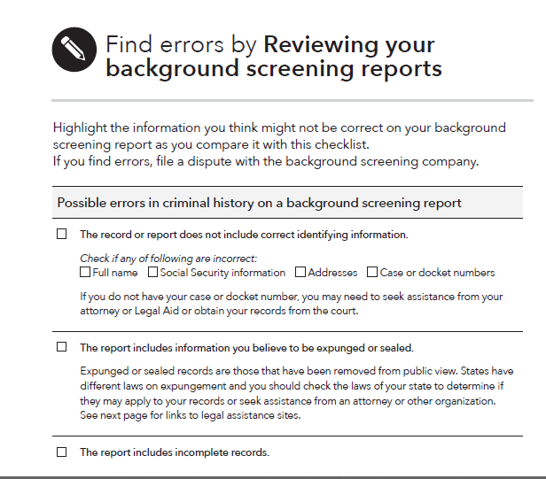
Tool: Reviewing your background screening reports
How to review criminal history information in background screening reports
Notes:
Tool: Reviewing your background screening reports, pages 104-106 in the guide.
Review the following information from the guide:
An individual can use this tool to find errors by reviewing their background screening reports.
Possible errors in criminal history on a background screening report include:
The record or report does not include correct identifying information (full name, social security information, addresses, case or docket number).
The report includes information you believe to be expunged or sealed.
The report includes incomplete records.
The report lists single charges multiple times.
The report includes information that has been or should have been expunged, cleared or not reported under state of federal law.
The report includes arrests or other negative information that occurred more than seven years ago (except for convictions, which can stay on permanently in most states).
The report misclassifies misdemeanors as felonies.
The report includes a charge, arrest or conviction that is not yours- you were not charged of convicted of such an offense.
Get help from your attorney, legal aid, a pro bono (volunteer) or other attorney, or organization to check and correct your record. For a list of legal aid offices visit https://www.consumerfinance.gov/ask-cfpb/how-do-i-find-an-attorney-in-my-state-en-1549/. For a list of state-by-state legal assistance related to criminal records, visit https://cleanslateclearinghouse.org/find-a-lawyer/.

Slide 86
Handout: Obtaining your criminal records
Since background screening reports may include criminal record information, it’s important to check criminal records for mistakes
Where to get records:
  Local or state police department
  State criminal records authority
  State or county court records
  Federal court records
  FBI (Federal Bureau of Investigation)
Individuals may need to seek help with criminal records from legal aid, expungement clinics, or other organizations that provide assistance.
Notes:
Handout: Obtaining your criminal records, pages 107-108 in the guide.
Review the following information from the guide:
Since background screening reports may include criminal record information it’s important to check these records for mistakes.
Where to get records:
Local or state police department
State criminal records authority
State or county court records
Federal court records
FBI (Federal Bureau of Investigation)
Criminal record data, including expungement data, may be difficult to understand and hard to correct. You may need to seek help from legal aid, expungement clinics, or other organizations that provide assistance.
For help with finding sources for criminal records in your state, visit https://clearinghouse.lac.org.

Slide 87
Your Money, Your Goals
Additional resources
Notes:
Additional resources

Slide 88
Additional resources – links to helpful resources
Help with:
General guidance in reentry
Employment and hiring
Resources for workforce practitioners
Housing
Benefits
Healthcare
Student loans
Taxes
Child support
Notes:
Review the following information from pages 109-111 in the guide:
The last section in the toolkit provides links to helpful resources for reentry on topics such as housing, employment, benefits, healthcare, student loans, taxes and child support.

Slide 89
Focus on Reentry
Closing
Notes:
Closing

Slide 90
How will you use the tools?
Throughout the training you have made notes in your guide, electronically, or on paper
Take a moment to reflect on how you might use the tools
Share with the group what tools you think you’ll use the most
Notes:
Have participants share how they could use the tools either using a web-based platform or with sticky notes and flip charts. Consider the following options:
Place sticky notes (5 min)
During a break in training, write the name of each tool on individual flip chart pages, one tool per page. At the end of training, ask participants to place their sticky notes on the areas designated for each tool.
Categorize (10 min)
Create pairs/small groups and ask each pair/group to look for groupings or categories of the ideas captured on the sticky notes.
Each group reports back (15 min)
If you identify potential usages that haven’t already been identified, ask questions to prompt participants to share ideas.
Ask participants to place dots on the three tools that they’re going to try during the next month.

Slide 91
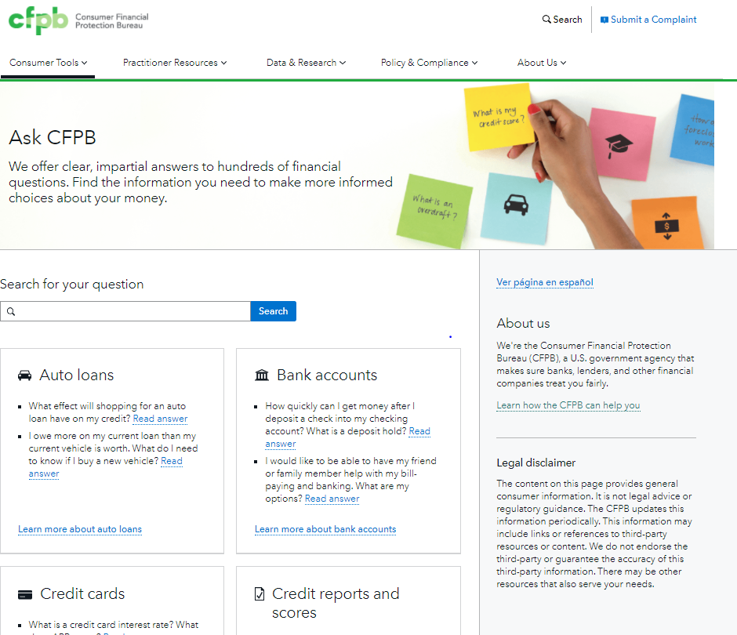
Ask CFPB
https://www.consumerfinance.gov/ask-cfpb/
Notes:
Screenshot from website 10/30/20.

Slide 92
Ordering materials
Visit the Your Money, Your Goals home page and look for the “Order free copies” links: consumerfinance.gov/your-money-your-goals.
  Provide a street address, rather than a PO Box for your order.
  Plan for shipping time of 4-6 weeks. Order now so that they arrive in time.
If you need materials faster, email YourMoneyYourGoals@cfpb.gov. Use “YMYG Materials Order” as your subject line to ensure prompt attention to your email.
Most Your Money, Your Goals materials will come shrink-wrapped, hole-punched, but not bound. Supply your own large-size binder clips or 1.5 inch binders for the toolkits.
Booklets are the exception. They arrive spiral bound unless they are those ordered for correctional facilities, which are not bound and are shrink wrapped.

Slide 93
Q & A Options
Ask us now how to use these materials in your work.
Email ideas for new materials, improvements, and translations: yourmoneyyourgoals@cfpb.gov
Use the materials: https://www.consumerfinance.gov/your-money-your-goals/
Ask CFPB: https://www.consumerfinance.gov/ask-cfpb/
Submit a complaint: https://www.consumerfinance.gov/complaint/
Tell your story: https://www.consumerfinance.gov/your-story/

