Slide 1
Your Money, Your Goals
A financial empowerment toolkit
Notes:
THIS PRESENTATION SUPPORTS THE SEPTEMBER 2018 VERSION OF YOUR MONEY, YOUR GOALS: A FINANCIAL EMPOWERMENT TOOLKIT. This document will be referred to throughout this presentation as “the toolkit.”
INTRODUCTION TO YOUR MONEY, YOUR GOALS TRAINING MATERIALS
This PowerPoint presentation will help you to provide training to potential users of the toolkit. Potential users include anyone who works directly with people that have low-income or are economically vulnerable. They generally come from non-profit, community-based, or private sector organizations or city, county, or tribal government agencies. This presentation includes the visual aids (PowerPoint slides) and facilitation guide (notes section of slides) necessary to conduct a total of 6-8 hours of training on the full content of the toolkit.
We recommend that you tailor your presentation to focus on only the topics that are most relevant for the people you are training. Choose the tools and handouts that they are most likely to use with the people they serve.
The training is organized into sections or activities associated with specific content modules in the toolkit. Each new section of the training begins with:
Section or module # and title
Estimated time for the section or module
Methodology or description of the type of activities used in the section or module (opener, facilitated discussion, small group exercise, role-play, scenario analysis, etc.)
Corresponding section of the toolkit
Instructions for the facilitator
Effective training
To be effective, the training needs to be engaging.
Every section of the training has at least one activity built into it.
Minimally, follow the instructions in the training, and you will create an interactive experience.
Lecture alone or lecture and discussion is not engaging and not effective.
Here is a list of methodologies used throughout this training:
Opener—contest
Icebreaker
Presentation
Facilitated discussion
Brainstorming
Individual activity
Large group activity
Small group exercise
Exercise in pairs
Carousel
Contest
Scavenger hunt
Role play
Skit
Tool analysis
Vote with your feet
The facilitation instructions found in the notes section correspond to the visual aid presented on the slide.
NOTE: BEFORE STARTING YOUR TRAINING, DISTRIBUTE THE PRE-TRAINING SURVEY.
EXPLAIN THE FOLLOWING:
After today, you will be prepared to share information and tools with the people you serve on various financial topics.
To help the Bureau demonstrate changes in confidence and other results of your training, we will ask you to complete a pre-training and post-training survey.
Give participants 2 – 4 minutes to complete the pre-training survey.

Slide 2
Disclaimer
The Consumer Financial Protection Bureau (Bureau) created the Your Money, Your Goals toolkit for consumers, as well as the training materials presented today. These materials are being presented to you by a local organization. The organizations or individuals presenting these materials are not agents or employees of the Bureau, and their views do not represent the views of the Bureau. The Bureau is not responsible for the advice or actions of these individuals or entities. The Bureau appreciates the opportunity to work with the organizations that are presenting these materials.
This document includes links or references to third-party resources. The inclusion of links or references to third-party sites does not necessarily reflect the Bureau’s endorsement of the third-party, the views expressed on the third-party site, or products or services offered on the third-party site. The Bureau has not vetted these third-parties, their content, or any products or services they may offer. There may be other possible entities or resources that are not listed that may also serve your needs.
Notes:
Paraphrase this disclaimer for the group and briefly share information on the organization with which you are associated.
NOTE: Even though this slide has a lot of text, the entire disclaimer should be included visually during the training.

Slide 3
Your Money, Your Goals
Opening activity
Notes:
ACTIVITY – Training Section 1: Money and me
Estimated time: 20 minutes
Methodology: Opener—Contest
Corresponding section of the toolkit: Introduction (pages 9-12)
Instructions for facilitator:
Having an activity prior to introductions is intentional in the design of the training. Having participants reflect on attitudes and feeling about money and emotional and cultural influences on financial decisions makes them more open to understanding those decision-making influences on the people they serve. In addition, they may become more open to applying Your Money, Your Goals to their own lives.
FACILITATION TIP: If you have another activity that is participatory and helps uncover emotional and cultural influences on financial decisions, feel welcome to substitute that activity for the one described in this training.

Slide 4
Money and me: Opening activity
List all of the words, phrases, sayings, songs, or other associations you have with the word money.
Notes:
ACTIVITY – Training Section 1: Money and me
Instructions for facilitator:
Instruct participants to work in small groups.
Give each group a flip chart and marker.
Instruct them to brainstorm all of the associations they have with money per the PowerPoint slide on their flip chart paper.
Tell them the winning group is the one with the most associations.
Give them 2.5 to 3 minutes.
Call time and ask groups to count the total items listed and write the number on their flip charts.
Congratulate winning team.
Hang up their flip chart.
Ask other teams to add items they feel are missing from the list.
Go through many of the ideas (not all) and ask the large group to indicate whether the association is positive or negative with a thumbs up or thumbs down, respectively.
Based on majority vote, write “+” or “-” next to each entry on the flip chart.
If there is a lot of disagreement about an entry, facilitate a short discussion about the disagreement and write “?” next to those about which there does not seem to be agreement.

Slide 5
Money and me: Opening activity
money
any generally accepted medium
of exchange
Notes:
ACTIVITY – Training Section 1: Money and me
Instructions for facilitator:
Show and read the definition of “money.”
Contrast the definition of money to the list of associations generated by the team by asking: “How did we get from this simple definition of money to all of these positive and negative associations?”

Slide 6
Money – what does it mean?
Where do associations about money come from?
How do these associations reflect attitudes and feelings about money?
How are attitudes and feelings related to behaviors and actions?
What does this mean when we are working with the people we serve?
Notes:
ACTIVITY – Training Section 1: Money and me
Instructions for facilitator:
Ask some or all of the questions listed to facilitate a discussion.
Where do associations about money come from?
Be sure to add the following if not contributed by participants: family, peers, school, media, government, businesses, communities of faith, social and service organizations. Ask people for specificity including examples of how family or peers or media, for example, may create lasting associations about money for people.
How do these associations reflect attitudes and feelings about money?
Be sure to add the following if not contributed by participants: Our attitudes and feelings about money may be rooted in some of these associations.
How are attitudes and feelings related to behaviors and actions?
Be sure to add the following if not contributed by participants: Our behaviors and actions are often driven by our attitudes and feelings. This is part of the reason our knowledge—what we know is good practice with money—and our actions do not line up.
So what does this mean when we are working with the people we serve?
Be sure to add the following if not contributed by participants: While it’s easy to think about financial empowerment as providing people with information and opportunities to develop financial management knowledge and skills, financial empowerment must also consider and help people understand some of the underlying attitudes and feelings about money and how these impact practices and behaviors today. Attitudes and feelings may drive practices and actions. Understanding the origins of attitudes and feelings about money can help people understand the reasons behind some of their actions and makes changes if they want to make changes.
Be sure to highlight cultural differences based on socio-economic status, ethnicity, region, and age.
Summarize by sharing:
Attitudes and beliefs about money may drive behavior. Understanding origins of these attitudes and beliefs can help you better understand what influences some productive and unproductive money practices. It is also important to understand your own attitudes or biases around money and financial issues—this can help ensure you do not judge someone for their:
Financial situations
Current financial practices
Past financial decisions
Their current financial goals

Slide 7
Your Money, Your Goals
Overview of the training and introductions
Notes:
Training Section 2: Overview of the training and introductions
Estimated time: 10 minutes
Methodology: Presentation / Icebreaker (Introduction Activity)

Slide 8
Training purpose
To provide you with:
An orientation to the Consumer Financial Protection Bureau.
An overview of financial topics relevant to the work you do.
Tools and handouts you can use with the people you serve.
Strategies for using the Your Money, Your Goals toolkit.
The knowledge and confidence to use the toolkit with the people you serve.
Notes:
Training Section 2: Overview of the training and introductions
Instructions for facilitator:
Review training purpose: To provide you with an orientation to the Consumer Financial Protection Bureau, strategies for using the toolkit, and the tools, knowledge, and confidence to provide financial empowerment services to the people you serve.

Slide 9
Training objectives
By the end of the training, you will be able to:
Describe the purpose of the Bureau and access and use tools and materials available at consumerfinance.gov.
Explain key financial empowerment concepts presented in the toolkit.
Take action to use the tools and handouts in the toolkit with the people you serve as part of your day-to-day work.
Notes:
Training Section 2: Overview of the training and introductions
Methodology: Presentation
Instructions for facilitator:
Explain that the purpose of the training is like the mission—overall what the training is trying to do.
Explain that objectives are the specific things they will know or be able to do as a result of the training.
Review objectives. Be sure to paraphrase, not read.
NOTE: If you have chosen to focus your training on just a few topics or even just a few tools, edit the objectives on this slide to reflect that focus.

Slide 10
Introduction activity
Share name
Organization
“What do you expect or hope to get from this training?”
Notes:
ACTIVITY – Training Section 2: Overview of the training and introductions
Methodology: Icebreaker
Instructions for facilitator:
Invite participants to introduce themselves to the group by sharing their name, their organization, and sharing: “What do you expect or hope to get from this training?”
Write their expectations or hopes on flip chart paper. Revisit these at the end of the training to check in as to whether the training met their expectations or hopes for the training.
FACILITATION TIP: Try to encourage people to be brief and avoid sharing the details of their roles and responsibilities at work as well as details about what their organization does – otherwise you will have difficulty keeping on the training schedule. It is important NOT TO SKIP introductions because you are concerned about time. Participants are accustomed to some level of introduction in convenings. This is even more important if the group represents a heterogeneous mix of participants and organizations.
Alternative Approaches to the Introductions:
Meet and Mix at the table – An alternative for large groups (more than 25 to 30 participants)
Ask participants to share their names, organizational affiliations, and training expectations to the other participants sitting at their table.
Ask the group to find one thing all of them have in common. You can ask them to identify a common characteristic around one topic area (money) or leave it wide open to facilitate rapid sharing within the tables.
Provide teams with about 7 – 9 minutes to work in groups—share name, etc. and work to find an item they have in common.
Ask each table to share the item they have in common.
Write these on flip chart.
After the sharing is complete, write ”the ability to use Your Money, Your Goals with the people we serve” on the list of items they have in common and explain that they will all have this in common by the end of the training.
Vote with Your Feet – An alternative for small groups (less than 20 to 25 participants)
Develop a list of questions that have four answers to them. For example:
What season does your birthday fall within? Spring, Summer, Fall, Winter
What is the most important financial empowerment topic for the people you serve? Budgeting, Credit, Debt Management, Consumer Protection
How long have you worked with your organization? I just started, Less than 1 year, 1 – 3 years, more than 3 years
You can include questions about sports teams people may support in your area, local food that is their favorite, favorite book or movie genre, the item they would want with them if stranded on a desert island, etc.
Write the answers for the questions on flip charts. Be sure that the answers to one question are written on four different flip charts. Then add one answer from the next question on each flip chart and so on. For the activity, ask people to stand under the flip chart that best represents their answer to the question you read. Then, have the smallest grouping of individuals introduce themselves by sharing their name and organizational affiliation. Then read the next question and repeat the process. If someone is in the group introducing themselves that has already shared their information, you can skip them to ensure everyone has a chance to introduce themselves.
With the final question, be sure to have anyone who has not introduced themselves share their information whether they are in the group that is introducing themselves or not.

Slide 11
Your Money, Your Goals
Introduction to the CFPB and financial empowerment
Notes:
Training Section 3: Introduction to the Bureau and financial empowerment
Estimated time: 15 minutes
Methodology: Presentation/Facilitated Discussion / Debate or Large Group Brainstorm / Carousel

Slide 12
The CFPB’s mission and vision
MISSION
To regulate the offering and provision of consumer financial products or services under the Federal consumer financial laws and to educate and empower consumers to make better informed financial decisions.
VISION
Free, innovative, competitive, and transparent consumer finance markets where the rights of all parties are protected by the rule of law and where consumers are free to choose the products and services that best fit their individual needs.
Notes:
Training Section 3: Introduction to the Bureau and financial empowerment
Methodology: Facilitated Discussion and Presentation
Instructions for facilitator:
Share additional information about the Bureau:
The CFPB is working to ensure that consumers get the information they need to make financial decisions they believe are best for themselves and their families – that prices are clear up front, that risks are visible, and that nothing is buried in fine print.
Explain that a key goal of the training is to connect frontline staff to Bureau resources, including the Submit a Complaint system.

Slide 13
Office of Community Affairs
Part of the Bureau’s Division of Consumer Education and Engagement
Serves populations who may lack full, affordable access to financial services
  Low- to moderate-incomes
  Low wealth
  Otherwise financially underserved or vulnerable
Notes:
Training Section 3: Introduction to the Bureau and financial empowerment
Instructions for facilitator:
Use the following information to explain the Bureau:
The Office of Community Affairs serves the variety of populations who may lack full, affordable access to financial services, including people with low- to moderate-incomes; low wealth, and people who are in other ways financially excluded or vulnerable. By any measure, the numbers of consumers whose income level contributes to financial fragility constitutes a significant portion of the U.S. population.
According to 2017 data from the U.S. Census Bureau, some 39.7 million people, including children, live in households that have incomes below the federal poverty level, while another 56 million live between 100 and 200 percent of the poverty threshold.
The Bureau created Your Money, Your Goals to reach these consumers by empowering those that serve them: frontline nonprofit or tribal social service staff, community volunteers, staff in legal aid organizations, and faith-based organizations. By providing people like you with high quality information, they have the tools and resources to start the financial conversation with the people they already serve. This training will provide you with the confidence to use these tools and resources.
Source for Census Bureau statistics:
https://www.census.gov/library/publications/2018/demo/p60-263.html
See Tables 3 and 5

Slide 14
Financial empowerment
What is financial empowerment?
How is it different from financial literacy, financial capacity, or other commonly used terms?
Skill and confidence to use knowledge
Financial empowerment
Financial literacy
=
Notes:
Training Section 3: Introduction to the Bureau and financial empowerment
Corresponding section of the toolkit: Introduction (page 7)
Instructions for facilitator:
Use the animations in this slide to guide the questions and discussion
Transition by reminding participants that an informed consumer is the best defense.
ASK: What is financial empowerment?
Write their ideas on flip chart paper.
ASK: How is it different from financial literacy, financial capability, or other commonly used terms?
NOTE: It may be helpful to differentiate strategy terms (financial education, financial coaching, and financial counseling) from outcome-based terms (financial literacy, financial capability, financial fitness).
Share definition of financial empowerment using the slide and information from page 7 of the Introduction
While financial empowerment includes the concept of financial literacy, it goes beyond just acquiring knowledge. The main focus of financial empowerment is to build the skills you need to manage money and learn to choose the financial products and services that work for you.
When you’re financially empowered you’re both informed and skilled. You know where to get help with your financial challenges and can access and choose financial products and services that meet your needs. This sense of empowerment builds confidence, helping you effectively use your financial knowledge, skills, and resources to reach your goals.
FACILITATION TIP: Consider writing this definition on a flip chart and leaving it posted throughout the training.
Share the relationship of financial empowerment to financial literacy by using the slide and information.
Explain that financial education, which is inclusive of other strategies, such as coaching, counseling, technology-based approaches, and so on, leads to financial literacy and that financial literacy plus confidence—the confidence to make decisions and use knowledge, skills, and tools including financial products and services—is financial empowerment.

Slide 15
Financial empowerment and service providers
Trust
Opportunities for providing financial empowerment
Access
=
Notes:
Training Section 3: Introduction to the Bureau and financial empowerment
Corresponding section of the toolkit: Introduction, pages 6-8
Instructions for facilitator:
Explain rationale for the toolkit. Be sure to highlight that:
As a trusted source of information and resources, you are in a good position to provide financial empowerment services to the people you serve. You have access to and the trust of many people that would benefit from financial empowerment services.
Review the intended audience of the toolkit.
This toolkit is designed for anyone who works directly with people that have low-income or are economically vulnerable that are served by a wide range of organizations and on a broad range of issues.
Users of this toolkit may have different titles, but you generally come from non-profit, community-based, or private sector organizations or city, county, or tribal government agencies, and are generally responsible for working with people to:
Conduct needs assessments
Develop action plans
Provide resources and referrals needed to implement action plans
Monitor progress and evaluate results
ASK: Given this explanation, are you within the target audience for this toolkit?
Instruct participants to raise their hands if the answer to this question is “yes.”
Facilitate a dialogue with those participants who do not see themselves reflected in this definition using questions such as:
“How is your job fundamentally different from the functions described?”
“How do you feel this kind of toolkit may benefit your work even though you see yourself as outside the target audience for the toolkit?”
FACILITAITON TIP: In all likelihood, participants may not identify as being within the target audience if they have a supervisory role to staff that provide direct service, or they see their job as encompassing more than the broad functions listed here. It is important to help them identify how they are within the target audience for the toolkit.

Slide 16
Debate
Team 1
As service providers, we should provide financial empowerment information and tools to the people we serve.
Team 2
As service providers, we should not provide financial empowerment information and tools to the people we serve.
Notes:
ACTIVITY – Training Section 3: Introduction to the Bureau and financial empowerment
Methodology: Debate (Option A) or Carousel (Option B)
NOTE: Prior to the training, select either Option A (Debate ) or Option B (Carousel)—not both—for use in your workshop.
OPTION A: Debate (Option B is on the next slide)
Instructions for facilitator:
Give half of the room time to discuss the reasons they think they SHOULD provide financial empowerment services to the people they serve
Give the other half of the room time to discuss the reasons they think they SHOULD NOT provide financial empowerment services to the people they serve.
They should each elect one person to provide a 2-minute presentation of key points defending their positions. Instruct them to use visual aids (flip chart) to highlight key points.
Have each group present.
Summarize pros and cons to service providers taking on the role of providing financial empowerment to the people they serve.
FACILITATION TIP: If you have more than 20 people in your training, consider two teams for each “side” of the debate.

Slide 17
Benefit / Cost Analysis
What are the benefits of financial empowerment
  For you?
  For the people you serve?
  For your program?
What are the costs of financial empowerment
  For you?
  For the people you serve?
  For your program?
Notes:
ACTIVITY – Training Section 3: Introduction to the Bureau and financial empowerment
OPTION B: Carousel in Large Group or Small Groups
Instructions for facilitator:
Set up 6 flip charts throughout the room. Have one question written on each flip chart as follows:
Flip Chart 1: What are the benefits of financial empowerment for you?
Flip Chart 2: What are the costs of financial empowerment for you?
Flip Chart 3: What are the benefits of financial empowerment for the people you serve?
Flip Chart 4: What are the costs of financial empowerment for the people you serve?
Flip Chart 5: What are the benefits of financial empowerment for your program/organization?
Flip Chart 6: What are the costs of financial empowerment for your program/organization?
Instruct participants to count off to six and assemble based on their numbers.
Have group 1 start at flip chart 1, group 2 at flip chart 2, and so on with one marker per group.
Give them 1 minute to brainstorm all the responses they can think of to the question on the flip chart.
After 1 minute (adjust this as necessary), call time and instruct groups to rotate to the next flip chart (group 1 goes to flip chart 2, group 2 goes to flip chart 3, and so on).
Instruct teams to ADD TO the ideas contributed before them. Continue until each group has visited each flip chart. Review contributions.
FACILITAITON TIP: This activity can also be done as a large group with facilitator writing or in small groups with each group completing its own benefit/cost analysis.

Slide 18
Your Money, Your Goals
An orientation to the toolkit
Notes:
Training Section 5: An orientation to the toolkit
Estimated Time: 60 Minutes
Methodology: Presentation / Scavenger Hunt / Large Group or Small Group Discussion
Corresponding section of the toolkit: The entire toolkit will be used in this section of the training.

Slide 19
Organization of the toolkit
Introduction
Module 1: Setting Goals
Module 2: Saving
Module 3: Tracking Income and Benefits
Module 4: Paying Bills
Module 5: Getting through the Month
Module 6: Dealing with Debt
Module 7: Understanding Credit Reports and Scores
Module 8: Choosing Financial Products and Services
Module 9: Protecting your Money
Notes:
Training Section 5: An orientation to the toolkit
Methodology: Presentation
Corresponding section of the toolkit: Table of contents, pages 1-5
Instructions for facilitator:
Review organization of the toolkit using slide and information in the Table of contents.
Review the purpose of the toolkit: The goal of Your Money, Your Goals is to improve outcomes by making it easier for you to help the people you serve become more financially empowered.
Highlight the following key points:
Do not treat the toolkit like a curriculum.
Provide the right content and tools at the right time.
Use individual discussions or assessments to figure out where to start.

Slide 20
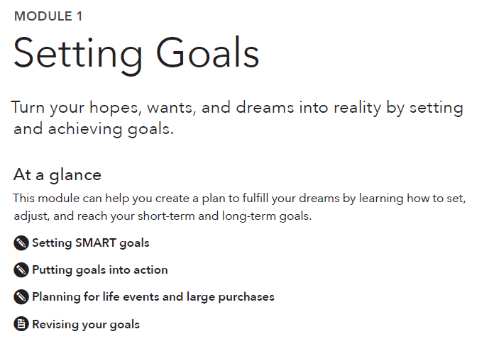
Navigating the modules
Notes:
Training Section 5: An orientation to the toolkit
Methodology: Presentation
Corresponding section of toolkit: Module 1, page 24
Instructions for facilitator:
Ask participants to flip to page 24 of the toolkit, so they can follow along with your presentation.
Explain that each module begins with an “At a glance” section, which lists the tools and handouts that are included at the end of that module.

Slide 21


Navigating the modules
Tool
Handout
Notes:
Training Section 5: An orientation to the toolkit
Methodology: Presentation
Instructions for facilitator:
The words “tool” and “handout” do not appear in the titles of the tools/handouts.
The toolkit uses icons to indicate a tool or a handout.
Explain the difference between a tool and a handout
A tool involves actions that the user can take. There are fields that need to be filled out. Tools are best used in a facilitated conversation between a frontline staff person and the person they’re helping.
A handout is an informational brochure. It has good tips and information for someone to take home with them. It doesn’t require any immediate action or a facilitated conversation.
Following the “At a glance” section is the content information of the module.
Here, ask participants to flip through pages 25, 26, and 27 to see the sections of content in Module 1

Slide 22
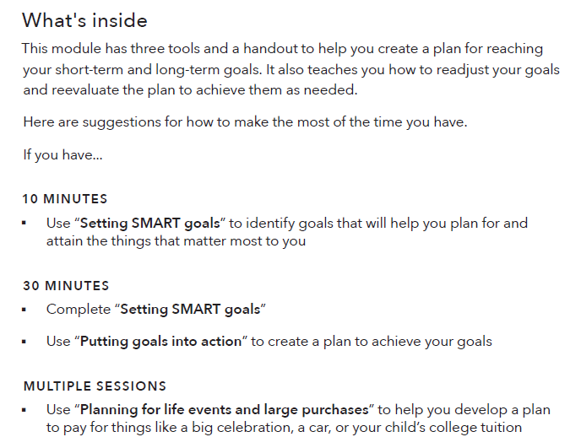
Navigating the modules
Notes:
Training Section 5: An orientation to the toolkit
Methodology: Presentation
Corresponding section of the toolkit: Module 1, page 28
Instructions for facilitator:
The last part of the content section of each module, before the tools and handouts, is the “What’s inside” section.
This section provides a short explanation of the purpose of each tool and handout.
It also provides guidelines for which tools to use, depending on how much time you have to dedicate to financial empowerment topics during your appointment.

Slide 23

Navigating the modules
To access a dynamic and fillable version of this tool, visit consumerfinance.gov/your-money-your-goals/tools
Notes:
Training Section 5: An orientation to the toolkit
Methodology: Presentation
Section of toolkit: Module 1, page 29
Instructions for facilitator:
Each tool begins with a “Getting started” page, which is intended for the case worker or frontline staff person to read before using the tool with someone.
The “Getting started” page offers some background and context for the tool.
It also has a “What to do” section with brief instructions and “A step further” section with suggestions of what someone could tackle next, after this tool is completed.
At the bottom of the “Getting started” page you’ll see a link to where you can download the tool by itself. You will be able to fill it out on your computer, if you want. For tools that require calculations, there are auto-calculation formulas built in.
Ask your participants to flip through pages 29-37 to look at the tools and handouts in Module 1.
Point out the “Tool” and “Handout” icons.
FACILIATION TIP: If you have internet access during your training, click on the link on this slide and demonstrate how to download a tool. Pick one that has calculated fields, like the “Spending tracker” in Module 3.

Slide 24
Toolkit organization
Tool: Setting SMART goals
Tool: Putting goals into action
Tool: Planning for life events and large purchases
Handout: Revising goals
Module 2: Saving
Tool: Savings plan
Tool: Saving and asset limits
Tool: Finding a place for savings
Handout: Saving at tax time
Module 3: Tracking Income and Benefits
Tool: Income and benefits tracker
Tool: Choosing how to get paid
Tool: Increasing income and benefits
Module 4: Paying Bills
Tool: Spending tracker
Tool: Bill calendar
Tool: Choosing how to pay bills
Tool: Cutting expenses
Tool: Prioritizing bills
Module 5: Getting through the Month
Tool: Creating a cash flow budget
Tool: Improving cash flow
Tool: Adjusting your cash flow
Module 1: Setting Goals
Introduction
Tool: Financial empowerment self-assessment
Tool: My money picture
Notes:
Training Section 5: An orientation to the toolkit
Methodology: Presentation
Corresponding section of the toolkit: Table of contents, pages 1-5
Instructions for facilitator:
Review the tools and handouts in the Introduction and Modules 1-5

Slide 25
Toolkit organization
Module 6: Dealing with Debt
Tool: Debt log
Tool: Debt-to-income calculator
Tool: Debt action plan
Tool: Comparing auto loans
Tool: Repaying student loans
Tool: When debt collectors call
Handout: Avoiding medical debt
Module 7: Understanding Credit Reports and Scores
Tool: Requesting your free credit reports
Tool: Reviewing your credit reports
Handout: Disputing errors on your credit reports
Tool: Getting and keeping a good credit history
Module 8: Choosing Financial Products and Services
Tool: Finding financial products and services
Tool: Comparing financial service providers
Tool: Opening a checking or savings account
Tool: Avoiding checking account fees
Tool: Evaluating your prepaid or payroll card
Handout: Knowing your prepaid card rights
Handout: Sending money abroad
Module 9: Protecting your Money
Handout: Protecting your identity
Handout: How to handle identity theft
Handout: Spotting red flags
Handout: Submitt a complaint
Notes:
Training Section 5: An orientation to the toolkit
Methodology: Presentation
Section of toolkit: Table of contents, pages 1-5
Instructions for facilitator:
Review the tools and handouts in Modules 6-9

Slide 26
Where would you start if someone…
Felt overwhelmed by debt?
Felt like she couldn’t make ends meet?
Wants to buy a car and get the best rate she can for the money she must borrow?
Wants to understand direct deposit and payroll cards?
Has used short-term, small-dollar credit products in the past and wants to avoid these in the future?
Wants to make changes but does not have clear goals?
Has no savings but wants to start?
Wants to open an account but doesn’t know what kind of account or where?
Notes:
ACTIVITY – Training Section 5: An orientation to the toolkit
Methodology: Scavenger Hunt
Instructions for facilitator:
Explain that they will be going on a scavenger hunt through the toolkit.
Instruct small groups to review each question and to locate the module and specific tools within the module that address each question.
Instruct participants to write their answers to each question on a flip chart using markers.
Provide teams 15 - 20 minutes to complete.
Ask participants to share answers; use answer key (below) to augment their solutions.
Following answers, ask participants to share reactions or questions they may have regarding the toolkit, given the scavenger hunt through it.
ANSWER KEY:
1. Felt overwhelmed by debt?
Module 6: Dealing with Debt
The “Debt action plan” tool (page 130)
2. Felt like she couldn’t make ends meet? (ANY OF THESE ANSWERS IS ACCEPTABLE)
Module 3: Tracking Income and Benefits
The “Increasing income and benefits” tool(page 74)
Module 4: Paying Bills
The “Spending tracker” (page 81)
The “Cutting expenses” tool (page 90)
The “Prioritizing bills” tool (page 93)
Module 5: Getting through the Month
The “Creating a cash flow budget” tool (page 99)
The “Improving cash flow” tool (page 102)
The “Adjusting your cash flow” tool (page 107)
3. Wants to buy a car and get the best rate she can for the money she must borrow? (ANY OF THESE ANSWERS IS ACCEPTABLE)
Module 1: Setting Goals
The “Planning for life events and large purchases” tool (page 34)
Module 6: Dealing with Debt
The “Comparing auto loans” tools (page 132)
Module 7: Understanding Credit Reports and Scores
The “Getting and keeping a good credit history” tool (page 179)
4. Wants to understand direct deposit and payroll cards?
Module 3: Tracking Income and Benefits
The “Choosing how to get paid” tool (page 69)
5. Has used short-term, small-dollar credit products in the past and wants to avoid these in the future? (ANY OF THESE ANSWERS IS ACCEPTABLE)
Module 2: Saving
The “Savings plan” tool (page 45)
Module 5: Getting through the Month
The “Creating a cash flow budget” tool (page 99)
Information on avoiding problems with debt in Module 6: Dealing with Debt (page 118)
6. Wants to make changes, but does not have clear goals?
Module 1: Setting Goals
The “Setting SMART goals” tool (page 29)
7. Has no savings but wants to start?
Module 2: Saving
The “Savings plan” tool (page 45)
8. Wants to open an account but doesn’t know what kind of account or where?
Module 8: Choosing Financial Products and Services
The “Finding financial products and services” tool (page 192)
The “Comparing financial service providers” tool (page 204)
The “Opening a checking or savings account” tool (page 212)
FACILITATION TIP: Participants may have answers that vary. If they do, ask them to explain the reason they chose the module and tool.
FACILITATION TIP: If you are pressed for time, consider covering this quickly by asking for discussion about one, two or three of the questions on the slide. This would probably be enough for most people to understand that many financial empowerment topics require specialized knowledge and expertise to properly address and still provide a great segue into a discussion about a resource and referral guide.

Slide 27
Your Money, Your Goals
Starting the money conversation
Notes:
Training Section 6: Starting the money conversation
Estimated Time: 45 Minutes (If role play is skipped, then this section will take less time.)
Methodology: Presentation / Individual Activity and Discussion in Pairs / Role Play / Skit or Large Group Brainstorm
Corresponding section of the toolkit: Introduction tools, pages 13-23

Slide 28
Tool: Financial empowerment self-assessment
Complete the “Financial empowerment self-assessment” tool in the Introduction
Reflection Questions
  How did you feel about completing this assessment?
  Were there topics you knew more about than you thought you would?
  What topics would you like to learn more about?
  How can you learn more about them?
Notes:
ACTIVITY – Training Section 6: Starting the money conversation
Methodology: Individual Activity and Discussion in Pairs
Corresponding section of the toolkit: Introduction, the “Financial empowerment self-assessment” tool, pages 14-20
Instructions for facilitator:
Provide rationale for the “Financial empowerment self-assessment” tool.
The “Financial empowerment self-assessment” tool has three parts, designed to help you understand how much financial knowledge you already have. Learning more will not only benefit the people you serve, but it may also benefit you as you apply what you learn to your own life.
This tool will help you see how much you know and where you may need to learn more.
Invite participants to complete this assessment tool. Provide 7 minutes.
Review the answers in a participatory way.
FACILITATION TIP: Answer key is in the toolkit page immediately following the tool. Be sure to ask participants to not look ahead when completing this assessment.
Ask participants to get into pairs and discuss the reflection questions—be sure to review one question at a time.

Slide 29
Situation assessment
A picture of conditions today used to inform and plan for actions to change conditions in the future
Notes:
Training Section 6: Starting the money conversation
Methodology: Presentation
Instructions for facilitator:
Define situation assessment using slide
Assessment gives you a picture of what is going on now so you can better target information and skill building opportunities for yourself or the people you serve.
Assessment involves gathering information to understand conditions today, as well as what someone knows, can do, or feels about a specific topic.
This information is used to inform and plan for actions to change conditions, knowledge, abilities, behaviors, or beliefs.

Slide 30
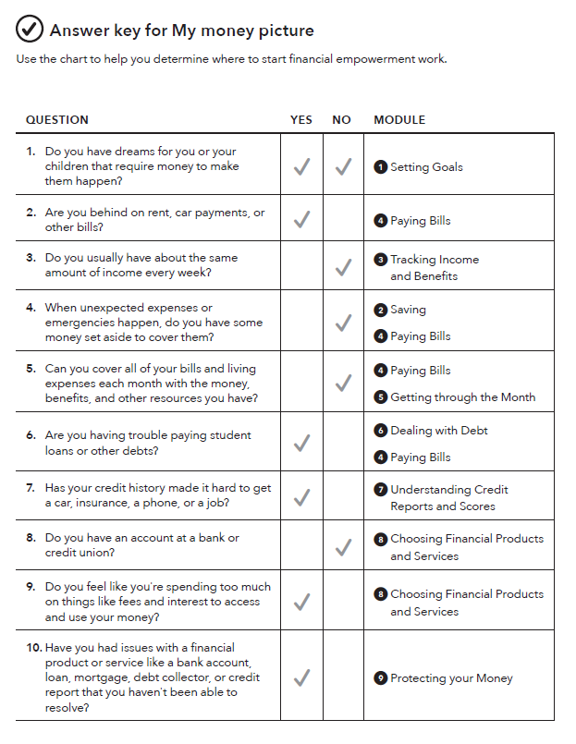
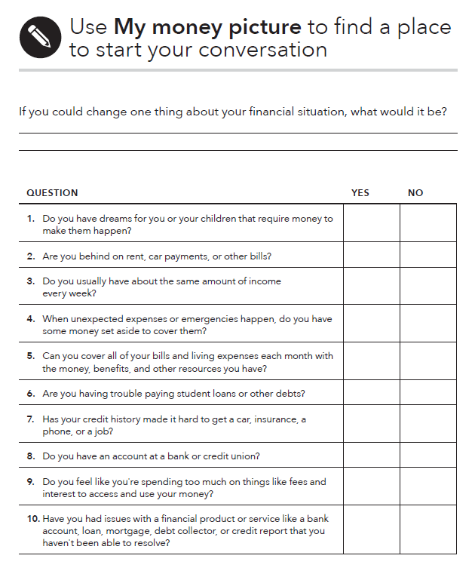
Tool: My money picture
Notes:
Training Section 6: Starting the money conversation
Methodology: Presentation
Corresponding section of the toolkit: Introduction, the “My money picture” tool, pages 21-23
Instructions for facilitator:
Review the purpose of the “My money picture” tool (ask participants to follow along on pages 21 and 22 of the toolkit).
The “My money picture” tool is designed to help service providers understand each person’s goals and financial situation. This information can help them target the right module of the toolkit for each person.
For example, if a person you’re working with has a goal to buy a car or a home, learning about how to improve her credit history and scores may help them qualify for a lower cost loan. You can target Module 7: Understanding Credit Reports and Scores.
If you are working with someone that is unable to make ends meet, you can target Module 5: Getting through the Month.
This tool will help you match each person’s goals and financial situation with specific modules and tools within the toolkit.
Be sure to state that using this tool is NOT MANDATORY. It is a tool they can use to more effectively and efficiently match a person’s needs with information and tools in the toolkit.
Share options for using the tool:
When the person fills out intake paperwork for your organization or program
When meeting with them for an initial assessment
When they are waiting for other services (such as waiting to have their tax returns prepared at a Volunteer Income Tax Assistance site)
OR
Send this home with them to fill out privately
Use it as a guide to ask questions in a conversational style to better understand their financial concerns and goals
Ask the questions over several sessions
Review the answer key for the tool (ask participants to follow along on page 23 of the toolkit). Make sure to underscore that frontline staff should review the answer key with the person they are helping as a facilitated conversation.

Slide 31
Your Money, Your Goals
Module 1: Setting Goals
Notes:
Note: Training sections for content modules are labeled by their module number (ex: Module 1), rather than by training section number.
Module 1: Setting Goals
Estimated Time: 45 Minutes
Methodology: Presentation / Facilitated discussion / Scenarios in small groups
Corresponding section in toolkit: Module 1 (pages 24-37)

Slide 32
SMART goals
Specific
Measurable
Achievable
Relevant
Time bound
Notes:
Module 1: Setting Goals
Methodology: Presentation
Corresponding section of the toolkit: Module 1, pages 26-27
Instructions for facilitator:
Encourage participants to follow along in Module 1 in the toolkit.
Explain the qualities of strong goals using the following:
Specific
When setting a goal, ask yourself the questions: Who? What? Why?
A specific goal has a much greater chance of being met than a general goal.
Measurable
You should be able to track your progress toward meeting the goal.
Ask yourself questions like: How much? How many? How will I know when it is done?
Achievable
Is this goal something that you can actually reach?
You might want to get rid of credit card debt tomorrow or become a millionaire in a year, but for most of us, that's a totally impossible goal!
That doesn't mean that your goals should be easy. Your goal may be a stretch for you, but it should not be extreme or impossible.
Relevant
Set goals that matter to you and are a priority in your life.
Ask yourself the questions: Is this something that I really want? Is now the right time to do this?
Time bound
Goals should have a clearly defined timeframe, including a target or deadline date.

Slide 33
Turn hopes and dreams into goals
I’d like to buy a new television.
I want to get out of
credit card debt.
I will save $400 and purchase a new television in six months.
I will pay down $1,000 of my debt over the next 18 months.
Hopes and dreams
Strong goals
Notes:
Module 1: Setting Goals
Methodology: Facilitated discussion
Corresponding section of the toolkit: Module 1, page 26
Instructions for facilitator:
Review examples by asking: “Why is a hope or dream NOT a goal?” “What makes this strong goal strong?”
Ask participants to list the things someone needs to reach goals. Write their responses on flip chart paper. Be sure to add the following:
Every goal requires commitment and time. To reach goals, you may also need:
Information
Tools
Transportation
Money
Other resources
An action plan—small steps needed to reach a goal
Assistance from a professional
For goals that require money to reach, you will want to know: How much do I need to set aside every week (or month) to meet my goal?
This applies to both debt reduction and savings goals.

Slide 34
Tool: Setting SMART goals
Identify the values that guide you
Transform hopes and dreams into SMART goals
Brainstorm list of hopes and dreams
Notes:
Module 1: Setting Goals
Methodology: Presentation
Corresponding section of the toolkit: Module 1, the “Setting SMART goals” tool (page 29)
Instructions for facilitator:
The “Setting SMART goals” tool in Module 1 has 3 steps:
Step 1: List your values to help you think about what is important to you and your family.
Step 2: Thinking about your values, write a list of things you'd like to change and dreams you have. They can be short term (less than six months to achieve) or long term (more than six months to achieve).
Step 3: Create a SMART goal from one or two items on your list of dreams of things you’d like to change. Write down what makes this goal specific, measurable, achievable, relevant, and time bound.

Slide 35
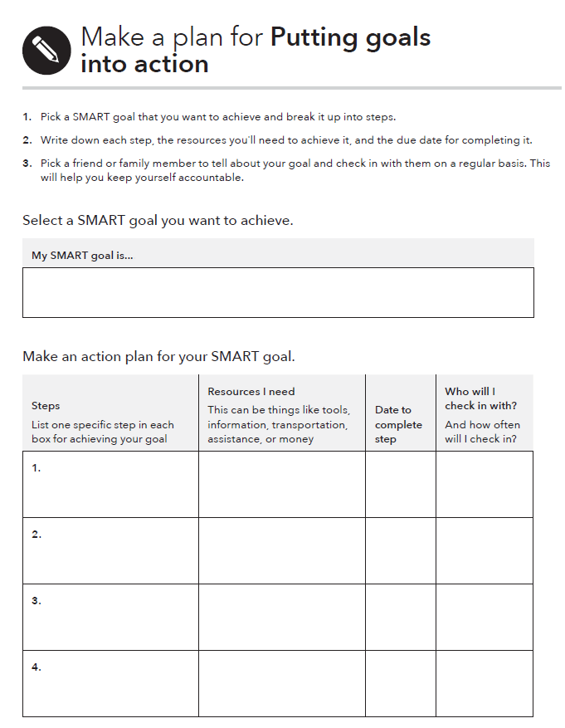
Tool: Putting goals into action
What to do:
Break up your goal into small, actionable steps. Write each step in a separate box.
Consider what resources you will need to take each step and write them next to that step.
Set a deadline for each step’s completion.
Think about sharing your progress with a friend or family member. Add their name next to the step and how often you will check in with them. This can help keep you motivated.
Notes:
Module 1: Setting Goals
Methodology: Presentation
Corresponding section of the toolkit: Module 1, the “Putting goals into action” tool, pages 32-33
Instructions for facilitator:
All goals require commitment and time.
Remind participants that while some goals require setting money aside to reach, they may also require more information, help from a professional, use of a new tool, or an action plan.
Accountability is also important if you want to achieve your goals. That’s why this tool encourages you to share your progress with a trusted friend or family member.
Use this example in demonstrating how the tool works
Sample SMART goal:
I want to pay my bills on time every month starting August 1.
Assuming lack of money is not the primary reason bills are not being paid on time, here are some steps you could take to reach that goal:
Collect credit card statements, loan payment statements, utility bills, phone bills, and documentation of other payments made each month.
Highlight payment amounts and due dates.
Complete the “Bill calendar” tool in Module 4.
Consider using automatic payment methods for some recurring bills or online bill payment.
Highlight that an action plan for a SMART goal that requires money should also include the “Savings plan” tool in Module 2.
FACILITATION TIP: You could write these steps in the action plan format on a flip chart or pull up the fillable tool from the Bureau’s website and type this example directly into it.

Slide 36
Handout: Revising goals
Reasons you may need to revise your goal:
Your circumstances have changed
You can’t meet your weekly savings goal
You’ve used up your emergency savings
Your goal doesn’t feel important anymore
Notes:
Module 1: Setting Goals
Methodology: Large group discussion
Corresponding section of the toolkit: Module 1, the “Revising goals” handout (page 36)
Instructions for facilitator:
Give an example of how a change in circumstance can impact a goal
If you lose your job, you might change your goal of saving for a nicer car to a goal of making sure that the car you have continues to run well.
Brainstorm in a large group how you might revise your existing goal if:
You can’t meet your weekly savings goal
Key takeaway: Change the goal to something that costs less money or increase the number of weeks you are giving yourself to save for the goal.
You’ve used up your emergency savings
Key takeaway: Create a new goal to build up more emergency savings.
Your goal doesn’t feel important anymore
Key takeaway: Come up with a different goal that does feel important, based on your values.

Slide 37
Life events and large purchases
Life events
  Some are planned
  Some happen without warning
Large purchases
  Uncertainty about how to pay can cause stress and anxiety
Notes:
Module 1: Setting Goals
Methodology: Facilitated discussion
Corresponding section of the toolkit: Module 1, pages 26-27
Instructions for facilitator:
ASK: What is a life event?
Something that happens—may be planned or unplanned—that many people experience generally at specific life stages although this is not always the case.
ASK: What is a large purchase?
Something that is generally only purchased one or a few times in life that requires more money than most people have in disposable income from one paycheck. Examples include: large appliances, cars, and home repairs. These may be planned or unplanned.
Solicit examples from participants and estimates for how much they would cost. A few examples:
Moving in with a partner, getting married, getting separated, getting divorced, or becoming widowed
Birth or adoption of a child
Illness or short- or long-term disability
Loss of a job
Celebrating a landmark birthday or anniversary, accomplishment, or rite
of passage
Death of a family member
Retirement
Your own final expenses
Buying a car
Buying a home
Education or training

Slide 38
Planning for life events and large purchases
Group 1: 18-year old graduating from high school. Plans to attend trade school to become a skilled welder.
Group 2: 28-year old food services manager at a state university diagnosed with cancer. He is married and has an infant.
Group 3: 36-year old mother who is getting divorced. She has two children ages 4 and 8. Must find a job for the first time in 9 years; before having children she was a math teacher in the public school system.
Group 4: 45-year old man being downsized out of manufacturing job. Married with one child who is 15 years old. The child has plans to go to college out of state.
Group 5: 56-year old long-haul truck driver who would like to retire in 6 years. Has saved minimally for retirement. Children are grown and out of the house; however, one has lost his job and has plans to return home with his two preschool children.
Notes:
ACTIVITY - Module 1: Setting Goals
Methodology: Scenarios in small groups
Corresponding section of the toolkit: Module 1, pages 26-27
Instructions for facilitator:
Show the slide above.
Divide the participants into small groups.
Give each group one of the scenarios.
Instruct participants to identify what life events the individual is likely to have already experienced, likely to experience one day as well as any large purchases you can see his or her incurring in the future.
On a flip chart, draw a path with a stick figure or star person in the middle of it. Label the bottom of the path “The Past” and label the top of the path “The Future.”
Instruct participants to copy this drawing on their own flip chart and then list the life events and large purchases as well as a guesstimate of the costs associated with each on the path and when they will occur (in the past or in the future) for the individual in their assigned scenario.
Each group should be prepared to present.

Slide 39
Planning for life events and large purchases
What are the reasons for thinking about and anticipating life events and large purchases?
Do most people do this? Why or why not?
How does an exercise like this empower individuals?
How can an exercise like this backfire?
What did you learn from this exercise?
Notes:
ACTIVITY - Module 1: Setting Goals
Methodology: Scenarios in small groups
Corresponding section of the toolkit: Module 1, pages 26-27
Instructions for facilitator:
Following the group presentations, process the exercise using the following questions (also on the PPT slide):
What are the reasons for thinking about and anticipating life events and large purchases?
Do most people do this? Why or why not?
How does an exercise like this empower individuals?
How can an exercise like this backfire?
What did you learn from this exercise?

Slide 40
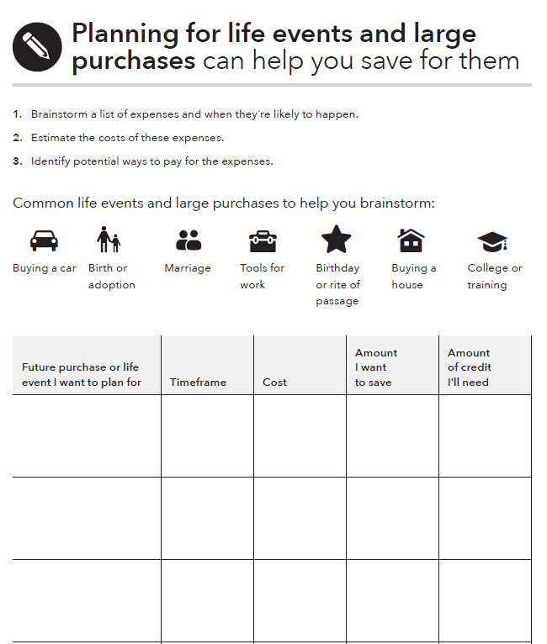
Tool: Planning for life events and large purchases
What to do:
Brainstorm a list of expenses using the categories at the top of the tool as a guide.
Research and estimate the actual costs. Add in any associated expenses (like the interest you might pay on a car loan).
Identify how much you might borrow versus how much you'll need to save.
Identify ways to keep the costs as low as possible.
Notes:
Module 1: Setting Goals
Methodology: Presentation
Corresponding section of the toolkit: Module 1, the “Planning for life events and large purchases” tool, pages 34-35
Instructions for facilitator:
Introduce the “Planning for life events and large purchase” tool and explain how to complete it using the following instructions from the tool:
Think about the life events you are likely to experience and the large purchases you might need to make. If you rely on a car to get to and from work, you will probably need to replace it at some point in the future. If you use tools in your trade, they may need to be updated or replaced periodically. Brainstorm a list of these types of expenses using the timeline chart below.
Consider where you are now, and when you are likely to experience some life events (like a graduation party) or need to make large purchases. If your child is ten years old now, a high school graduation party will be in about eight years. If your car is five years old or has a lot of miles on it, you may need to replace it within the next five years or less.
Estimate the costs of these expenses. Research the costs of the large purchases you plan to make or costs associated with life events you are expecting. If the life event or purchase is likely to happen more than five years from now, remember that the cost of almost everything gradually increases over time.
Identify potential ways to pay for these expenses. For example, you can borrow money to buy a reliable used or new car. If you plan to borrow money, consider saving some money for a down payment to keep your monthly payments as low as possible. Many large purchases may require a combination of borrowing money and paying a portion up front to cover the cost.

Slide 41
Module 1: Opportunities for financial empowerment
If you have 10 minutes…
  Use “Setting SMART goals” to identify goals that will help you plan for and attain the things that matter most to you
If you have 30 minutes…
  Complete “Setting SMART goals”
  Use “Putting goals into action” to create a plan to achieve your goals
If you have multiple sessions….
  Use “Planning for life events and large purchases” to help you develop a plan to pay for things like a big celebration, a car, or your child’s college tuition
  Follow up to see if progress is being made toward your goals
  Use the “Revising goals” handout to update or revise goals as needed

Slide 42
Your Money, Your Goals
Module 2: Saving

Slide 43
What is savings?
Savings is money you set aside today to use in the future
What are examples of unexpected expenses or emergencies?
Notes:
Module 2: Saving
Methodology: Facilitated Discussion and Small Group Brainstorm
Corresponding section of the toolkit: Module 2: Saving, page 38
Instructions for facilitator:
Ask participants to share their definition of savings.
Share definition of savings using slide.
Have participants list examples of unexpected expenses or emergencies in small groups on flip chart paper using marker.
After 3 minutes, ask participants to circle those they think could be handled with $1,000 or less.
Instruct groups to post their flip charts and share cumulatively.
Make summary comments about the number of unexpected expenses that can be managed with $1,000. Contrast to the “conventional wisdom” advocating 3 - 6 months’ worth of living expenses.
Explain that $500 to $1,000 is a possible goal for most—they can imagine it and it can make a very, very big difference.
Explain that having $500 to $1,000 to cover emergencies and unexpected expenses can help avoid debt.
Also explain: Once people see they can save this much, then they can work toward 1 month’s living expenses, 3 months’, etc. over the longer term.

Slide 44
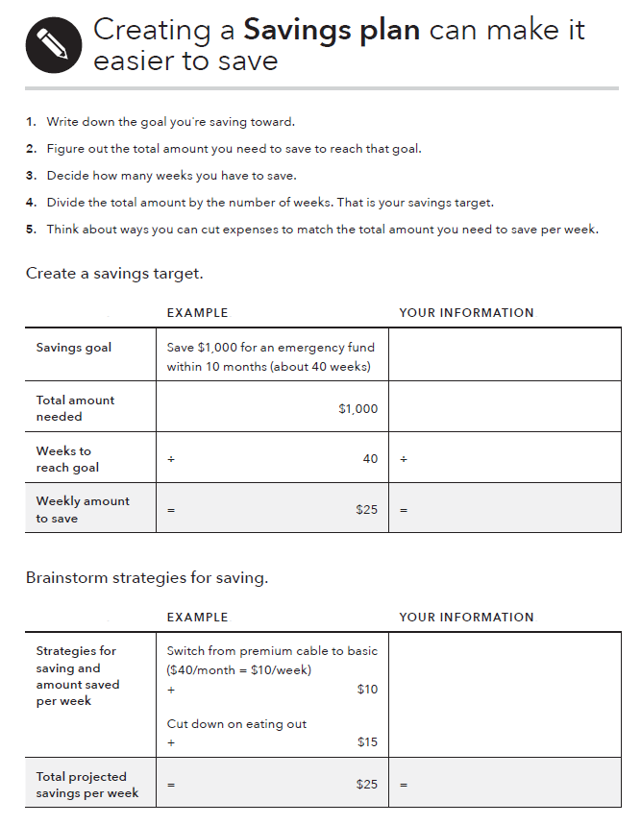
Tool: Savings plan
What to do:
Pick a reason for saving. Consider starting an emergency fund.
Figure out how much money you’ll need to save for that goal and how many weeks you have to save.
Divide the amount of money you want to save by the number of weeks you have to save it. That’s your weekly savings target.
Brainstorm some ways to decrease spending or increase income to meet your weekly savings target.
Notes:
Module 2: Saving
Methodology: Presentation
Corresponding section in toolkit: Module 2, the “Savings plan” tool, pages 45-46
Instructions for facilitator
Explain the components of the “Savings plan” tool.
Review the examples in the tool for setting a savings target and brainstorming strategies for saving.
ASK: When could you see using this tool?
FACILIATION TIP: Download this tool from the CFPB website in advance of your training and demonstrate the automatic calculation feature in the “Create a savings target” section.

Slide 45
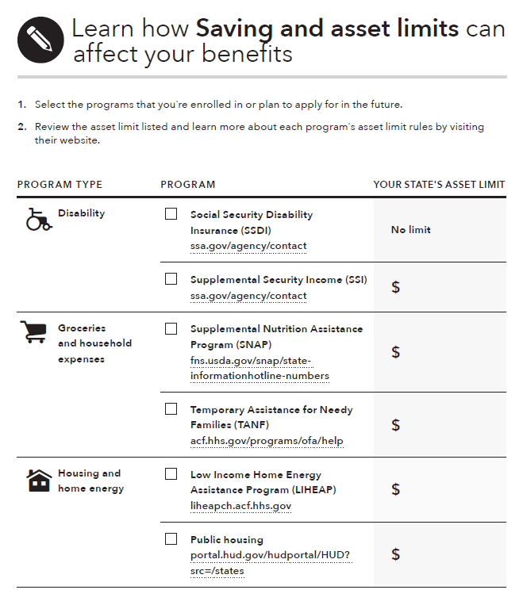
Tool: Saving and asset limits
What are the reasons this tool is included?
Notes:
Module 2: Saving
Methodology: Facilitated Discussion and Large Group Activity
Corresponding section in the toolkit: Module 2, the “Saving and asset limits” tool, pages 47-49
Instructions for facilitator:
Review tool by asking: “What are the reasons this tool is included?”
If there is time, complete the tool as much as possible with the group based on their own knowledge and experience.
You may also complete the tool with your state’s information, make copies, and share it with the group.
FACILITATION TIP: Prior to training, make a copy of the tool or download the fillable tool from the Bureau’s website. Use flip charts to fill in the tool with the group during the training or bring up the tool on your computer and type directly into it. Following the training, check the information. When the tool is completed, be sure to recognize the contributions of the group in a footnote.

Slide 46
Finding a place for savings
Where can you keep money you save?
What are the benefits?
  A benefit is something that provides you with an advantage. A benefit is something that is good for you.
What are the risks?
  A risk is any chance for loss. Where there is risk, there is uncertainty in the outcome or result.
Notes:
ACTIVITY - Module 2: Saving
Methodology: Carousel
Corresponding section of the toolkit: Module 2,the “Finding a place for savings” tool (page 50)
NOTE: This is an optional activity. If you are short for time, consider cutting this activity.
Instructions for facilitator:
Prior to training, hang flip charts throughout the room that have two columns on them: one titled “Benefits” and one titled “Risks.”
ASK: Where can you keep money you save?
Write each idea on its own flip chart.
NOTE: For all of those places that include keeping the money in the home, put these on one flip chart.
Have the group count off so small groups each have one flip chart to start with.
Have them visit each flip chart and brainstorm the benefits and risks of each place to save.
Give them 30 seconds at each flip chart—less as the exercise progresses; the idea is to make this a kinesthetic brainstorming session (carousel), as participants move around the room.
Once every group has visited each flip chart, review each flip chart briefly with the group.

Slide 47
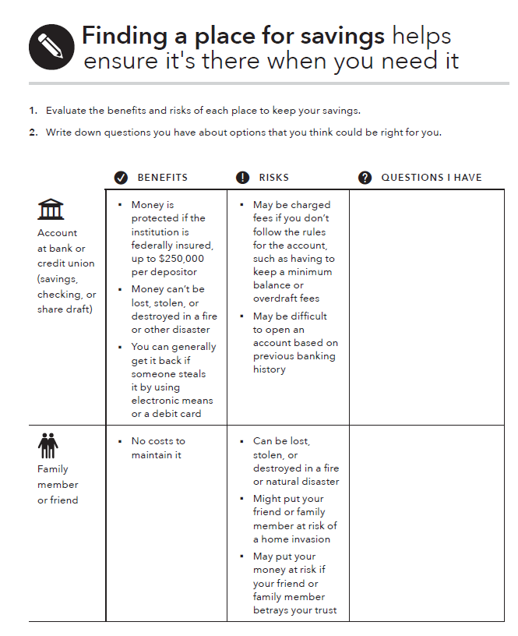
Tool: Finding a place for savings
What to do:
Carefully review the benefits and risks of each place to keep your savings.
Write down what questions you have about options that may be right for you.
Notes:
Module 2: Saving
Methodology: Presentation
Corresponding section of the toolkit: Module 2, the “Finding a place for savings” tool, pages 50-52
Instructions for facilitator:
Share an excerpt of the “Finding a place for savings” tool following the activity and have people find the tool in their toolkits.

Slide 48
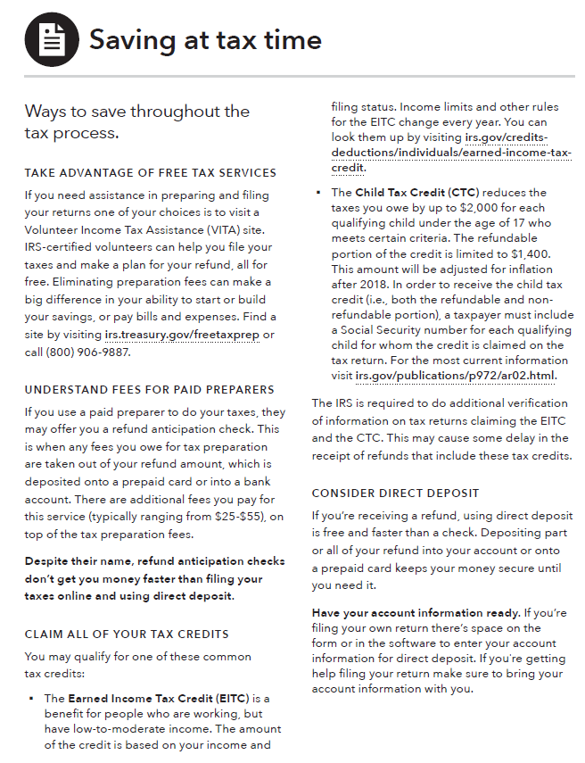
Handout: Saving at tax time
The IRS is required to do additional verification of information on tax returns claiming the EITC and the CTC. This may cause some delay in the receipt of refunds that include these tax credits.
For more information go to https://www.irs.gov/individuals/refund-timing
Notes:
Module 2: Saving
Methodology: Facilitated Discussion
Corresponding section in toolkit: Module 2, the “Saving at tax time” handout, pages 53-54
Instructions for facilitator:
Use the information in the “Saving at tax time” handout to review:
Availability of free tax preparation services. Ask participants to name organizations in your area that provide IRS-sponsored Volunteer Income Tax Assistance (VITA) services. Talk about the advantages of using VITA.
Key points of the federal earned income tax credit (EITC)
Benefit for working people who have low to moderate income.
Reduces the amount of federal income tax owed and may result in a refund.
A state or city EITC may also be available, depending on where they live.)
Tax refund is based on income and filing status.
Other tax credits, too, such as the Child Tax Credit (CTC).
Benefits of using your tax refund to kick start your emergency savings.

Slide 49
Module 2: Opportunities for financial empowerment
If you have 10 minutes…
  Use “Savings plan” to build a weekly savings target that will help you accomplish your goals
If you have 30 minutes…
  Complete “Savings plan”
  Use “Finding a place for savings” to pick a place that’s right for you to keep your savings
If you have multiple sessions…
  Review the “Saving at tax time” handout for tips on how to prioritize saving when you get your tax refund
  Use “Saving and asset limits” to get a clear picture of how much you can save while still maintaining your public benefits
Notes:
Module 2: Saving
Methodology: Presentation and Discussion
Corresponding section of the toolkit: Module 2, page 44
Instructions for facilitator:
Highlight opportunities for introducing financial empowerment depending on the amount of time available:
If you have time during the training:
ASK: What other ways could you introduce the financial empowerment tools from this module in your work?
WRAP UP
Savings is money you set aside today to use in the future. People save for many reasons. Reasons to save include emergencies and goals such as: their own goals - like a new TV, appliances, a home, their children’s education, and retirement
Why save for emergencies? Because they will happen. Many emergencies or unexpected expenses can be managed with $500 to $1,000 in an emergency fund.
When you save for emergencies in advance, you can handle them when they happen without having to skip your other bills or borrow money.
When you borrow money, you have to pay fees and sometimes interest. And on top of that, you will probably have to use some of your income going forward to pay back the money you borrow. So saving money now for unexpected expenses and emergencies can save you even more money later.

Slide 50
Your Money, Your Goals
Module 3: Tracking Income and Benefits
Notes:
Module 3: Tracking Income and Benefits
Estimated Time: 30 minutes
Methodology: Facilitated Discussion / Tool Analysis / Presentation
Corresponding section in toolkit: Module 3, pages 55-76

Slide 51
Income and benefits
Income
Regular income
Irregular income
Seasonal
One-time occurrence
Benefits
Notes:
Module 3: Tracking Income and Benefits
Methodology: Facilitated Discussion
Corresponding section in toolkit: Module 3, pages 55-56 and 58
Instructions for facilitator:
Define income.
Definition from page 55 of the toolkit: “Income is the money you receive from part-time or full-time work, self-employment, and investments.”
Ask participants to differentiate regular, irregular, seasonal, and one-time income.
ASK: How do these different kinds of income impact budgeting and cash flow?
ASK: How are benefits (public) different from income?
Main point about benefits (from page 58 of the toolkit): “Benefits are important financial resources that may cover some essential living expenses. That’s why it’s important to track benefits the same way you’d keep track of your income. But benefits aren’t as flexible as income, because they usually can only be spent on specific things. For example, if you qualify for the Supplemental Nutrition Assistance Program (SNAP), you can only use those benefits to purchase certain groceries.”

Slide 52
Garnishment
If a creditor sues you for unpaid debts and wins, they might collect the debt by garnishing your wages
  Garnishments can be taken out of your paycheck by your employer
  Garnishments can also come directly from your bank account
Your wages can also garnished to pay back:
  Back child support
  Defaulted federal student loans
  Back taxes
  Unpaid court costs, or other debts to a government agency
Notes:
Module 3: Tracking Income and Benefits
Methodology: Facilitated Discussion
Corresponding section in toolkit: Module 3, page 62
Instructions for facilitator:
Wage garnishments give the government or creditors the right to collect money directly out of someone’s paycheck. This can generally only happen with a court order.
Common reasons for wage garnishment are:
Taxes owed to the IRS or the state
Money owed for child support
Money owed for delinquent student loans
Other unpaid or delinquent debts

Slide 53
Limits to wage garnishment
The amount that can be garnished from wages under federal law is usually limited to the smaller of these two amounts:
25 percent of your disposable income |  |  | Difference between your income and 30 times the federal minimum wage
 | EXAMPLE |  |  | EXMAPLE
Weekly earnings | $300 |  | Federal minimum wage | $7.25
 | x 25% |  |  | x 30
Total garnishment | = $75 |  | Subtotal | = $217.50
Weekly earnings | $300
 | - 217.50
Total garnishment | = $82.50
In this example, federal law would limit your garnishment to $75, because it's less than $82.50.
Notes:
Module 3: Tracking Income and Benefits
Methodology: Facilitated Discussion
Corresponding section in toolkit: Module 3, pages 62-63
Instructions for facilitator:
With a wage garnishment order, only a certain percentage of the employee’s disposable earning can be withheld.
Federal law limits the amount that may be garnished.
Generally the amount must be the lesser of two figures: 25% of disposable income or the amount that the person earns each week over the federal minimum wage multiplied by 30. You may wish to direct participants to the example in the toolkit.
Some states provide additional protections that allow consumers to take home more pay than would be allowed using only the federal limits.
All mandatory deductions are protected outright from garnishment:
Federal, state and local taxes and
Social Security and Medicare contributions
Voluntary deductions are not protected.
Generally, amounts received for Social Security, disability, retirement, child support, and alimony are protected from garnishment from regular creditors.
If you owe the federal government for student loans or back taxes, however, these sources may not be protected.

Slide 54
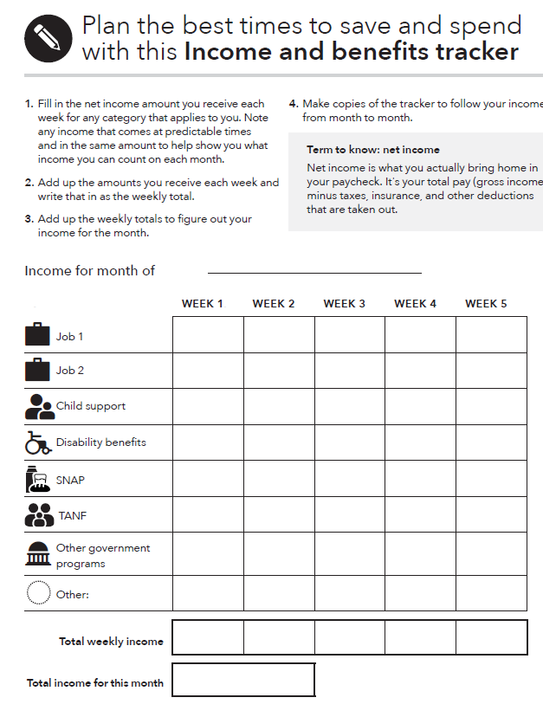
Tool: Income and benefits tracker
What to do:
Gather all of your pay stubs, benefits statements, and records of electronic payments.
Enter the amount of income or benefits you receive next to the correct category in the appropriate week of the month.
Notes:
Module 3: Tracking Income and Benefits
Methodology: Presentation
Corresponding section in toolkit: “Income and benefits tracker” in Module 3, pages 67-68
Instructions for facilitator:
Explain how to use the “Income and benefits tracker.”
Review the categories included.
Distinguish between income and benefits. While income (like from a job) can be used to pay for anything, some benefits can only be used for a particular purpose, like food or medical costs.
Define “net income” using the information in the grey call-out box in the tool (page 68)
Net income is what you actually bring home in your paycheck. It's your total pay (gross income) minus taxes, insurance, and other deductions that are taken out.
Explain that users should record net income, not gross income, in the tracker.
Ask participants if they feel there are major categories missing. (Explain the tradeoff between many categories and utility of the form.)
FACILIATION TIP: Download this tool from the CFPB website in advance of your training and demonstrate the automatic calculation feature.

Slide 55
Tool: Choosing how to get paid
Cash
Paper check
Direct deposit
Payroll cards
Government benefits card
EBT
Notes:
Module 3: Tracking Income and Benefits
Methodology: Presentation
Corresponding section in toolkit: “Choosing how to get paid” tool in Module 3, pages 69-73
Instructions for facilitator:
Review each method for receiving income as well as the benefits and risks of each.
Pay particular attention to the difference between a government benefits card and an EBT card.
Government benefits card (See also Module 8, page 188)
Government agency loads your benefits onto a prearranged prepaid card where you can access the funds.
Has full federal consumer protections in case of unauthorized transfers or other errors (includes needs-tested programs administered by the federal government, like SSI)
EBT card
A certain type of government benefits card (replacing paper-based benefits) used for needs-based programs funded by the federal government but administered by the state, such as TANF, SNAP, and other programs (availability, fees, and other terms vary by state and program)
May not have protections for returning funds taken through unauthorized transactions or other errors
Ask participants to share their feelings about the utility of this tool with the people that they serve.

Slide 56
Tool: Increasing income and benefits
Review this tool on pages 74 – 76
Think about the people that you serve.
Which strategies listed do you think are most feasible for them?
  Circle these.
What strategies are missing?
  Add these.
Notes:
ACTIVITY - Module 3: Tracking Income and Benefits
Methodology: Tool Analysis
Corresponding section in toolkit: “Increasing income and benefits” tool in Module 3, pages 74-76
Instructions for facilitator:
FACILITAITON TIP: This activity can be done individually, in pairs, or in small groups.
Ask participants to think about the people they serve.
Ask them to analyze this form from the perspective of the people they serve.
Have them circle the strategies for increasing cash and other financial resources they think will be feasible for them.
Have them add strategies they feel are missing.
Solicit ideas from the group.
Write them on flip charts.
Consider adjusting the tool post-training and redistributing it based on participants’ insights.

Slide 57
Module 3: Opportunities for financial empowerment
If you have 10 minutes…
  Review "Choosing how to get paid" to see the pros and cons of different payment methods and pick what works best for you
If you 30 minutes…
  Complete the "Income and benefits tracker" to see how much money you’re bringing home each month
If you have multiple sessions…
  Use "Increasing income and benefits" to think about ways you can boost the amount of money you’re making
Notes:
Module 3: Tracking Income and Benefits
Methodology: Presentation and Discussion
Corresponding section in toolkit: Module 3, page 66
Instructions for facilitator:
Highlight opportunities for introducing financial empowerment depending on the amount of time available:
If you have time during the training:
ASK: What other ways could you introduce the financial empowerment tools from this module in your work?
WRAP UP
Managing income and benefits is essential to financial empowerment. Many people do not think about their income beyond the amount they receive.
Understanding issues of timing and predictability can help you take control of your finances. And if you find you don’t have enough money, it’s important to identify strategies that can help you bring in more income or resources.
Finally, some ways of receiving income may be more beneficial to you than others. Understanding the benefits and risks of a paper paycheck versus direct deposit versus a payroll card can empower you to make a different choice that may benefit you and your family.

Slide 58
Your Money, Your Goals
Module 4: Paying Bills
Notes:
Module 4: Paying Bills
Estimated time: 30 minutes
Methodology: Vote with Your Feet/ Presentation / Tool Analysis / Small Group Exercise / Presentation
Corresponding section in toolkit: Module 4, pages 77-95

Slide 59
Needs, wants, and obligations
Spending
  Money you use to pay for a wide range of basic needs, your financial obligations, and other things you may want.
Needs, wants, and obligations
  Needs are things you must have to live.
  Wants are things you can survive without.
  Obligations are things you must pay because you owe someone money (a car loan) or have been ordered to pay someone (child support).
Notes:
ACTIVITY - Module 4: Paying Bills
Methodology: Vote with your Feet
Corresponding section of the toolkit: Module 4, page 78
Instructions for facilitator:
Prior to the session, hang up three signs on the walls: “Need,” “Want,” and “Obligation.”
Review the definition of spending.
Review the definitions of needs, wants, and obligations.
Tell people you are going to read off a list of items that you could spend money on. Use the list of example expenses below or use others that may be more contextually or culturally relevant to the people you are training. Limit the number of examples to 4 – 6.
Ask participants to stand under the sign that best represents the category they would put that item in: need, want, or obligation.
After you read each item, facilitate a discussion to uncover the reasons people have voted the way they have.
Be sure to ask questions like:
What are some of the reasons you see the item as a need? Want? Obligation?
What could be some of the reasons people see the same item so differently?
How does this relate to your work with people?
Link back to opening exercise related to attitudes and values about money and the influence of culture.
Example expenses:
Rent
Savings for vacation
Cell phone including data plan
Paper towels
Personal grooming related expenses
Bottled water
Coffee (the kind you make at home)
Pet food
Credit card payment
Home-based Internet connection
Baby formula
Cigarettes

Slide 60
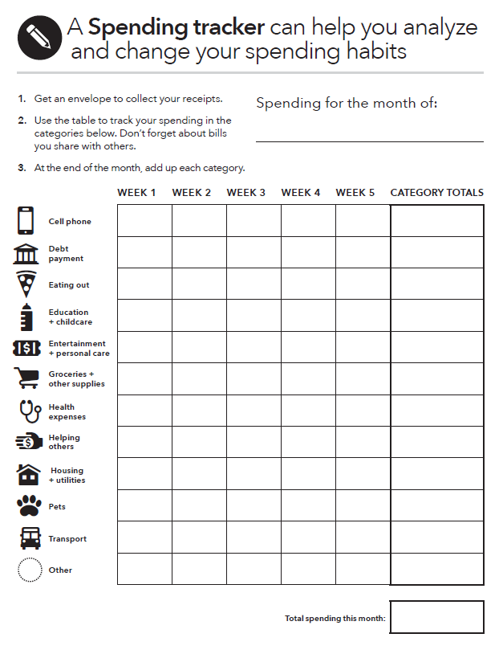
Tool: Spending tracker
What to do:
Get a small container or envelope. Every time you spend money, get a receipt and put it into the case or envelope.
Analyze your spending. Go through your receipts and enter the total you spent in each category for each week.
Notice trends. Identify any areas you can eliminate or cut back on—these will generally be wants.
Notes:
Module 4: Paying Bills
Methodology: Presentation
Corresponding section of the toolkit: The “Spending tracker” in Module 4 (pages 81-83)
Instructions for facilitator:
Review the list of categories and corresponding icons on the back of the Getting Started page (page 82).
ASK: Why is “cell phone” first?
The categories in this tool, and all the tools in the toolkit, are listed in alphabetical order. This sets a judgement-free tone for the conversation on tracking spending. The important part is to track.
Demonstrate the auto-calculation feature of the tool. Be sure to download the tool in advance.

Slide 61
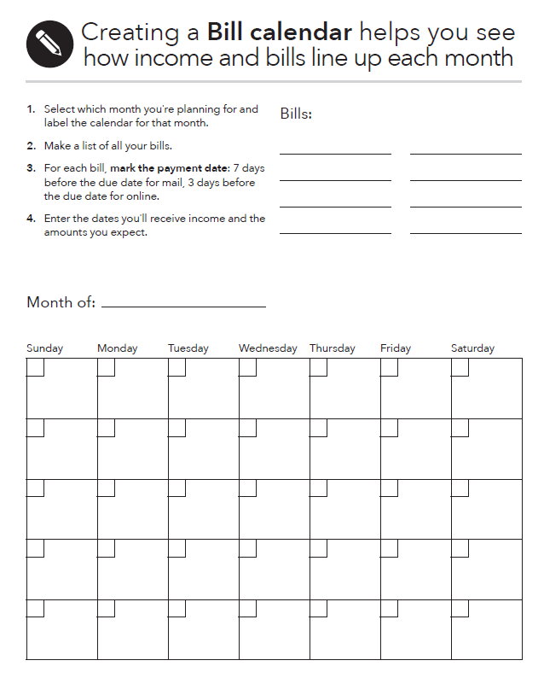
Tool: Bill calendar
What to do:
Gather all the bills you pay in one month or use the information from your spending tracker.
Write the date when you must send the payment or when the money must be taken out of your account, in advance of the due date.
Write down the name of the company or person you owe the money to and the amount that’s due on the date the bill must be sent to arrive on time.
Put this calendar where you will see it every day.
Notes:
Module 4: Paying Bills
Methodology: Presentation
Corresponding section of the toolkit: The “Bill calendar” in Module 4, pages 84-85
Instructions for facilitator:
Review the “Bill calendar” with participants using the following instructions:
Print or download the bill calendar and fill in the name of the month and year.
Add numbers to represent the days of the month.
Gather all of the bills you pay in one month OR use the information from your spending tracker.
Write the due dates for these bills. Since due dates are when bills must arrive, write the date bills must be sent:
If paying by mail, mark the due date at least 7 days before it is due.
If paying online, mark the due date at least 3 days before it is due.
For in-person or automatic bill payment, mark one or two days before the due date to ensure you are not late.
Fill in the calendar with the business or person you owe the money to, the date the money must be sent to arrive on time, and the amount that is due.
Put this calendar somewhere you will see it every day to ensure you are not forgetting about important bills.

Slide 62
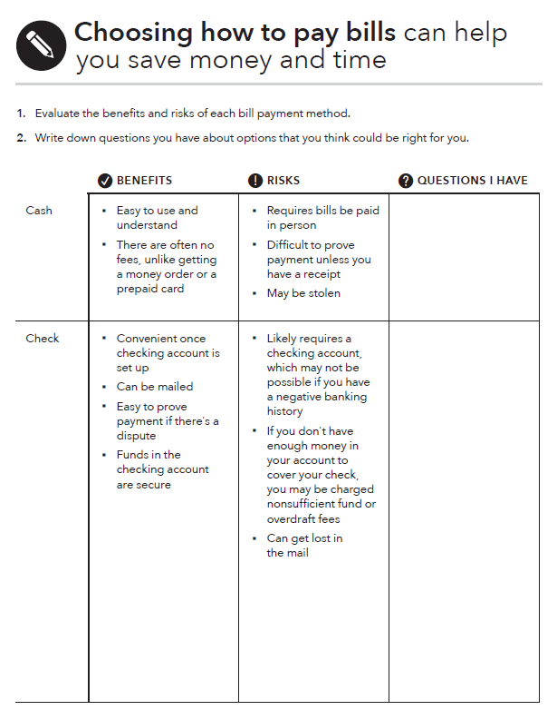
Tool: Choosing how to pay bills
What to do:
Read through the bill payment methods.
Consider the features of each. Some features can be either advantages or disadvantages, depending on what is important to you.
Decide which method to pay your bills is the right choice for you.
Notes:
Module 4: Paying Bills
Methodology: Presentation
Corresponding section of the toolkit: The “Choosing how to pay bills” tool in Module 4, pages 86-89
Instructions for facilitator:
Review the different ways you can pay bills that are covered in the tool.
Cash
Checks
Credit or debit cards
Money orders
Online or mobile bill payments
Prepaid cards
Picking a method that helps you consistently pay your bills on time can help you build a payment record that may improve your ability to access credit.
Review the risks and benefits associated with each method, outlined in the tool.
Explain that with information about the advantages and disadvantages of each method of bill payment, individuals can make choices that may help them:
Save time
Save money
Avoid additional or unnecessary fees
Create a reliable record of bill payment

Slide 63
Tool: Cutting expenses
Review this tool on pages 90-92.
Think about the people you serve.
Which strategies listed do you think are most feasible for them?
  Circle these.
What strategies are missing?
  Add these.
Notes:
ACTIVITY - Module 4: Paying Bills
Methodology: Tool Analysis
Corresponding section of the toolkit: The “Cutting expenses” tool in Module 4,pages 90-92
Instructions for facilitator:
NOTE: This activity can be done individually, in pairs, or in small groups
Ask participants to think about the people they serve.
Ask them to analyze this tool from the perspective of the people they serve.
Have them circle the strategies for cutting spending they think will be feasible for the people they serve.
Have them add strategies they feel are missing.
Solicit ideas from the group.
Write them on flip charts.

Slide 64
Consequences of skipping bills
Group 1:
  Consequences of paying rent late.
  Consequences of missing multiple rent payments.
Group 2:
  Consequences of making car payment late.
  Consequences of missing multiple car payments.
Group 3:
  Consequences of being late with electricity bill.
  Consequences of multiple late electricity bill payments.
Group 4:
  Consequences of missing payday loan payment.
  Consequences of missing credit card payment.
Notes:
ACTIVITY - Module 4: Paying Bills
Methodology: Small Group Exercise
Corresponding section of the toolkit: The “Prioritizing bills” tool in Module 4, pages 93-95
Instructions for facilitator:
Have participants count off into 4 groups.
Have each group list the consequences of both its “a” and “b” scenario on a flip chart.
Have groups share their lists after 7 minutes.
Add to list of consequences as appropriate.
FACILITATION TIP: If there are more than 20 participants, consider have two group 1s, two group 2s, etc. as necessary.

Slide 65
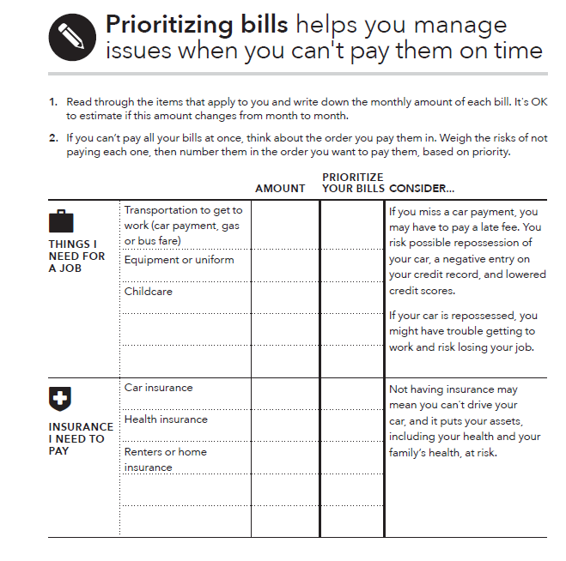
Tool: Prioritizing bills
What to do:
Read through the list of expenses. Identify what you need to pay to protect your housing and income, keep your insurance, and meet any court-ordered obligations.
Prioritize your bills.
Notes:
Module 4: Paying Bills
Methodology: Presentation
Corresponding section of the toolkit: The “Prioritizing bills” tool in Module 4, pages 93-95
Instructions for facilitator:
Review approach to prioritization and the rationale for this.
Be sure to emphasize that this is a short-term plan ONLY.
Explain that people often pay the creditors that complain the loudest. IF and only IF they truly cannot pay all their bills, they must come up with a short-term plan to avoid long-term consequences of not paying some bills or expenses that could lead to their losing their job, their shelter, key assets, or having legal consequence by not paying obligations, especially those that have been court-ordered.
ASK: When could you envision using this tool with the people you serve?

Slide 66
Module 4: Opportunities for financial empowerment
If you have 10 minutes…
  Use the “Spending tracker” to get a clear picture of where you’re using your money and financial resources.
If you have 30 minutes…
  Use “Choosing how to pay bills” to learn about all of the payment options you have for paying your bills.
  Use “Cutting expenses” to brainstorm ideas for cutting expenses from your budget.
  Use “Prioritizing bills” to make decisions about which bills to pay when you can’t make ends meet
If you have multiple sessions…
  Use the “Bill calendar” to visually organize all of your bills in a monthly calendar
Notes:
Module 4: Paying Bills
Methodology: Presentation and Discussion
Corresponding section of the toolkit: Module 4, page80
Instructions for facilitator:
Highlight opportunities for introducing financial empowerment depending on the amount of time available.
If you have time during the training
ASK: What other ways could you introduce the financial empowerment tools from this module in your work?
WRAP UP
Making changes to how you spend means knowing the difference among your needs, wants, and obligations—changes can generally only be made to spending for wants.
Paying bills on time may help you avoid late fees, fines, increased costs of services, and decreases in your credit scores.
If you find you are spending too much, you can apply some of the strategies for cutting spending. But be sure you are clear about the items that are your needs, your obligations and your wants before you start cutting spending. Finally, sometimes you can’t cover all of your needs, wants and obligations in a month.
Use a conscious strategy if you are going to have to skip or delay payments. Consider protecting your income, shelter, and assets before sending a payment to the “squeakiest wheel.”
It is always your responsibility to pay what you owe. But, for example, if you need your car to get to and from your job, in a month that your income is short, you may want to consider delaying a credit card payment and risking late fees instead of missing a car payment and risking repossession.
The tools from this module and Module 3 will help you create a cash flow budget, which is covered in Module 5.

Slide 67
Your Money, Your Goals
Module 5: Getting through the Month
Notes:
Module 5: Getting through the Month
Estimated time: 45 minutes
Methodology: Facilitated Discussion / Presentation / Scenario Analysis / Small Group Exercise / Presentation
Corresponding section in toolkit: Module 5, pages 96-108

Slide 68
Cash flow
What is a cash flow budget?
How is it different from a regular budget?
What do you think may be the benefit of this approach?
Notes:
Module 5: Getting through the Month
Methodology: Facilitated Discussion
Corresponding section of the toolkit: Module 5, page 96
Instructions for facilitator:
Explore what participants know about cash flow by asking: “What is a cash flow budget?”
After participants offer some ideas, share definition: A cash flow budget projects what money you expect to come in and how much you think you’ll spend each week and when you expect the expenses to occur.
Contrast cash flow to regular budget by asking: “How is a cash flow budget different from a regular budget?”
After participants offer some ideas, share definition: A cash flow budget tracks the timing of income and spending. This is key.
ASK: What do you think may be the benefit of this approach?

Slide 69
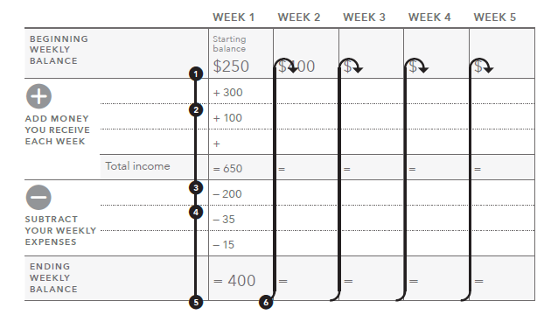
Tool: Creating a cash flow budget
Notes:
Module 5: Getting through the Month
Methodology: Presentation
Corresponding section of the toolkit: “Creating a cash flow budget” tool in Module 5, pages 99-101
Instructions for facilitator:
Review the components of a cash flow budget by explaining each step in the process and pointing out where that step is recorded on the tool:
Enter your starting balance for the month under Week 1. This is the total amount of money available to you from cash on-hand, prepaid cards, and checking and saving accounts.
Write down the amounts you receive during Week 1 from the categories listed. If you have income from other categories, add them together and write them under "Other."
Add up all your income for Week 1 and enter under "Total income."
Write down the amounts you spend during Week 1. If you have expenses from other categories, add them together and write them under "Other."
Subtract all the expenses for Week 1 from the "Total income" for Week 1. Write this amount in "Ending weekly balance."
Copy the amount from "Ending weekly balance" from Week 1 into the "Starting balance" for Week 2. Repeat steps 2 through 5 for the remaining weeks in the month.
FACILITATION TIP: Consider going through these instructions with the actual tool pulled up on the screen, typing in sample information in each section and showing the automatic calculation feature.

Slide 70
Managing cash flow: Scenario overview
Rafael is a single parent with two children.
He is often late with his rent and other bills, because he does not have the money when he needs it.
After tracking his spending, he developed a cash flow budget with an educator at a parenting class he takes through Cooperative Extension in his community.
Using the cash flow, make some recommendations to Rafael so he can make ends meet.
Notes:
ACTIVITY - Module 5: Getting through the Month
Methodology: Scenario Analysis
Corresponding section of the toolkit: Module 5
Instructions for facilitator:
Instruct participants to get into groups of three.
Review the introduction facts of the scenario they will analyze.

Slide 71
Managing cash flow scenario
Notes:
ACTIVITY - Module 5: Getting through the Month
Methodology: Scenario Analysis
Corresponding section of the toolkit: Module 5
Instructions for facilitator:
Make copies of this slide and distribute or transfer the information from this slide into the “Creating a cash flow budget” tool, print the third page, and distribute.
Additional information on the scenario
Rafael earns $14.65/hour and works 40 hours per week; he is paid every other week. (His net pay was calculated using an online calculator from ADP based on Oklahoma state tax laws. He is head of household, claims 3 federal exemptions, and has no voluntary deductions. The number was rounded up to $990.)
Credit card payment reflects minimum payment; personal loan is to grandmother (owes $2,000).
Rent includes utilities--electricity, gas, water, sewer, garbage pickup.
Part-time childcare is provided by family member at a big discount ($10/day to cover expenses for 7 days a week). This expense increases during the summer months when the kids are not in school (from $10/day to $25/day). However, during May, June, July, and August, the income from landscaping (his part-time job) doubles.

Slide 72
Cash flow analysis
When does Rafael run out of money?
What can he do (or try to do) to better match the timing of his income and his expenses? Develop a prioritized list.
How does the SNAP benefit factor into the cash flow?
The next month is not included in the example. What will Rafael’s situation be at the beginning of next month? How much cash will he have? What bills will he have? What should he do now to prepare for the following month?
Notes:
ACTIVITY - Module 5: Getting through the Month
Methodology: Scenario Analysis
Corresponding section of the toolkit: Module 5
Instructions for facilitator:
Instruct participants to analyze the cash flow and answer the first three questions above.
After 5 minutes, reveal the fourth question and instruct them to answer this within their groups.
Process as a large group:
When does Rafael run out of money? Answer: At the end of the first week.
What can he do (or try to do) to better match the timing of his income and his expenses? Develop a prioritized list. Possible answers:
See if landlord will accept rent payment the second week instead of the first.
See if the landlord will take half of the payment the first week of the month and half the third week of the month.
See if student loan payment can be moved to final week of the month. Explore other payment plans depending on type of loan such as Income Based Repayment.
See if auto loan payment can be moved.
How does the SNAP benefit factor into the cash flow? Answer: SNAP is important because it covers food; however, it makes it look like he has more cash during the first week than he actually does because SNAP can only be used for food.
The next month is not included in the example. What will Rafael’s situation be at the beginning of next month? How much cash will he have? What bills will he have? What should he do now to prepare for the following month? Possible answers:
His situation will be the same next month. He needs to get more income. First, he should make sure he is getting all of the benefits he and his family qualify for. Once this is done, he needs to consider getting more income from another part-time job.
ASK: Would a regular monthly budget highlight the shortfalls in cash?
Answer: No
Reason: Total income and benefits not including the starting cash balance is $3,272 for the month. Total expenses for the month $3167.22. While the budget is tight, a typical static monthly budget would show that everything is covered with a surplus of $104.78. This is the problem with a regular, static monthly budget.
Be sure to ask participants:
What do you think about this approach to budgeting versus the traditional approach? Be sure to discuss the week-by-week nature of this tool rather than the overall static monthly approach that might be presented by some financial educators.
What do you think are the potential benefits of using this approach with people? For yourself?
How did your opinion of this approach change after the case study?
What additional information do you need to feel comfortable with this approach to budgeting?

Slide 73
Developing a cash flow budget
Get a picture of your current situation by completing:
  The “Income and benefits tracker” in Module 3
  The “Spending tracker” in Module 4
  The “Cutting expenses” tool in Module 4
Notes:
Module 5: Getting through the Month
Methodology: Presentation
Corresponding section of the toolkit: Module 5
Instructions for facilitator:
Review the steps to creating a cash flow budget.

Slide 74
Developing a cash flow budget
Review your goals. Complete the “Setting SMART goals” tool in Module 1 to make sure your goals are actionable.
Review the “Planning for life events and large purchases” tool in Module 1.
Write the following in the approximate week you expect each item to happen:
  Projected income, benefits, and others resources, and
  Spending that cannot be cut.
Notes:
Module 5: Getting through the Month
Methodology: Presentation
Corresponding section of the toolkit: Module 5
Instructions for facilitator:
Review the steps to creating a cash flow budget.

Slide 75
Developing a cash flow budget
Set targets for spending to help create savings for goals, life events, and large purchases. Use the “Cutting expenses” tool in Module 4 to identity:
  Spending that can be eliminated
  Spending that can be reduced
Fill in savings for goals, life expenses, and large purchases.
Notes:
Module 5: Getting through the Month
Methodology: Presentation
Corresponding section of the toolkit: Module 5
Instructions for facilitator:
Review the steps to creating a cash flow budget.

Slide 76
Improving cash flow
    Increase sources of cash, income, or other financial resources, including accessing public benefits and applying for tax credits for which you qualify.
    Decrease your spending or uses of cash and other financial resources.
    Match timing of sources and uses of income where possible.
Notes:
ACTIVITY - Module 5: Getting through the Month
Methodology: Presentation and Small Group Exercise
Corresponding section of the toolkit: Module 5, page 96
Instructions for facilitator:
Explain that there are basically three overall strategies to improving cash flow:
Increase sources of cash, income, or other financial resources, including accessing public benefits and applying for tax credits.
Decrease spending or uses of cash and other financial resources.
Match timing of sources and uses of income where possible.
Instruct small groups to brainstorm specific ways to smooth out cash flow. Encourage them to think about ways to increase income, decrease spending, and match timing.
Encourage the group to select one person to write the ideas on a piece of paper.
Give teams 3 minutes to brainstorm.
Have them report out cumulatively soliciting ideas using round robin format (one idea per team until all teams have contributed, then repeat until ideas are exhausted).
Write their ideas on flip charts organizing them by category.

Slide 77
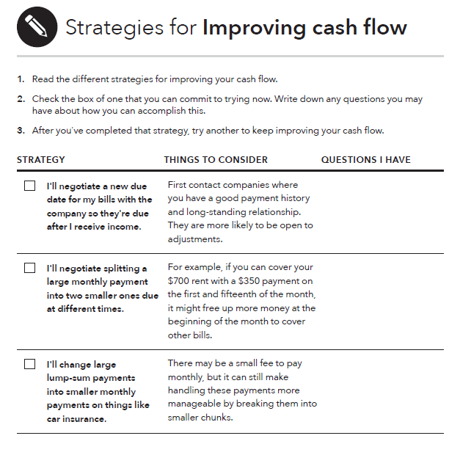
Tool: Improving cash flow
What to do:
Read through the strategies for improving your cash flow.
Write down any questions you have or next steps you can take.
Commit to implementing one or two strategies for the coming month and see if your cash flow improves.
Notes:
Module 5: Getting through the Month
Methodology: Presentation
Corresponding section of the toolkit: The “Improving cash flow” tool in Module 5, pages 102-106
Instructions for facilitator:
Following the activity, instruct participants to review the “Improving cash flow” tool.
Encourage them to add ideas from the activity not included in the tool.

Slide 78
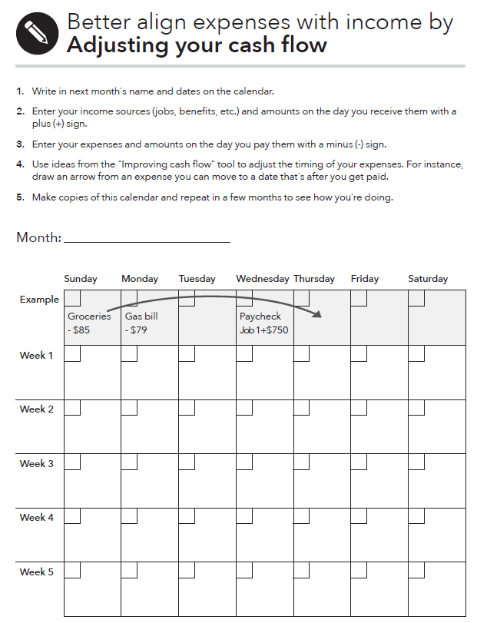
Tool: Adjusting your cash flow
What to do:
Fill in the calendar with the dates for that month.
Use your cash flow budget to enter your income (including benefits) and expenses.
Try moving expenses around to better align with when you have income in places where you’re coming up short.
Take action to make the changes a reality.
Notes:
Module 5: Getting through the Month
Methodology: Presentation
Corresponding section of the toolkit: The “Adjusting your cash flow” tool in Module 5, pages 107-108
Instructions for facilitator:
Laying out your income and expenses on a calendar can help you visualize your cash flow, making it easier to make adjustments.
Once you’ve entered your income and benefits, try moving expenses around to better align with when you have income in places where you’re coming up short.
Summarize by sharing:
A cash flow budget is a projection of how you will get and use your cash and other financial resources.
A cash flow budget is different from a regular budget, because it includes not only the amount for each budget item, but also the timing of your income and expenses.
This is important because people often find themselves flush with cash one week—and splurge on something fun—but come up short the next week for a necessity.
Timing matters. A cash flow budget will help an individual identify where she is falling short within the month. It can help her ensure she has the financial resources on hand to cover the most important expenses—so she doesn’t fall short covering the rent, for example. A cash flow budget can better help an individual target areas where they could consider cutting back.
Remember, sometimes there is not enough money to cover the month. In this case it is important to develop a short-term plan to prioritize bills and pay those that protect income, shelter, assets, and continue obligations. This can help responding in the moment to a debt collector collecting on a lower priority debt. But when making these decisions, people should be fully aware of the consequences and know money not paid today will become a debt in the future.

Slide 79
Module 5: Opportunities for financial empowerment
If you have a 10-minute session…
  Use “Improving cash flow” to learn about strategies and habits you can change to help your cash flow
If you have a 30-minute session…
  Use “Adjusting your cash flow” to find expenses that you can move or reduce to make sure your weekly cash flow is positive
If you have multiple sessions…
  Use “Creating a cash flow budget” to see how your income and expenses line up
Notes:
Module 5: Getting through the Month
Methodology: Presentation
Corresponding section of the toolkit: Module 5, page 98
Instructions for facilitator:
Highlight opportunities for introducing financial empowerment depending on the amount of time available:
If you have time during the training:
ASK: What other ways could you introduce the financial empowerment tools from this module in your work?
Remind participants that a cash flow budget helps someone UNDERSTAND how the timing of income and expenses may be causing shortfalls within a month; these shortfalls can be masked in a static monthly budget.
WRAP UP
The following steps can help you make a cash flow budget;
Keep track of everything you earn and spend money on for a week, two weeks, or one month. The “Income and benefits tracker” from Module 3 and the “Spending tracker” from Module 4.
Analyze your spending.
Use this information to create a cash flow budget.
Remember to include savings for goals, large purchases, and life events, too!
Your cash flow budget is about setting targets for how you will use your income going forward.

Slide 80
Your Money, Your Goals
Module 6: Dealing with Debt
Notes:
Module 6: Dealing with Debt
Estimated time: 90 minutes
Methodology: Facilitated Discussion / Stand Up-Sit Down / Activity in Pairs / Presentation / Exercise in Small Groups / Personal Stories
Corresponding section of the toolkit: Module 6, pages 109-150

Slide 81
What is debt?
What is debt?
  Money you owe.
  Debt is a liability.
  Debt may obligate future income.
How is debt different from credit? For our purposes…
  Credit is the ability to borrow money.
  Debt is the result of using credit.
Notes:
Module 6: Dealing with Debt
Methodology: Facilitated Discussion
Corresponding section of the toolkit: Module 6, page 111
Instructions for facilitator:
ASK: What is a debt?
After participants offer some ideas, share definition: Money you owe to another person or business. Debt is a liability. Debt may obligate future income.
ASK: How is debt different from credit?
After participants offer some ideas, share definition: Credit is the ability to borrow money and repay it later. Debt is the money that you have to repay when you’ve used credit.
ASK: How is secured debt different from unsecured debt?
After participants offer some ideas, share definitions: Secured debt is debt that has an asset attached to it. When debt is secured, a lender can take that asset if you get too behind on payments.
Ask participants for examples of secured debt.
After participants offer some ideas, share examples:
A home mortgage loan is secured with the home you are buying. If you don’t pay your loan, the lender can foreclose on your home, sell it, and use the money from the sale to cover some or all of your loan. In some states, the lender can ask you to pay the balance if the sale doesn’t pay off the loan.
An auto loan is secured with your car. If you don’t pay your loan, the lender can repossess (repo) your car and sell it to cover some or all of the loan. In some states, they can also ask you to pay the balance if the sale doesn’t pay off the loan.
A pawn loan is secured with the item you have pawned. The lender physically holds the item during the loan. If you don’t make the payment when it’s due, the pawned item is eventually sold.
An item purchased under a rent-to-own agreement, like a couch or television, must be returned or it will be picked up by the store if you don’t make the payment.
Debt from a secured credit card is secured by funds you deposit at a bank or credit union when you open the card. Your credit limit will generally equal your deposit. For example, if you deposit $300, your credit limit will be $300. If you don’t pay back the credit card, the bank can pay itself from your deposit. You can use a secured credit card to build up your credit history. This can help you qualify for an unsecured credit card in the future.
Unsecured debt does not have an asset attached to it.
Ask participants for examples of unsecured debt.
After participants offer some ideas, share examples:
Credit card debt (most credit cards are unsecured)
Department store charge card debt
Medical debt
Student loan debt
If these loans are not paid as agreed, they often go to collections.

Slide 82
Good debt, bad debt
Loan from friend or family member
Auto loan
Student loan
Payday loan
Mortgage (loan for a home)
Auto title loan
Pawn shop loan
Notes:
ACTIVITY - Module 6: Dealing with Debt
Methodology: Stand Up, Sit Down Activity
Corresponding section of the toolkit: Module 6, pages 110-111
Instructions for facilitator:
Explain that some people think of some debt as good debt and some debt as bad debt.
Explain that as each type of debt appears on the screen, they should stand up if they think the debt is bad debt and stay seated if they think it is good debt.
Reveal the debts listed above one at a time.
Facilitate a discussion about the reasons people think the debt is good or bad.
FACILITATION TIP: Be sure to challenge them a bit around “conventional wisdom.” For example, people have long believed student loan debt is “good debt.” Is this always the case? The same was true with mortgages in the past. Are pawn shop loans always bad? If someone is short of money, given a payday loan versus a pawn shop loan, do they think one is a better option than the other?
Use the following points to augment the discussion:
Loan from friend or family member
GOOD—Likely to have flexible terms; may be low or no interest; missed payments not reported to credit reporting agencies
BAD—Can create family conflict; cannot be used to build credit history
Auto loan:
GOOD—Can help you get needed transportation for job, school, life; secured with the car so will likely not need additional collateral; regular payment can help build credit history
BAD—Depending on loan, terms can be unfavorable; borrowing full value of car can lead to being upside down in loan (owing more than the car is worth); missed payment can result in repossession—no transportation for job and negative entry on credit reports
Student loan:
GOOD—Can help you access postsecondary education or training, which can lead to a higher paying job; federal student loans have repayment options; regular payment can help build credit history
BAD—Borrowing more to pay for education than likely wages within career can support in terms of repayment; borrowing for education but not completing degree (created a liability without the benefit of a potentially higher paying job); terms and conditions misunderstood (allowing interest to accrue); likely to not be forgiven even in bankruptcy except under extreme circumstances
Payday loan:
GOOD—Can help you get needed cash quickly and with little hassle
BAD—short-term, small-dollar; may not to be able to pay in full within initial term (generally 14 days) and may need to renew; often leads to repeat loans; if renewal not paid, post-dated check will be cashed and can deplete your accounts and/or overdraft them and lead to overdraft charges
Mortgage (loan for a home):
GOOD—Can help you get a home of your own; currently, interest rates are low, so the loan is less expensive than in decades past; secured with the house so will likely not need additional collateral; regular payment can help build credit history
BAD—Depending on loan, terms can be unfavorable; if you borrow the full value of the home and home values decrease, you could be upside down in the loan (owing more than the home is worth); missed payments can result in foreclosure—no home and negative entry on credit reports; selling the home can be difficult depending on the market and the condition of the home
Auto title loan:
GOOD—Can help you get needed cash quickly and with little hassle
BAD—Can lead to loss of your car title if the loan not paid as agreed
Pawn shop loan:
GOOD—Can help you get needed cash quickly and with little hassle
BAD—Can lead to loss of asset pawned if loan not paid as agreed

Slide 83
Co-signers: Agree to pay the loan
Co-signing on a loan
  Means you have the same obligation to pay the debt as the borrower
  Can result in you having to repay any missed payments
  Can affect your credit score and ability to obtain a future loan
Before co-signing, read the terms of the loan and consider carefully before taking on the risk.
Notes:
Module 6: Dealing with Debt
Methodology: Presentation
Corresponding section of the toolkit: Module 6, page 112
Instructions for facilitator:
Explain:
Lenders sometimes ask for a co-signer when they are concerned that a prospective borrower will not be able to repay a loan. The co-signer helps decrease a lender’s concern about repayment. If you decide to co-sign for a loan, you should read the terms of the loan and consider carefully before taking on the risk of co-signing.
A co-signer is a co-borrower and has the same obligation to pay a debt as the borrower. In most cases a lender or creditor does not even have to first attempt to seek repayment of a debt from the borrower before seeking repayment from you as a co-signer. A co-signer is at risk of having to repay any missed payments. And, if the borrower defaults on the loan, you as a co-signer have generally agreed to repay the entire loan.
Your credit score may also be affected, for example, if the borrower is late with or fails to make any payments.
Co-signing a loan may also affect your ability to obtain a future loan because a creditor may take into account the increased amount of debt that you have as a result of co-signing for a loan.

Slide 84
Types of debt
This module talks about three types of debt:
  Student loan debt
  Medical debt
  Payday loans
There are also tools to help you:
  Manage your debt
  Respond to debt collectors
  Shop for an auto loan
Notes:
Module 6: Dealing with Debt
Methodology: Presentation
Corresponding section of the toolkit: Module 6, pages 112-113
Instructions for facilitator:
Explain:
Different types of debt have different rules about borrowing and repayment. It’s important to know these details so you can best prepare for how to better handle your debt.
FACILITATION TIP: Consider reviewing the remaining slides in this module and thinking about which types of debt (and corresponding tools and handouts) are most relevant to the people being served by those you are training. Covering every topic in this module will take a significant amount of time and you may overload the people you are training. If you feel strongly that all topics are relevant, think about breaking up the remaining slides into two, or even three, training sessions.

Slide 85
Student loan debt
Two types of student loans
  Federal student loans
  Private student loans
Not sure which you have?
  Check the National Student Loan Data System www.nslds.ed.gov
Notes:
Module 6: Dealing with Debt
Methodology: Personal Stories and Presentation
Corresponding section of the toolkit: Module 6, pages 113-115
Instructions for facilitator:
Explain the difference between federal student loans and private student loans.
Federal student loans
These loans are made or guaranteed by the federal government. They usually have names like Direct Loan, Stafford, PLUS, or Perkins.
Federal student loans usually offer more flexible repayment options than private student loans. The interest rate on federal student loans is set by the government and is fixed, which means it will stay the same for the length of the loan. Also, with certain types of federal student loans (called subsidized loans), the government will pay the interest on your loan while you’re in school at least half-time.
Private student loans
Private student loans are made by a lender such as a bank, credit union, state agency, or a school. They may have names like “alternative” or “institutional” loans. Most private student loans have variable interest rates, which means that your interest rate could increase or decrease over the life of the loan.
Private student loans don’t generally offer the flexible repayment terms or borrower protections featured in federal student loans. You might also need a co-signer to qualify for some private student loans.
If you’re not sure whether your loan is federal or private, you can check the National Student Loan Data System, or NSLDS, at www.nslds.ed.gov. It provides a list of all your federal student loans, including which servicer is handling your account(s). If your loan is not listed in the NSLDS, it’s most likely a private loan.
Discuss student loan debt with the participants using information from pages 113-115 of the toolkit.
Ask participants to share stories from their work with people (without naming them) or their own student loan stories.
Keep track of themes from stories.
Share how many seem to stem from not understanding terms completely or not matching borrowing level with earning potential.

Slide 86
Tool: Repaying student loans
Group 1: Standard repayment plans (standard, graduated, and extended)
Group 2: Income driven repayment plans (Revised Pay As You Earn, Pay As You Earn, and Income-based repayment)
Group 3: Temporary repayment options (Deferment and Forbearance)
Group 4: Loan forgiveness (Teacher Loan Forgiveness Program and Public Service Loan Forgiveness Program)
Notes:
ACTIVITY - Module 6: Dealing with Debt
Methodology: Teach Back
Corresponding section of the toolkit: The “Repaying student loans” tool in Module 6, pages 135-141
Instructions for facilitator:
Break participants into 4 groups. A large number of participants can be broken into more than 4 groups, with some groups being assigned the same topic.
Assign each group one of the four federal student loan repayment options outlined on the slide
Ask participants to use information in the “Repaying student loans” tool (pages 135-141) to learn about their assigned repayment options. Each group will then teach back the information to the rest of the participants.
Groups should be prepared to spend 3-5 minutes discussing:
How each payment option works
How long you have to keep making payments before the rest of the loan is forgiven
Who may qualify for the repayment option
Conclude this activity by discussing the following information:
There are many options for repaying federal student loans to help make them more affordable to pay. Paying your loans on time and being in good standing are important to help you qualify for these repayment plans.
Don’t ignore student loan payment notifications. Missing payments on your federal student loans can hurt your ability to qualify for an alternative repayment plan that could lower your monthly payments.
You may not be eligible for an alternative repayment plan, based on the type of the loan you have and your financial circumstances. If you do apply for a different repayment option, it’s important to continue making your loan payments under your current payment schedule until you receive written notification that you have been approved. This ensures your loan will continue to be in good standing.
Private student loan repayment options are generally more limited than federal student loans. If you're having difficulty paying back a private loan then it’s important to communicate with your loan servicer.
Private lenders may offer:
Forbearance options that allow you to delay some payments on the loan.
Alternative repayment plans, including plans where payments start low and gradually increase over the loan term (known as “graduated payment plans”).
Loan modifications based on a borrower's’ financial circumstances, on a case-by-case basis. Finally, some lenders will cancel or forgive debt upon the death or disability of a borrower.
To learn more about these options, contact your private student loan servicer.

Slide 87
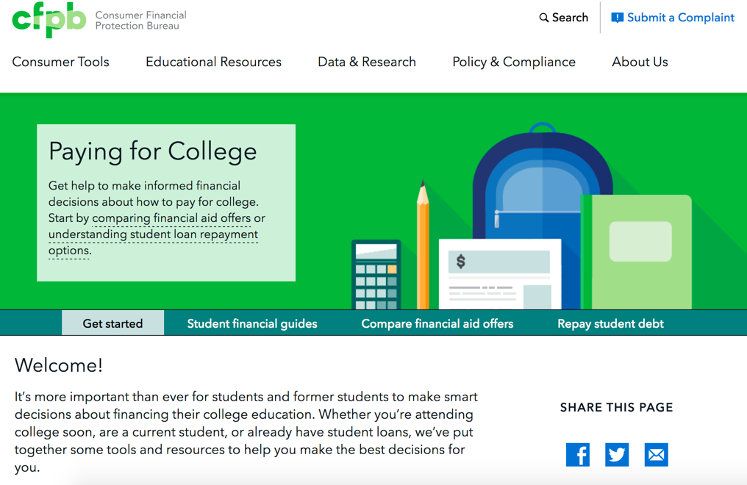
Paying for college
Visit http://www.consumerfinance.gov/paying-for-college
Notes:
Module 6: Dealing with Debt
Methodology: Presentation
Instructions for facilitator:
Review the CFPB’s “Paying for College” online tool:
Researching schools
Filling out the Free Application for Federal Student Aid (FAFSA), a first step in figuring out how to pay for college
Choosing a loan
Comparing financial aid packages and college costs across more than one school
Managing your money while in college
Repaying your student loans
FACILITATION TIP: If you have internet access, go to the site and show it to people you are training.

Slide 88
Medical debt
Two numbers to know about medical debt
  37 percent
  6 months
Notes:
Module 6: Dealing with Debt
Methodology: Presentation
Corresponding section of the toolkit: Module 6, pages 115-116
Instructions for facilitator:
Review the following information:
For many people, a large portion of the money they owe is medical debt. Thirty-seven percent of working age adults in America reported having trouble paying medical bills or having medical debt in 2016.
Source: S.R. Collins, M.Z. Gunja, M.M. Doty, and S. Beutel, How the Affordable Care Act Has Improved Americans’ Ability to Buy Health Insurance on Their Own, page 15, The Commonwealth Fund, February 2017. See: commonwealthfund.org/publications/issue-briefs/2017/feb/how-affordable-care-act-has-improved-americans-ability-buy
Medical debt has increasingly been a major factor in the decline of credit scores for some people. As of September of 2017, the three major credit reporting companies—Equifax, Experian, and TransUnion—must now wait six months before they include past due medical debts on your credit reports. This gives you time to help address any delays or disputes that may arise with your insurance provider and settle the debts before the medical debt affects your credit scores.

Slide 89
Handout: Avoiding medical debt
Preparing for medical bills
  Check what’s covered by insurance and make sure your information is up to date
  Keep good records
  Review medical bills carefully
Disputing medical bills
  Negotiate your bill
  Act quickly to resolve or dispute medical bills
Paying for medical bills
  Find out about charity care
  Don’t pay for medical bills on credit cards unless you can pay the balance
Notes:
Module 6: Dealing with Debt
Methodology: Facilitated Discussion
Corresponding section of the toolkit: The “Avoiding medical debt” handout in Module 6, pages 149-150
Instructions for facilitator:
Review some ways to avoid medical debt. Be sure to ask participants for their ideas and suggestions.
Use the following information from the handout on pages 149-150 to add to the discussion.
Ask your insurer what it will cover and the cost before getting a procedure or test done. If something isn’t covered, ask if there are alternatives that are covered. This helps you avoid medical debt by reducing your out-of-pocket cost upfront.
Prepare an organized record of all your medical bills and explanation of benefits (EOB) from your insurance company (these are usually mailed to you with a line-by-line explanation of costs, what insurance covered, and what you may owe).
Check each bill carefully before you pay it. If you don’t recognize the provider, check the date of service to see if you had a medical treatment on that day. Some providers who bill you directly may be associated with a hospital where you were treated, so you may not know you were receiving services from them at the time of treatment.
Hospitals or doctor’s offices may negotiate the amount of the bill with you. The total may be reduced if you pay the whole amount up front.
Get your repayment plan agreement in writing and request the following terms:
No interest on the debt
Monthly statements showing the amount paid and the outstanding balance
That the debt servicing stays with the healthcare provider and not be turned over to a third-party collection agency
An agreement that you don’t have to make full payment right away if you’re late or miss a payment on your plan
Act quickly to resolve or dispute medical bills. First verify that you owe the amount on the bill. Check that the amount that insurance is covering is correct, and pay the bill right away or negotiate repayment if you can’t afford to pay the entire bill all at once. If you delay payment and it ends up in collections, it can have a negative effect on your credit scores.
If you don’t owe the bill or the amount is incorrect, dispute it as soon as possible. Bill disputes can take a while to clear up, and in the meantime the bill is still owed and could be subject to late fees or interest.
Many hospitals have financial assistance programs, which may be called “charity care,” if you’re unable to pay your bill. Ask your provider if they offer any kind of assistance before you get treatments—or immediately afterwards. There may be a time period to sign up for these kinds of programs, so check the deadlines for enrollment beforehand.
If you aren’t able to pay your medical bill, ask your provider for a payment plan with little or no interest before paying the bill with a credit card. Once you’ve paid with a credit card, you’ll no longer be eligible for a payment plan. Putting large medical charges on your credit card is risky, especially if you don’t have the money to pay off the card immediately. You can end up paying interest on that medical debt. Also, your medical debt will look like credit card debt to creditors, who might weigh that differently when considering a loan application.

Slide 90
Example of how a 14-day payday loan could work
Borrower visits payday lender. No credit check or consideration of borrower’s ability to repay the loan.
Borrower provides lender with 14-day post-dated check or borrower’s authorization to take money out of bank or credit union account.
Borrower gets loan. Median loan is $350 and fees range $10 - $30 for each $100 borrowed.
In 14 days, the check could be deposited or money taken out of account by the borrower’s authorization. If the borrower doesn’t have the money to repay, in some states the loan may be renewed. In this example, the borrower pays $52.50 to renew.
Every 14 days, the borrower must either repay the loan or renew it, if allowed by their state. The average borrower takes out 5 loans in a row before repaying the original amount. In this example, it would cost $262.50 to borrow $350.
Notes:
Module 6: Dealing with Debt
Methodology: Presentation and Discussion
Corresponding section of the toolkit: Module 6, pages 116-117
Instructions for facilitator:
ASK: What is a payday loan?
Augment participants’ responses with the following facts from the toolkit:
A payday loan or a “cash advance” is a short-term loan, generally for $500 or less. It is generally due on your next payday.
You must either give the lender access to your checking account by electronic debit or write a post-dated check for the full balance in advance, so the lender can deposit your check when the loan comes due.
Depending on state law and individual lender practices, other loan features can vary. For example, payday loans can be structured to be paid off in one lump-sum payment, but interest-only payments ("renewals" or “rollovers”) are possible in some states.
In some states, payday loans may be structured so that they’re repayable in payments over a longer period of time, called “payday installment loans.”
The typical cost of the loan may range from $10 to $30 or more for every $100 you borrow. So a typical two-week payday loan with a $15 fee per $100 borrowed equals an annual percentage rate (APR) of almost 400 percent.
You may also have to pay additional fees to your bank or credit union if there isn’t enough money to cover the loan payment when the payday lender tries to take the money you owe out of your account or cash the postdated check. This is on top of fees you’re already paying the lender.
State laws and other factors can influence how much you can borrow and the fees you're charged. Some state laws restrict or prohibit payday lending.

Slide 91
Cost of unexpected car repair
COST INFORMATION | EMERGENCY SAVINGS | CREDIT CARD | PAYDAY LOAN
Amount needed | $350 | $350 | $350
Annual Percentage Rate (APR) | None | 15.99 percent APR | $15 for every $100 borrowed for 14 days—equals a 391 percent APR
Repayment terms | You can decide when you rebuild your savings | Must pay at least a certain amount each month—for this example, we're using a fixed monthly payment of $25 | Must pay back loan amount ($350) plus fee ($52.50) within 14 days
Time to repay | None | 16 months | 14 days
Total interest and fees | $0 | $40 over 16 months | 52.50 for every 14-day loan
Total cost of car repair | $350 | $390 | $402.50
Notes:
CTIVITY - Module 6: Dealing with Debt
Methodology: Exercise in Pairs
Corresponding section of the toolkit: Module 6, pages 118-121
Instructions for facilitator:
Ask people some of the benefits of having emergency savings. Write on flip chart.
Share that one benefit is that it can save you money—sometimes a lot of money.
Ask participants to review the table, in their toolkit or on this slide, in pairs. Explain that the terms of the two loan products are for example purposes only – that terms vary.
Have them list the costs of each approach to covering the unexpected auto repair cost (ex: replacing your spark plugs). Be sure to explain that there are direct costs—the additional money that each approach may require. But, there may be other costs, too such as stress of repaying a new debt.
Give pairs 5 minutes to complete.
Ask groups to share their thoughts.
Keep track of direct costs and other costs on flip charts.
ASK: How do you think the people you work with would respond to this information?
Use the following answers as a guide for the discussion.
Emergency Savings
Direct costs: use of savings, decreased spending because income dedicated to savings, future savings to replenish the amount used for spark plugs
Other costs: discipline of regular savings to build and replenish emergency fund
Credit Card
Direct costs: interest paid on money borrowed—$40; obligation of future income until credit card balance is paid in full
Other costs: stress of credit card bill; could impact credit score positively or negatively depending on payment pattern
Payday Loan
14 days to repay:
Direct costs: origination fees—$52.50; cost of renewal fees ($52.50 every 14 days in the example) if you cannot repay in full; obligation of future income until payday loan paid in full.

Slide 92
Debt settlement services
What is debt settlement?
Should you use a debt settlement service to deal with your debt?
What are the consequences of using a debt settlement service?
What are some red flags to watch out for when deciding to do business with a debt settlement service?
Notes:
Module 6: Dealing with Debt
Methodology: Facilitated Discussion
Corresponding section of the toolkit: Module 6, pages 121-122
Instructions for facilitator:
ASK: What is debt settlement?
Explain: Debt settlement companies say they can renegotiate, settle, or in some way change the terms of your unsecured debt to a creditor or a debt collector. That may include reducing the balance, interest rates, or fees you owe. It’s possible for you to try to do this yourself by contacting your creditors.
As a group discussion, or in small groups, discuss the following questions:
ASK: Should you use a debt settlement service to deal with your debt?
ASK: What are the consequences of using a debt settlement service?
Allow the group to discuss the pros and cons to using a debt settlement service.
If it is not mentioned, state:
Debt settlement companies charge fees, but it’s generally illegal for them to charge up-front fees.
Some debt settlement companies advertise that they will help consumers, but they ask you to stop paying your debts while you save up money to settle the debts. Not paying on your debts can create problems for you.
ASK: What are some red flags to watch out for when deciding to do business with a debt settlement service?
If it is not mentioned, state:
You should avoid doing business with any company that promises to settle the debt if the company:
Charges any fees before it settles your debts
Promotes a “new government program” to bail out personal credit card debt
Guarantees to you that it can make the debt go away
Tells you to stop communicating with the creditors
Tells you it can stop all debt collection calls and lawsuits
Guarantees that the unsecured debts can be paid off for pennies on the dollar

Slide 93
Tool: Debt log
On the debt log, you will include:
  The person, business, or organization you own money to;
  The amount you owe them;
  The amount of your monthly payment; and
  The interest rate you are paying and other important terms.
To complete this tool, you may need to get all of your bills, credit card statements, court orders, mortgage and loan agreements, together in one place and a copy of your credit report.
Notes:
odule 6: Dealing with Debt
Methodology: Presentation and Facilitated Discussion
Corresponding section of the toolkit: The “Debt log” in Module 6, pages 124-126
Instructions for facilitator:
Explain how to use the “Debt log”
Remember, a bill isn't always debt.
For instance, your monthly phone bill isn't debt, but any past due amount for that bill is. If you're repaying a loan (like a credit card or mortgage), the entire amount is considered debt and should be included here.
ASK: How would you use this tool with the people you serve?

Slide 94
Debt-to-income ratio
How much debt is too much?
Debt-to-income ratio
This simple calculation shows you how much of your income goes toward paying your debt.
The debt-to-income ratio is a good measure of how much of your income is obligated to debt.
Notes:
Module 6: Dealing with Debt
Methodology: Presentation
Corresponding section of the toolkit: The “Debt-to-income calculator” tool in Module 6, pages 127-129
Instructions for facilitator:
Explain what the debt-to-income ratio is and how it is used.
Determining your debt-to-income ratio is one way to check the overall health of your finances. It measures how much pressure debt is putting on your budget, which helps you decide if you can handle more deb

Slide 95

Debt-to-income
$.50 is going to debt
$.50 for everything else:
Taxes
Utilities
Cell phone
Gasoline
Food
Clothing
School fees
Gifts
Savings
Car repairs
Home repairs
Appliances
Furniture
Household supplies
Pet food and supplies
And so on
Notes:
Module 6: Dealing with Debt
Methodology: Presentation
Corresponding section of the toolkit: The “Debt-to-income calculator” tool in Module 6, pages 127-129
Instructions for facilitator:
Discuss debt-to-income (DTI) in real terms using the following:
If someone’s DTI is 50% that means that $.50 out of every dollar they earn goes towards his/her debt.
That leave $.50 out of every dollar to pay for everything else.
What is everything else?
Taxes
Utilities
Cell phone
Gasoline
Food
Clothing
School fees
Gifts
Savings
Car repairs
Home repairs
Appliances
Furniture
Household supplies
Pet food and supplies
And so on

Slide 96
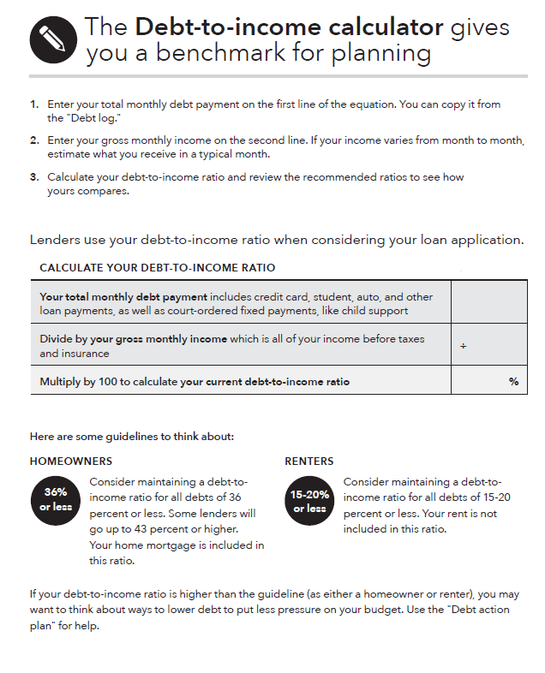
Tool: Debt-to-income calculator
What to do:
Complete the "Debt log” to figure out your total monthly debt payment.
Figure out your gross monthly income (before taxes or insurance). If your income varies from month to month, estimate your income on a typical month (it’s better to estimate lower for the purposes of this tool).
Notes:
Module 6: Dealing with Debt
Methodology: Presentation
Corresponding section of the toolkit: The “Debt-to-income calculator” tool in Module 6, pages 127-129
Instructions for facilitator:
Explain how to calculate the debt-to-income (DTI) ratio.
If possible, pull up the tool from the toolkit on your screen and demonstrate the auto-calculation feature in the tool.

Slide 97
Tool: Debt-to-income calculator
Renters
  Consider maintaining a debt-to-income ratio of .15 - .20, or 15% - 20%, or less.
Homeowners
  Consider maintaining a debt-to-income ratio of .28, or 28%, or less for just the mortgage (home loan), taxes, and insurance.
  Consider maintaining a debt-to-income ratio for all debts of .36, or 36%, or less.
Notes:
Module 6: Dealing with Debt
Methodology: Presentation
Corresponding section of the toolkit: The “Debt-to-income calculator” tool in Module 6, pages 127-129
Instructions for facilitator:
FACILITATION TIP: Summarize this slide on a flip chart if you are doing the Shawna activity described on “Activity in pairs” slide.
Explain how to interpret the DTI ratio.
Renters: Consider maintaining a debt-to-income ratio of .15 - .20, or 15% - 20%, or less.
This means that monthly credit card payments, student loan payments, auto loan payments, and other debts should take up 20% or less of your gross income.
Homeowners: Consider maintaining a debt-to-income ratio of .28 - .35, or 28% - 35%, or less for just the mortgage (home loan), taxes, and insurance.
This means that if you have a mortgage, the mortgage alone should take up no more than 28% of your income.
This includes the monthly principal, interest, taxes, and insurance (called PITI).
Homeowners: Consider maintaining a debt-to-income ratio for all debts of .36, or 36%, or less.
This means that if you have a mortgage and other debts—credit card payments, student loan payments, auto loan payment, and payday loan payments–your debt-to-income ratio should be below 36%.
Some lenders will go up to 43% or higher for all debt.
If you have court-ordered, fixed payments, such as child support, count these as debt for this purpose.

Slide 98
Calculating debt-to-income ratio
Shawna has just graduated, completing her Associate’s degree in nursing. She has already landed a full-time job earning $17.50 per hour. She works full time (160 hours per month). She will be working at a hospital 21 miles from her home and public transportation is not a viable option for her.
She found a good used car, but she can’t afford to buy it without a loan. Her monthly payments on that loan would be $158.
Every month she also pays the following debts:
  Student loan $205.00
  Credit card #1 $90.00; Credit card #2 $55
  Mortgage $625.00
What is the debt to income ratio without car loan? With the car loan?
Based on her DTI, do you think she can afford the loan?
Notes:
ACTIVITY - Module 6: Dealing with Debt
Methodology: Presentation
Corresponding section of the toolkit: The “Debt-to-income calculator” tool in Module 6, pages 127-129
Instructions for facilitator:
Instruct participants to complete the DTI in pairs.
Have them determine whether the individual should take on more debt.
Instruct them to calculate the DTI without the proposed new debt and with the proposed new debt.
Provide about 3 minutes for participants to calculate the answers.
Consider writing the answers on a flip chart.
Answers
Gross income = 160 hours x $17.50/hour = $2,800
Monthly debt before car loan = $975/month
DTI = .35 or 35%
Monthly Debt with car loan = $1,133
DTI with car loan = .40 or 40%
Instruct participants to share their answers and whether they felt the individual should get the new loan.
Explain that if Shawna gets the loan, that $.40 out of every $1 she earns will be committed each month to cover her debts.
Explain that this leaves $.60 out of every dollar to cover everything else. Ask participants what everything else includes. Write their ideas on a flip chart.
Be sure to add the following if not shared by the participants:
Savings
Taxes
Insurance – Car and Health
Utilities
Food
Clothing
Childcare
Health care (that has not turned into debt)
Child support
Charitable contributions and gifts and
Other family expenses
ASK: What can Shawna do to lower her DTI?

Slide 99


Tool: Debt action plan
The two ways to reduce debt:
  Pay smallest debt first
  Pay highest interest rate first
Consider the pros and cons of each.
Notes:
Module 6: Dealing with Debt
Methodology: Presentation
Corresponding section of the toolkit: The “Debt action plan” tool in Module 6, pages 130-131
Instructions for facilitator:
Review two primary methods for reducing debt outlined in Tool 3:
Pay smallest debt first
Description: After you've made all your minimum payments, increase your payment on the smallest debt. After it's paid off, add that extra amount to your minimum payment on the next smallest debt.
Pro” If you have many small debts, you might see progress quickly by reducing the number of debts you owe.
Con: If the interest rate and fees are high on your larger debts and you pay the smaller ones first, you might pay more in total over the length of the debt.
Pay highest interest rate first
Description: After you've made all your minimum payments, increase your payment on the debt that has the highest interest rate. After it's paid off, add that extra amount to your minimum payment on the next highest-rate debt.
Pro: By paying off the debts that charge you the highest interest and fees first, you save money overall.
Con: You might not feel like you're making progress very quickly, especially if the first debt is large.

Slide 100
Tool: Comparing auto loans
When shopping for an auto loan, evaluate the total cost to help you negotiate a deal you can afford.
Know what you can negotiate
Check your credit score
Review your loan contract before signing
Notes:
Module 6: Dealing with Debt
Methodology: Presentation
Corresponding section of the toolkit: The “Comparing auto loans” tool in Module 6, pages 132-134
Instructions for facilitator:
Review the following information:
Shopping for an auto loan and negotiating the terms can save you hundreds or even thousands of dollars over the life of your loan. Learn more about what is negotiable at www.consumerfinance.gov/consumer-tools/getting-an-auto-loan/know-what-is-negotiable
FACILITATION TIP: If you have an internet connection, bring up this webpage and review the tips.
A higher score will help you get a lower interest rate and reduce the total loan cost.
You will cover credit reports and scores in Module 7.
Lenders are required to give you documents that explain the loan. Before you sign, check that the annual percentage rate (APR), amount financed, finance charges, and total of all payments are correct. Make sure you and the lender have copies of the signed paperwork.
If you don’t understand something, ask them to explain it again until it makes sense. Consider bringing someone with you to help review the papers before you sign. Review the “Spotting red flags” handout in Module 9 to learn what to watch out for in the sales process.
FACILITATION TIP: Save a copy of this tool to your desktop before the training or find it online if you have an internet connection at your training site. Show the tool and it’s auto-calculation features.

Slide 101
Tool: When debt collectors call
If you have questions about the debt, do not send money or even acknowledge the debt the first time you are contacted. Why?
  You want to make sure you actually owe the debt, and
  You want to make sure the individual contacting you really has the authority to collect the debt
Also, ask for the name, number and address for the debt collector and request information about the debt in writing.
If you're sued by a debt collector, be sure to respond to court documents.
Notes:
Module 6: Dealing with Debt
Methodology: Presentation
Corresponding section of the toolkit: The “When debt collectors call” too in Module 6, pages 141-148
Instructions for facilitator:
Review the list of questions to ask if a debt collector calls on page 142 of the “When debt collectors call” tool.
This tool also contains sample letters people can send to debt collectors to verify the debt or to request that they stop contacting them.
Remember, however, that stopping contact does not erase the debt.
Explain:
Debt collectors use persuasive techniques to get you to send in money to pay your debt. Before you send in money, you should confirm that you actually owe the debt. You should also confirm that the collection isn’t fraudulent and is legitimate.
You may be able to confirm this information during an initial or follow-up discussion with the debt collector, but be careful of fraudulent debt collectors. Make sure that you recognize the debt, and confirm that you have not already paid it.
When the phone rings:
Sometimes it’s hard to know if a caller is really a debt collector. To avoid falling victim to a scam, ask for the name, number, and address for the debt collector and request information about the debt in writing.
Be wary of sharing your personal information by phone. If a stranger asks for your Social Security number, date of birth, or bank account information, this can be a red flag.
Don’t ignore court documents. If you don’t respond to court documents, or if you don’t show up for a court hearing, the court will usually issue a money judgment against you. You may want a lawyer to advise or represent you at the hearing. To find a lawyer in your state to discuss debt collection with, visit www.consumerfinance.gov/askcfpb/1433.

Slide 102
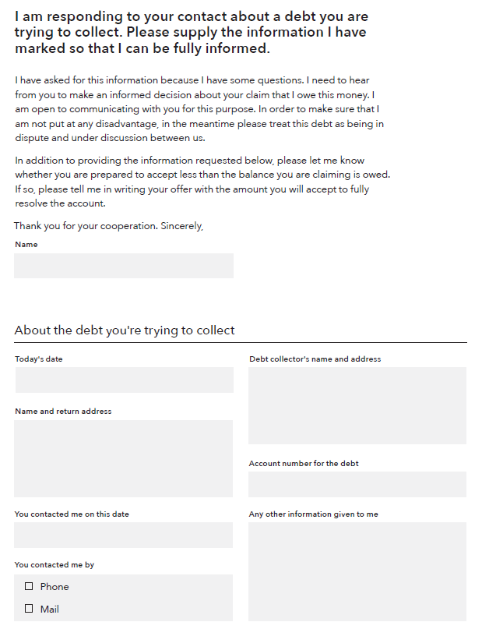
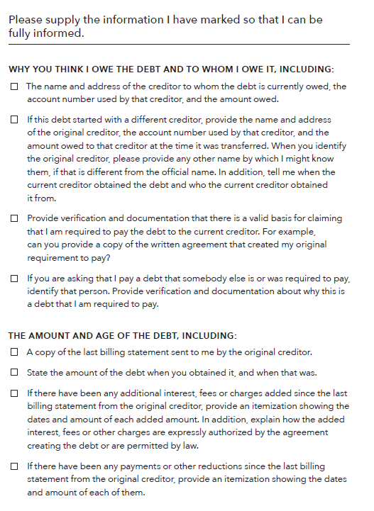
Verify the debt
Notes:
Module 6: Dealing with Debt
Methodology: Presentation
Corresponding section of the toolkit: The “When debt collectors call” too in Module 6, pages 142-148
Instructions for facilitator:
Review the debt verification letter template and the dispute letter template.
FACILITATION TIP: Save a copy of this tool to your desktop before the training or find it online if you have an internet connection at your training site. Show the tool fillable fields.
Explain why it is important to ask for more information:
If you have questions about the debt, ask the debt collection agency for specific information before you send money or acknowledge the debt. You can do this by sending a “verification letter,” asking the debt collector to provide you with certain information regarding the debt. The letter you receive from the debt collector should contain a notice about your right to request more information about the debt.
Send this letter as soon as you can.
If you ask in writing before 30 days have passed, a debt collector has certain legal responsibilities to give you some information.
If the debt is not legitimate (if it's not yours or you already paid it), don't delay in disputing it.
Use the second letter template to send the debt collector a letter disputing the debt immediately. You may lose your ability to dispute the debt if you wait.

Slide 103
Know your rights
The Fair Debt Collection Practices Act protects consumers from harassment:
Repeated phone calls intended to annoy, abuse, or harass
Obscene or profane language
Threats of violence or harm
Publishing lists of people who refuse to pay their debts
Calling you without telling you who they are
Using false, deceptive, or misleading practices
Notes:
Module 6: Dealing with Debt
Methodology: Presentation
Corresponding section of the toolkit: The “When debt collectors call” too in Module 6, pages 142-148
Instructions for facilitator:
Explain highlights of the Fair Debt Collection Practices Act.
The Fair Debt Collection Practices Act (FDCPA) says what debt collectors can and cannot do.
Under this law, a debt collector generally is a person or company that regularly collects debts owed to others, usually when those debts are past-due. These are often called “third party debt collectors.”
This law does not apply to individual or companies trying to collect their own debts.
The law states that debt collectors may not harass, oppress, or abuse you or any other people they contact. Some examples of harassment are:
Repeated phone calls that are intended to annoy, abuse, or harass you or any person answering the phone
Obscene or profane language
Threats of violence or harm
Publishing lists of people who refuse to pay their debts (this does not include reporting information to a credit reporting company)
Calling you without telling you who they are
The law also says debt collectors cannot use false, deceptive, or misleading practices. This includes misrepresentations about:
The debt, including the amount owed
That the person on the phone is an attorney (unless they are an attorney)
Threats to have you arrested
Threats to do things that cannot legally be done
Threats to do things that the debt collector has no intention of doing
Keep a file of all letters or documents a debt collector sends you and copies of anything you send to a debt collector.
Write down dates and times of conversations along with notes about what you discussed. These records can help you if you have a dispute with a debt collector, meet with a lawyer, or go to court.
ASK: When could you see using this tool? What obstacles do you anticipate in using this information?
We use “companies” in YMYG instead of businesses.

Slide 104
Module 6: Opportunities for financial empowerment
If you have a 10 minute session…
  Review "When debt collectors call" if you’re having a problem with debt collection to prepare yourself the next time a debt collector contacts you
  Review the "Avoiding medical debt" handout if you’re dealing with high medical bills to learn about ways to handle medical debt
If you have a 30 minute session…
  Complete the "Debt log” to gain an understanding of all the debt you owe
  Use the “Debt-to-income calculator” to discover how much stress debt is putting on your budget
If you have multiple sessions…
  Fill out the "Debt action plan” to find a strategy for paying down your debt that works for you
  Bring "Comparing auto loans” with you when you shop for an auto loan to help find the best deal
  Use "Repaying student loans” to understand what repayment plans are available to you
Notes:
Module 6: Dealing with Debt
Methodology: Presentation and Discussion
Corresponding section of the toolkit: Module 6, page 123
Instructions for facilitator:
Highlight opportunities for introducing financial empowerment depending on the amount of time available:
If you have time during the training:
ASK: What other ways could you introduce the financial empowerment tools from this module in your work?
WRAP UP
After lack of income, debt is likely to be the most common concern the people you serve share.
Understanding what debt is, how to manage debt, and how to reduce it not only improves individual and family financial stability (less income is being eaten up by debt every month), but also reduces stress.
Understanding rights around debt collection and dealing with special debts like medical debt and student loans is also important.
As with reaching a goal, however, getting out of debt takes time and commitment.
The people you serve often have many things going on in their lives, so if this is their biggest concern, focusing on this area can make a big difference in their lives.
Dealing with debt today gives people more options tomorrow.

Slide 105
Your Money, Your Goals
Module 7: Understanding Credit Reports and Scores

Slide 106
What is credit?
Credit is the ability to borrow money and repay it later.
Debt is the money that you have to repay when you’ve used credit.
You can have credit available to use without having debt.
Notes:
Module 7: Understanding Credit Reports and Scores
Methodology: Facilitated Discussion and Presentation
Corresponding Section in toolkit: Module 7, pages 151-152
Instructions for facilitator:
ASK: What is credit?
After people share their ideas, put up the bullets on this slide and review this example:
You may have a credit card that is paid off—meaning you have credit available to use but don’t owe any debt.

Slide 107
What is credit?
Use of credit
Creates credit history
Compiled into credit reports
Used to calculate credit scores
Notes:
Module 7: Understanding Credit Reports and Scores
Methodology: Presentation
Corresponding Section in toolkit: Module 7, page 152
Instructions for facilitator:
Explain the following:
When you take out a credit card or other loan, you create (or add to) your credit history. Sometimes when people talk about their financial situation, they say they have “good credit” or “bad credit.” This usually refers to their credit history.
Credit reporting companies gather information from your credit history into a credit report. A credit report may show some of your bill payment history, along with some public record information and a record of how often you have applied for credit.
A credit report may also show how much available credit you have, how much of your available credit you’re using, whether you have made your payments on time, and whether debt collectors have reported that they’re attempting to collect debt that you owe.
The information in your credit report is used to create credit scores. Many lenders use credit scores to decide how much money they can lend you and how much interest to charge. In general, the higher your credit score, the better the loan terms may be.

Slide 108
Why do credit reports and scores matter?
A poor credit history can make it difficult for you to:
Get a job
Get and keep a security clearance for a job, including a military position
Get an apartment
Get insurance coverage
Pay lower deposits on utilities and get better terms on cell phone plans
Get a credit card
Improve your credit score
Notes:
Module 7: Understanding Credit Reports and Scores
Methodology: Facilitated Discussion and Presentation
Corresponding Section in toolkit: Module 7, pages 152-153
Instructions for facilitator:
Review the reasons credit reports and scores are important:
Explain that some people say credit reports and scores don’t matter to them because they never plan to get a loan. But the information in your credit report is also used to make a lot of other decisions about you.
A poor credit history can make it difficult for you to:
Get a job. A potential employer may use your reports to determine whether you will get a job.
Get and keep a security clearance for a job, including a military position.
Get an apartment. A landlord may use your reports or scores to determine whether to rent an apartment to you.
Get insurance coverage. An insurance company may use your reports or scores to determine whether to give you insurance coverage and the rates you will pay for coverage. This depends on the state you live in.
Pay lower deposits on utilities and get better terms on cell phone plans. Service providers, like cell phone companies and utility companies, may use them to screen you for deposit levels and cost of service.
Get a credit card.
Improve your credit scores. The information used to calculate your scores comes from your credit history.
If any of these things are important to you, improving your credit history can help you get them.
Having a positive credit history and good credit scores can open doors for you.
Having a poor credit history or low credit scores can create obstacles for you, such as costing you more money in terms of the price you will pay for loans, credit cards, and other services.

Slide 109
What’s in a credit report?
Header/identifying information
Public record information
Collection agency account information
Account information
Inquiries made to your account
Notes:
Module 7: Understanding Credit Reports and Scores
Methodology: Presentation
Corresponding section of the toolkit: Module 7, pages 154-162
Instructions for facilitator:
Explain that credit reports are divided into sections:
Header/identifying information
Includes:
Name
Current address
Social Security number
Date and place of birth
Employment history (this may not include all past jobs, but what's listed should be accurate)
Does not include: Information such as race or ethnicity
Public record information
Includes: Financial public records such as consumer bankruptcies, judgments, state and federal tax liens.
Does not include:
Records of arrests or convictions (specialty consumer reports, such as employment background screenings, often include arrests and convictions)
Marriage records or adoptions
Civil suits that haven't resulted in judgments
The three nationwide credit reporting companies are required to ensure that new and existing public record information that they use comes from sources that include specific information about you. This includes your name, address, and either your Social Security number or date of birth. This is to help keep the information accurate. The credit reporting companies update this every 90 days.
Collection agency account information
Includes:
Any accounts with a collection agency
The status of those accounts (both past and present)
Credit account information
Includes:
Open accounts you currently have and closed accounts you had before
Company name and account number
Date opened
Last activity
Type of account and status
Whether you’re a co-signer, authorized user, or guarantor
Date closed, if the account is no longer open
Credit limit
The date information was reported to the credit reporting companies
Amount currently owed and, if you’re late with payments, the balance due (known as “items as of date”)
Whether you owe a past due amount and the number of payments 30, 60, and 90 days late
Whether the account was charged off or deemed so delinquent that the creditor thinks it’s unlikely they’ll be able to collect the debt
Some accounts may not be listed, especially older accounts or those you have closed, of accounts for which information was not provided to that specific credit reporting company. So there may be inconsistencies across credit reporting companies in the contents of this section. It is important to make sure that the accounts listed do, or did at one time, belong to you.
Inquiries made to your account
Includes:
Hard inquiries are made by lenders after you apply for credit. These inquiries may affect your credit score. This is because most credit scoring models look at how recently and frequently you apply for credit.
Soft inquiries are reviews of your credit file when you have not sought to establish a new credit account. They include reviews of existing accounts by lenders, prescreening inquiries by prospective lenders, and your requests for your annual credit report. These won’t affect your credit score.

Slide 110
Negative information
Negative information can appear on your credit report for a specified period of time—seven years for most items.
Bankruptcy can stay on your credit report for up to 10 years.
Civil suits and judgments can be reported on your credit report for seven years or until the statute of limitations has expired, whichever is longer.
There is no time limit to the length of time that positive information can stay on your credit report.
Notes:
Module 7: Understanding Credit Reports and Scores
Methodology: Presentation
Corresponding section of the toolkit: Module 7, page 154
Instructions for facilitator:
Review how long negative information can be reported to someone who requests (because they are legally able to) someone’s credit report.

Slide 111
Negative information
Most consumer reporting companies are allowed to keep negative information about you in their files forever. They do this because there is no time limit on information (positive or negative) that a consumer reporting company may include in your credit report when you are applying for:
  Credit of $150,000 or more
  Life insurance with a face value of $150,000 or more
  A job with an annual salary of $75,000 or more
Notes:
Module 7: Understanding Credit Reports and Scores
Methodology: Presentation
Corresponding section of the toolkit: Module 7, page 154
Instructions for facilitator:
Review how long negative information can be reported to someone who requests (because they are legally able to) someone’s credit report.

Slide 112
Reading a credit report
Who does this credit report belong to?
Where does he live?
Where does he work? When did he start working there?
Does he have public records? If yes, describe it (them).
Is he late on any of his accounts? If yes, describe.
Are any of his accounts in good standing? If yes, describe.
What are the balances of his accounts in the account information section?
Does he have accounts in collection? What is the balance owed in collections?
What do his inquiries tell you?
What is your opinion of this person’s credit history. Is it positive or negative?
Notes:
ACTIVITY - Module 7: Understanding Credit Reports and Scores
Methodology: Exercise in Groups of Three
Corresponding section of the toolkit: Example credit report in Module 7, pages 155-160
Instructions for facilitator:
Instruct participants to get into groups of 3.
Instruct them to answer the questions on the slide using the example credit report in the toolkit.
Explain that the credit report is an example and is not based solely on any one of the formats used by the three major credit reporting companies.
After 7 – 10 minutes, solicit answers from participants.
Who does this credit report belong to? Miguel Simon Smith
Where does this person live? 457 First Street, Littleton, MI 09876
Where does he work? When did he start working there? Riviera Restaurants; hired in November of 2010
Does he have public records? If yes, describe it (them). Yes. Chapter 7 Bankruptcy and Civil Judgment
Is he late on any of his accounts? If yes, describe. Yes. He is 30 days late on his auto loan with Littletown Community Bank
Are any of his accounts in good standing? If yes, describe. Yes. His credit card payment.
What are the balances of his accounts in the account information section? Auto loan balance is $14,285; Credit card balance is $4,252
Does he have accounts in collection? What is the balance owed in collection? Yes. $2,500.
What do his inquiries tell you? He explored an auto loan and likely a store credit/debit card.
What is your opinion of this person’s credit history? Is it positive or negative?
FACILITAITON TIP: If time allows, cover some of the key terms used in credit reporting found in the toolkit immediately following the credit report example.
Ask participants if they know the definition before providing the explanation. Focus specifically on:
Authorized User
Delinquent
Default
Charge Off
Discharge
Refer participants to the list of definitions for common terms found in credit reports, on pages 161-162 of the toolkit.

Slide 113
Nationwide credit reporting companies
Equifax
Experian
TransUnion
You can get a free credit report from each of the three nationwide credit reporting companies once every 12 months at www.annualcreditreport.com
Notes:
Module 7: Understanding Credit Reports and Scores
Methodology: Presentation
Corresponding section of the toolkit: Module 7, page 153
Instructions for facilitator:
Review the three largest companies that create credit reports.
Underscore www.annualcreditreport.com and inform people to be aware of imposter websites.
Credit reporting companies collect information about you from many sources, including “furnishers.” Furnishers are people or companies that provide information about your credit, banking, payment history, and other behavior.

Slide 114
Credit reports for minors
If you’re under 18, you won’t have a credit report unless you:
Are an authorized user or joint owner on an account
Are an emancipated minor
Live in a state that allows you to enter contracts below the age of 18 and you’ve done so
Have student loans
Notes:
Module 7: Understanding Credit Reports and Scores
Methodology: Presentation
Corresponding section of the toolkit: Module 7, page 163
Instructions for facilitator:
If none of these apply to you and you have a credit report earlier than age 18, you may have been the victim of identity theft or credit or financial fraud.
Equifax allows the parent or legal guardian to order a minor’s credit report by calling (877) 784-2528.
Experian allows minors age 14 and older (or their guardians) to obtain their own credit report by mail or by calling (800) 311-4769.
Parents or guardians of minors 13 years or under may request a minor’s credit report by mailing or electronically uploading a request form and supporting documents to Experian. Forms and instructions are available at www.experian.com.
TransUnion allows a parent or legal guardian to order a minor’s credit report. A report is only available if the minor has a legitimate credit history (they are the joint owner or an authorized user on an account). You can send an email to childidtheft@transunion.com to see if a credit file exists. Or you can go to transunion.com and complete the Child Identity Theft Inquiry Form.
Read more about credit reports for minors at www.consumerfinance.gov/askcfpb/1271.
If you work with youth in foster care, there are special rules set up for how to get their credit reports. Learn more at www.consumerfinance.gov/ask-cfpb/search-by-tag/foster_youth.

Slide 115
What are credit scores?
Credit scores are calculated using the information in credit reports.
A higher score makes it easier to qualify for a loan or lower interest rates.
You have many credit scores
Notes:
Module 7: Understanding Credit Reports and Scores
Methodology: Presentation
Corresponding section of the toolkit: Module 7, page 164
Instructions for facilitator:
Explain:
Credit scores vary because different companies may look at different information about you and use different formulas for calculating your scores. Scoring companies may also create different credit scores that are used when you apply for different types of credit.
As a result, you have more than one credit score. Banks, credit card companies, and lenders may use different credit scores to make decisions about offering you credit.

Slide 116
Credit scores: Example based on FICO
Notes:
Module 7: Understanding Credit Reports and Scores
Methodology: Presentation
Corresponding section of the toolkit: Module 7, 165-166
Instructions for facilitator:
Explain:
Credit scores are calculated based on the information in your credit report.
Even though different credit scores have different mathematical formulas, they all use the information from your credit report.
While some pieces of information in your credit reports may be more important or less important, depending on which company is calculating your score, the key is to understand the information in your credit reports
Review the categories of information that influence a FICO score:
Payment history tracks whether you’re paying your bills on time. This is the biggest factor in your FICO scores. Paying bills late, not paying bills at all, and having bills that go to collections will likely cause your scores to drop. Paying your bills on time may help increase your scores.
Amounts owed tracks what you owe, including debts that you are paying down over time. It also includes your credit utilization rate, which is how much of your available credit you’re using. When the credit that’s available to you decreases because you’ve used a portion of it and now owe money, your scores may drop.
Length of credit history tracks how long you’ve had credit accounts—the longer the history, the more positive affect on your scores. A long credit history provides strong evidence of how you use credit and patterns of your payment behavior.
Types of credit used are also considered. For example, your FICO scores may increase if you have both revolving credit (such as credit cards) and other types of credit, such as a mortgage or an auto loan that you repay in installments, in good standing. Generally, it’s considered a good thing to have a mix of credit, such as a mortgage, an auto loan, and not too many credit cards.
New credit is tracked by measuring credit inquiries about you made by creditors and others. If there are too many inquiries, it may signal that you have a high demand for credit. Because this may be an indicator of risk, your scores may drop. Your scores are not affected at all when you check your credit reports yourself.

Slide 117
Credit utilization
Calculating your credit utilization rate
$5,000 total available credit
$3,500 charged
Utilization rate: $3,500 (amount charged) ÷ $5,000 (available credit) = 0.7 or 70%
Notes:
Module 7: Understanding Credit Reports and Scores
Methodology: Presentation
Corresponding section of the toolkit: Module 7, pages 167-168
Instructions for facilitator:
Explain:
The amount of credit you’re using compared to the amount you’ve been given is your “credit utilization rate.”
Credit scoring formulas penalize you for using too much of the credit you have available to you.
Many experts advise keeping your use of credit to no more than 30 percent of your total credit limit on your revolving credit accounts (for example, the total limit on all your credit cards combined).
For example:
If someone has one credit card with a $5,000 credit limit, and she has charged $3,500 on this card, her credit utilization rate is calculated as follows:
$3,500 (amount charged to credit card) divided by $5,000 (credit limit) = 0.7 or 70%
To figure out the maximum that she should charge on this card if she sets a goal of a 30% utilization rate, she should not charge more than:
$5,000 (the credit limit) multiplied by 0.3 (30%) = $1,500

Slide 118
Tool: Requesting your free credit reports
Pick a method to order your credit reports
  Online
  Phone
  Mail
Decide when you’ll order each report
If you get a report from a different credit reporting company every four months, you can monitor your credit for free
Notes:
Module 7: Understanding Credit Reports and Scores
Methodology: Presentation
Corresponding section of the toolkit: The “Requesting your free credit reports” tool in Module 7, pages 170-171
Instructions for facilitator:
Review the following information:
You are entitled to one free credit report every 12 months from each of the three nationwide credit reporting companies.
You can get all three reports at the same time
This is good if you're buying something big soon, that requires new credit, so you can correct errors right away.
Or you can get a report from one of the three credit reporting companies every four months.
Staggering them can help you see if anything is changing throughout the year or if any fraud has occurred.
Explain the other times you can get an additional free report. IF:
You’re unemployed and plan to look for a job in the next 60 days
You receive public assistance
You believe that your credit file is inaccurate due to fraud
Your report has recently been changed due to a disputed error
You had a consumer reporting company place an initial fraud alert on your credit file
You had a consumer reporting company place an extended fraud alert on your credit file
You’ve been denied things like credit, employment, or insurance because of information in your credit report—in this case, you have 60 days to request your report from when you get the notice
BUT, you must request these reports. They don’t just show up for you.

Slide 119
Tool: Requesting your free credit reports
To order through the website, visit: www.annualcreditreport.com
  Complete a form with basic information (name, Social Security number, address, etc.).
  Select the report(s) you want—Equifax, Experian, and/or TransUnion.
  Answer security questions: former addresses, amount of a loan you have, phone numbers that have belonged to you, counties you may have lived in, etc.
    If you are unable to answer these questions, you will have to use another method.
Save a PDF version of your report, print the report, or both.
Be sure you do this in a safe and secure location. Avoid doing this on public computers (library).
Notes:
Module 7: Understanding Credit Reports and Scores
Methodology: Presentation
Corresponding section of the toolkit: The “Requesting your free credit reports” tool in Module 7, pages 170-171
Instructions for facilitator:
Explain how to order credit reports online from www.AnnualCreditReport.com.
Explain alternative methods for getting a report from AnnualCreditReport.com in case the online report cannot be accessed (security questions are answered wrong or cannot be answered if generated by fraudulent information on the report).
Point out the phone number to call and instructions for downloading a paper form and mailing it in on page 171 of the toolkit
If you are under 18, you should not have a credit report unless:
You are an authorized user or joint owner on an account
You are an emancipated minor
Your state law allows you to enter contracts below the age of 18, and you have done so
You have student loans
You have been the victim of identity theft or credit or financial fraud

Slide 120
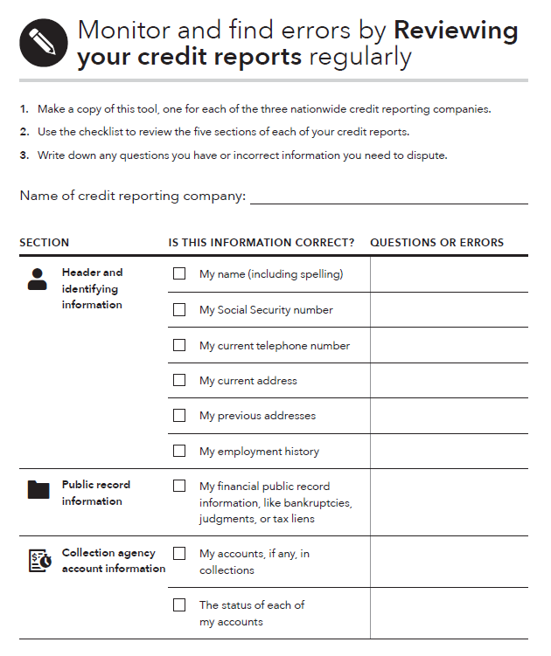
Tool: Reviewing your credit reports
What to do:
Start by getting free copies of your credit reports. Use the “Requesting your free credit reports” tool to find out how.
Read through each credit report carefully, using the checklist as a guide for what errors to look for.
Notes:
Module 7: Understanding Credit Reports and Scores
Methodology: Presentation
Corresponding section of the toolkit: The “Reviewing your credit reports” tool in Module 7, pages 172-174
Instructions for facilitator:
Review this information:
Errors on your credit reports can negatively affect your credit scores and ability to get a loan. Reviewing your reports on a regular basis can also help you monitor for things like identity theft and fraud.
Sometimes your information isn’t reported to all three nationwide credit reporting companies. As a result, some things may not be listed on all three reports, especially information about older accounts, accounts you’ve closed, or some of your older jobs or addresses.
This can cause inconsistencies among your credit reports. It’s most important to make sure that the information that is listed on each report is correct.

Slide 121
Handout: Disputing errors on your credit reports
To correct errors, it can help to contact both the credit reporting company and the source of the mistake.
You may file your dispute online, by phone, or by mail.
Explain the error and what you want changed.
  Clearly identify each mistake separately, state the facts, explain why you are disputing the information, and request that it be removed or corrected.
If you mail your dispute letter, send it by certified mail, return receipt requested.
Enclose a copy of the portion of your report that contains the disputed items and circle or highlight the disputed items.
Notes:
Module 7: Understanding Credit Reports and Scores
Methodology: Presentation
Corresponding section of the toolkit: The “Disputing errors on your credit reports” handout in Module 7, pages 175-178
Instructions for facilitator:
Highlight the dispute letter template on pages 177-178 of the toolkit. Demonstrate that you can fill it out on the computer.
Some of the credit reporting companies provide a dispute form you can use. You’ll also want to send a letter explaining the mistake(s).
Make sure you also include copies of all of your supporting documentation. Keep your originals.
Point out the URLs, phone numbers, and mailing addresses for filing disputes at the three nationwide credit reporting companies, on page 176 of the toolkit.

Slide 122
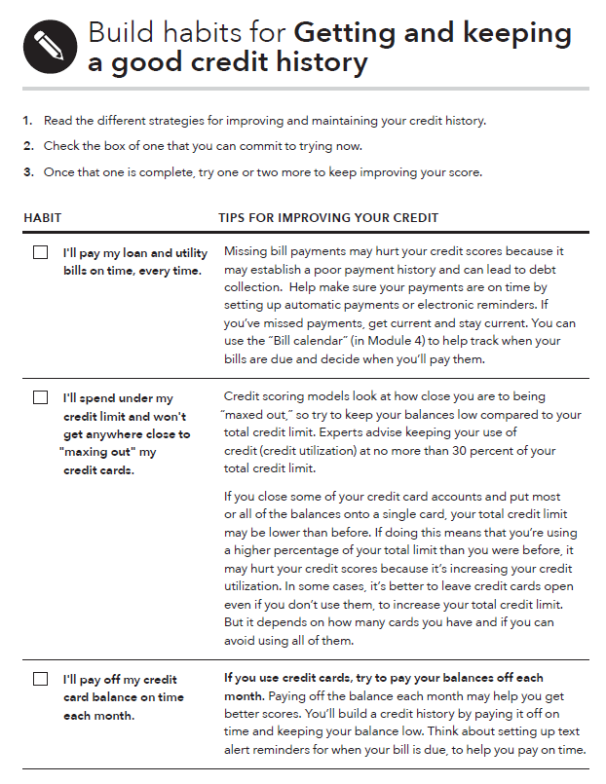
Tool: Getting and keeping a good credit history
What to do:
Identify a strategy for improving and maintaining your credit history that works for you.
Implement that strategy and monitor how your credit score improves.
Once you’re done with your first strategy, pick a new one and keep practicing good habits to maintain a strong credit history
Notes:
Module 7: Understanding Credit Reports and Scores
Methodology: Presentation
Corresponding section of the toolkit: The “Getting and keeping a good credit history” tool in Module 7, pages 179-181
Instructions for facilitator:
Go through each habit in the tool.
Ask participants if they have any tips to add.

Slide 123
Module 7: Opportunities for financial empowerment
If you have a 10-minute session…
  Complete “Requesting your free credit reports” to plan when you’re going to order your free annual credit reports
If you have a 30-minute session…
  Complete “Reviewing your credit reports” to make sure all the information in them is correct and up to date
  Review the “Disputing errors on your credit reports” handout to learn how you can dispute mistakes on your reports
If you have multiple sessions…
  Complete all three items described above to make sure the information on your credit reports is correct
  Use “Getting and keeping a good credit history” to pick strategies you can implement to improve your credit scores
Notes:
Module 7: Understanding Credit Reports and Scores
Methodology: Presentation
Corresponding section of the toolkit: Module 7, page 169
Instructions for facilitator:
Highlight opportunities for introducing financial empowerment depending on the amount of time available:
If you have time during the training:
ASK: What other ways could you introduce the financial empowerment tools from this module in your work?
WRAP UP:
Taking care of your credit history is important. Why?
Because credit reports and scores are not only used to determine whether you will get a loan or credit card.
This information can be used to determine access to and costs of other services like utilities, insurance and cell phones, ability to rent apartments, and employment.
While there are laws ensuring the information that is reported about you is fair and accurate, it is your responsibility to ensure the information is accurate.
The best way to do this is to regularly review your credit reports—at least one time per year. Use these tools to get, review, and then improve your credit reports and scores.

Slide 124
Your Money, Your Goals
Module 8: Choosing Financial Products and Services
Notes:
Module 7: Understanding Credit Reports and Scores
Estimated time: 45 minutes
Methodology: Facilitated Discussion / Exercise in Groups of Three / Presentation / Large Group Brainstorming
Corresponding Section in toolkit: Module 7, pages 151-181

Slide 125
Financial service providers
Bank or credit union
Car dealer
Check cashing store
Credit card company
Department store
Employer (working with a financial institution)
Grocery, retail, or other store
Large gas station chain
Large retail store
Non-profit organization
Online lender
Pawn shop
Payday loan provider
Prepaid card
Title loan company
U.S. Postal Service
Notes:
Module 8: Choosing Financial Products and Services
Methodology: Facilitated Discussion
Corresponding section of the toolkit: The “Finding financial products and services” tool in Module 8, pages 192-203
Instructions for Facilitator:
BEFORE THE TRAINING: Prepare a flip chart in the room. Do not reveal this slide.
Ask participants who provides financial services and products. Write their suggestions on a flip chart.
Then reveal the ideas listed on slide above.
Explain that financial services and products are provided by more than just banks.
Point out that before you can choose what kind of financial product or service to get or where to get it, it is important to think about what your goals and needs are.

Slide 126
Tool: Finding financial products and services
With your partner:
  Define the product or service.
  Explain how the product or service works.
  Brainstorm all of the places you can get this product or service.
  Brainstorm when you would use this product or service to manage your finances.
Be prepared to present your product or service and your work to the rest of the group.
Notes:
ACTIVITY - Module 8: Choosing Financial Products and Services
Methodology: Individual Activity and Facilitated Discussion
Corresponding section of the toolkit: The “Finding financial products and services” tool in Module 8, pages 192-203
Instructions for facilitator:
Get participants into groups of 2.
Distribute financial product/service cards to each pair. You will likely have cards left over. That’s okay.
FACILITATION TIP: The next 19 slides are the cards. Print these prior to the training. If you have a small group, you may want to give two cards to each pair.
Instruct participants in groups of 2 to:
Define the product or service.
Explain how the product or service works
Brainstorm all of the places you can get this product or service.
Brainstorm when you would use this product or service to manage your finances.
Instruct participants to use the material from pages 195-203 of the “Finding financial products and services” tool and their own experiences to complete description.
After 6 – 8 minutes, ask each group to present their product/service to the rest of the larger group.
Add to group presentations as appropriate.
Ask participants to share any questions or experiences they may have about these products or services or others in the tool that were not covered.

Slide 127
529 Plan
Definition
How it works
Where you can get this product/service
When would you use this product/service
Notes:
PRINT PRIOR TO TRAINING.
PRINT ONE COPY FOR EVERY TWO PARTICIPANTS.
DO NOT DISPLAY THESE SLIDES IN YOUR PRESENTATION.

Slide 128
Auto loan
Definition
How it works
Where you can get this product/service
When would you use this product/service
Notes:
PRINT PRIOR TO TRAINING.
PRINT ONE COPY FOR EVERY TWO PARTICIPANTS.
DO NOT DISPLAY THESE SLIDES IN YOUR PRESENTATION.

Slide 129
Auto title loan
Definition
How it works
Where you can get this product/service
When would you use this product/service
Notes:
PRINT PRIOR TO TRAINING.
PRINT ONE COPY FOR EVERY TWO PARTICIPANTS.
DO NOT DISPLAY THESE SLIDES IN YOUR PRESENTATION.

Slide 130
Bill payment services
Definition
How it works
Where you can get this product/service
When would you use this product/service
Notes:
PRINT PRIOR TO TRAINING.
PRINT ONE COPY FOR EVERY TWO PARTICIPANTS.
DO NOT DISPLAY THESE SLIDES IN YOUR PRESENTATION.

Slide 131
Certificates of Deposit (CD)
Definition
How it works
Where you can get this product/service
When would you use this product/service
Notes:
PRINT PRIOR TO TRAINING.
PRINT ONE COPY FOR EVERY TWO PARTICIPANTS.
DO NOT DISPLAY THESE SLIDES IN YOUR PRESENTATION.

Slide 132
Check cashing service
Definition
How it works
Where you can get this product/service
When would you use this product/service
Notes:
PRINT PRIOR TO TRAINING.
PRINT ONE COPY FOR EVERY TWO PARTICIPANTS.
DO NOT DISPLAY THESE SLIDES IN YOUR PRESENTATION.

Slide 133
Checking account
Definition
How it works
Where you can get this product/service
When would you use this product/service
Notes:
PRINT PRIOR TO TRAINING.
PRINT ONE COPY FOR EVERY TWO PARTICIPANTS.
DO NOT DISPLAY THESE SLIDES IN YOUR PRESENTATION.

Slide 134
Credit builder loan
Definition
How it works
Where you can get this product/service
When would you use this product/service
Notes:
PRINT PRIOR TO TRAINING.
PRINT ONE COPY FOR EVERY TWO PARTICIPANTS.
DO NOT DISPLAY THESE SLIDES IN YOUR PRESENTATION.

Slide 135
Credit card
Definition
How it works
Where you can get this product/service
When would you use this product/service
Notes:
PRINT PRIOR TO TRAINING.
PRINT ONE COPY FOR EVERY TWO PARTICIPANTS.
DO NOT DISPLAY THESE SLIDES IN YOUR PRESENTATION.

Slide 136
Money order
Definition
How it works
Where you can get this product/service
When would you use this product/service
Notes:
PRINT PRIOR TO TRAINING.
PRINT ONE COPY FOR EVERY TWO PARTICIPANTS.
DO NOT DISPLAY THESE SLIDES IN YOUR PRESENTATION.

Slide 137
Money or wire transfer service
Definition
How it works
Where you can get this product/service
When would you use this product/service
Notes:
PRINT PRIOR TO TRAINING.
PRINT ONE COPY FOR EVERY TWO PARTICIPANTS.
DO NOT DISPLAY THESE SLIDES IN YOUR PRESENTATION.

Slide 138
Mortgage
Definition
How it works
Where you can get this product/service
When would you use this product/service
Notes:
PRINT PRIOR TO TRAINING.
PRINT ONE COPY FOR EVERY TWO PARTICIPANTS.
DO NOT DISPLAY THESE SLIDES IN YOUR PRESENTATION.

Slide 139
Pawn loan
Definition
How it works
Where you can get this product/service
When would you use this product/service
Notes:
PRINT PRIOR TO TRAINING.
PRINT ONE COPY FOR EVERY TWO PARTICIPANTS.
DO NOT DISPLAY THESE SLIDES IN YOUR PRESENTATION.

Slide 140
Payday loan
Definition
How it works
Where you can get this product/service
When would you use this product/service
Notes:
PRINT PRIOR TO TRAINING.
PRINT ONE COPY FOR EVERY TWO PARTICIPANTS.
DO NOT DISPLAY THESE SLIDES IN YOUR PRESENTATION.

Slide 141
Payroll card
Definition
How it works
Where you can get this product/service
When would you use this product/service
Notes:
PRINT PRIOR TO TRAINING.
PRINT ONE COPY FOR EVERY TWO PARTICIPANTS.
DO NOT DISPLAY THESE SLIDES IN YOUR PRESENTATION.

Slide 142
Peer-to-peer transfer service
Definition
How it works
Where you can get this product/service
When would you use this product/service
Notes:
PRINT PRIOR TO TRAINING.
PRINT ONE COPY FOR EVERY TWO PARTICIPANTS.
DO NOT DISPLAY THESE SLIDES IN YOUR PRESENTATION.

Slide 143
Prepaid card
Definition
How it works
Where you can get this product/service
When would you use this product/service
Notes:
PRINT PRIOR TO TRAINING.
PRINT ONE COPY FOR EVERY TWO PARTICIPANTS.
DO NOT DISPLAY THESE SLIDES IN YOUR PRESENTATION.

Slide 144
Savings account
Definition
How it works
Where you can get this product/service
When would you use this product/service
Notes:
PRINT PRIOR TO TRAINING.
PRINT ONE COPY FOR EVERY TWO PARTICIPANTS.
DO NOT DISPLAY THESE SLIDES IN YOUR PRESENTATION.

Slide 145
Secured credit card
Definition
How it works
Where you can get this product/service
When would you use this product/service
Notes:
PRINT PRIOR TO TRAINING.
PRINT ONE COPY FOR EVERY TWO PARTICIPANTS.
DO NOT DISPLAY THESE SLIDES IN YOUR PRESENTATION.

Slide 146
Tool: Comparing financial service providers
Shop around when deciding on a financial service provider
Ask questions about:
  Fees and other costs
  Services offered
  Security
  Convenience
  Access
Notes:
Module 8: Choosing Financial Products and Services
Methodology: Presentation
Corresponding section of the toolkit: The “Comparing financial service providers” tool in Module 8, pages 204-211
Instructions for facilitator:
Review the following information:
The financial marketplace is very competitive.
Once you’ve decided what kind of financial product or service you need, you’ll likely have to choose between different companies that provide it.
When possible, talk to more than one provider and shop around until you find the one that best meets your needs.
Getting answers to common questions about things like fees, services, and convenience from several companies can help you choose the best option for you.
FACILITATION TIP: Save this tool to your computer before the training or, if you have an internet connection during the training, pull it up from the Bureau’s website. Scroll through the tool and review some of the questions people can ask when comparing financial service providers.

Slide 147
Tool: Opening a checking or savings account
Gather your documents
  Picture ID
  Second form of ID (Social Security card, birth certificate, or bill with name and address)
  Social Security number or ITIN for interest-bearing accounts
Bring the required amount of money to open the account
Get all the facts
Notes:
Module 8: Choosing Financial Products and Services
Methodology: Presentation / Facilitated Discussion
Corresponding section of the toolkit: The “Opening a checking or savings account” tool in Module 8, pages 212-214 and Module 8, page 184
Instructions for facilitator:
FACILITAITON TIP: Have a flip chart set up before you start this portion of your presentation.
Review the identification documents needed to open an account:
A picture ID issued by a state, or the U.S. or foreign government (check which foreign IDs your bank or credit union accepts)
One of these second forms of identification:
Social Security card
Birth certificate
Bill with your name and address on it
Your Social Security number or ITIN; if you don't have one, you may be able to open only a no-interest account
Savings accounts generally pay interest, which is considered income. If you earn interest, you may have to pay taxes on it. In order to open an account that pays interest, you must have a Social Security number or an Individual Taxpayer Identification Number (ITIN).
Some banks and credit unions have developed no-interest savings accounts that may fit your needs if you don’t have a Social Security number or ITIN or if your beliefs don’t allow you to receive interest.
Review the difference between opening balance and minimum balance requirement:
Be sure to find out how much you must keep in the account to avoid fees. This is called the “minimum balance requirement.”
A minimum balance requirement may not be the same amount of money you need to open the account.
ASK: What kinds of questions should you ask your bank or credit union before opening an account?
Write suggested questions on flip chart
Then instruct participants to review the list of questions in the tool (on pages 213-214).
Ask participants if they read anything that is missing from your flip chart list.
Add those missing questions to the flip chart.

Slide 148
Barriers to opening an account
You may have negative information in your file if you had a checking or savings account before and you:
Have an unpaid negative balance on that account, such as from an overdraft, which you have not repaid and the account was closed by the bank or credit union
Were suspected of fraud related to a checking or savings account
Had a joint account with someone else who had these types of problems
Notes:
Module 8: Choosing Financial Products and Services
Methodology: Presentation
Corresponding section of the toolkit: Module 8, pages 184-186
Instructions for facilitator:
ASK: Can anyone open an account at a bank or credit union?
After getting some responses from participants, explain that the answer is “not necessarily.” They may not have the money, have negative information in consumer reports, and lack proper identification.
Lack of identification:
If you don’t have a driver’s license, consider applying for a state-issued identification card.
Some banks and credit unions also accept foreign passports and Consular IDs. The Matricula Consular card is an official Mexican government identification document that is available through its consulates in the United States. You may also be able to get a similar ID from other countries, such as Guatemala and Argentina, through their consulates in the United States.
Negative information:
There are three main checking account reporting companies, that collect information about your checking account history:
ChexSystems
Early Warning
TeleCheck
Under federal law, these companies must, among other things, take steps to assure that the information they provide to banks is as accurate as possible.
They can’t include most negative information that’s more than seven years old.
Some banks and credit unions require you to pay these old charges and fees before you’re allowed to open a new checking or savings account, even if those fees are from another institution.
Many banks and credit unions offer checking accounts and prepaid cards that are designed to reduce risks, for both you and the financial institution, by preventing overdrafts and overdraft fees.
You can order copies of your ChexSystems, Early Warning, and TeleCheck reports.
Page 186 of the toolkit has contact information for each of these companies.
If you find mistakes on your reports, you can dispute them by sending a letter describing the mistakes and copies of any supporting documents.
You can download a sample dispute letter at www.consumerfinance.gov/askcfpb/2029.
You may want to consider using certified mail to send a dispute letter.

Slide 149
What is an overdraft?
An overdraft occurs when:
  You don’t have enough money in your account to cover a transaction
AND
  The bank pays for your transaction anyway
If you overdraw your account, you have to pay back those funds.
Notes:
Module 8: Choosing Financial Products and Services
Methodology: Presentation
Corresponding section of the toolkit: Module 8, pages 187
Instructions for facilitator:
Review the following information:
You can overdraw your account through
Checks
ATM transactions
Debit card purchases
Automatic bill payments
Electronic or in-person withdrawals.

Slide 150
Overdraft services
There are two types of overdraft services:
Overdraft protection - When you and your bank or credit union arrange for any overdrafts to be paid from money in your linked savings account
Opt-in service - When a bank or credit union allows you to spend more money than you have in your checking account, but at a cost for each transaction.
  For debit cards and ATM transactions, you have to opt in to this overdraft service
Notes:
Module 8: Choosing Financial Products and Services
Methodology: Presentation
Corresponding section of the toolkit: Module 8, page 187
Instructions for facilitator:
Review the following information:
Overdraft protection
You pay a fee when the money available in your savings account is used to pay an overdraft in your checking account.
The savings account often needs to be at that same bank or credit union.
Opt-in service
If you opt in, the bank may allow you to withdraw more money from an ATM or spend more with your debit card than what you have in your account.
This results in overdraft fees for each transaction you make without enough money in your account, which can happen several times in one day.
These fees are commonly $30-$35 for each transaction.
Some banks and credit unions charge you a separate fee every day that your account stays overdrawn.
If you don’t opt in, your bank or credit union will generally decline your card (without charging a fee) if you attempt to withdraw cash or make a purchase that costs more than what you have in your account.
The opt-in service applies only to one-time debit card and ATM transactions. It doesn’t affect overdrafts caused by checks or online bill payments.
If you’ve opted in to this service, you can opt out.

Slide 151
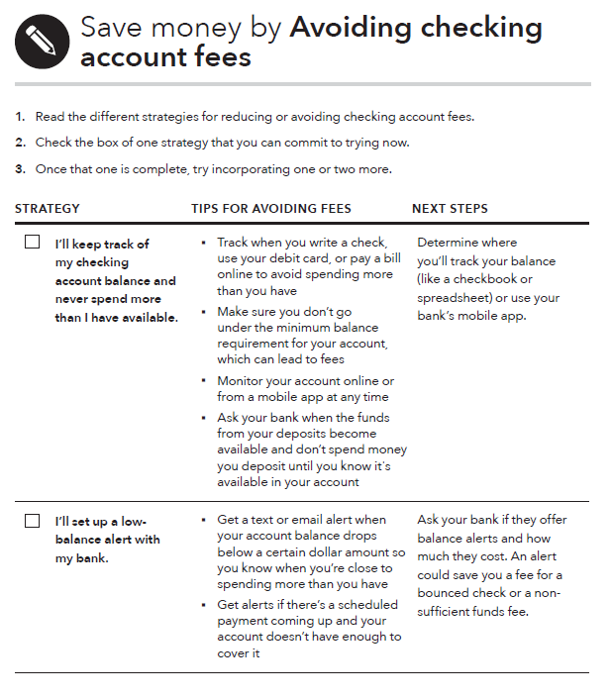
Tool: Avoiding checking account fees
What to do:
Identify a strategy for reducing fees that you want to try.
Implement that strategy.
Once you’re done with the first strategy, pick a new one until you’ve completed them all.
Notes:
Module 8: Choosing Financial Products and Services
Methodology: Facilitated Discussion
Corresponding section of the toolkit: The “Avoiding checking account fees” in Module 8, pages 215-218
Instructions for facilitator:
FACILITATION TIP: Have a flip chart set up before you start this portion of the training.
ASK: What can you do to avoid checking account fees?
Write suggestions/ideas given by participants on a flip chart.
Ask participants to review the list of ideas provided in the “Avoiding checking account fees” tool, on pages 216-218.
Ask participants if they read any ideas that are missing from the flip chart list.
Add those ideas to the flip chart.

Slide 152
Types of prepaid cards
Open-loop prepaid card
Closed-loop prepaid card
Reloadable prepaid card
Payroll card
Government benefits card
Electronic Benefits Transfer (EBT) card

Slide 153
Tool: Evaluating your prepaid or payroll card
Review the definitions of common prepaid card fees so you know what they are
Find the terms and fees for your prepaid or payroll card. These are usually on the back or inside of the card packaging
Get all the facts. Make sure you have all the answers about how the card works and what fees are involved. Consider researching prepaid cards online, so you can read about all the features before you buy it
Notes:
Module 8: Choosing Financial Products and Services
Methodology: Presentation
Corresponding section of the toolkit: The “Evaluating your prepaid or payroll card” tool in Module 8, pages 219-224
Instructions for facilitator:
Review the following information:
Each prepaid and payroll card has its own set of rules and fees.
Before you use your card, it’s important to understand the fees you’ll pay to maintain your account, make purchases, and withdraw money.
After adding up the fees, you can compare cards and also compare the cost of a card to the costs of a bank or credit union account.
Most prepaid cards have their own policies about loss, theft, and errors. Information about these policies can be found in the cardholder agreement.
Most prepaid cards also offer details about terms and fees on their website, so you can look online if you want to compare cards before buying one.
Point out the list of definitions for common prepaid card fees in the “Evaluating your prepaid or payroll card” tool, on page 220.

Slide 154
Handout: Knowing your prepaid card rights
YOU'LL HAVE THE MOST PROTECTION IF YOU REGISTER YOUR PREPAID CARD
Notes:
Module 8: Choosing Financial Products and Services
Methodology: Presentation
Corresponding section of the toolkit: The “Knowing your prepaid card rights” handout in Module 8, page 225
Instructions for facilitator:
Review the following information:
You have protections in case of an unauthorized transaction or other error if:
You are paid through a payroll card arranged by your employer
You receive certain types of government benefits through a government-arranged card, or
You receive any payments from the federal government onto your own prepaid card.
You generally can’t be held responsible for unauthorized charges or other errors on these cards if you report them promptly.
Depending on your card, you may also have some protections in case of an unauthorized transaction or other error in your account. Check your cardholder agreement to find out about your specific card’s terms and conditions.

Slide 155
Handout: Sending money abroad
The federal protections apply to most transfers (including wire transfers) that are:
  More than $15
  Made by a consumer in the United States
  Sent to a person or company in a foreign country
The federal protections don’t apply to transfers sent by companies that consistently provide 100 or fewer money transfers each year.
Notes:
Module 8: Choosing Financial Products and Services
Methodology: Presentation
Corresponding section of the toolkit: The “Sending money abroad” handout in Module 8, pages 226-227
Instructions for facilitator:
Review rights and protections
Before you send money, the provider must generally provide you with information about:
The amount that will be transferred by the provider
Fees and taxes you pay them
The total amount you will pay the provider
The exchange rate
Fees charged by the company’s agents abroad and certain other institutions involved in the transfer process
The amount of money expected to be received (which may not include certain foreign taxes or fees that are charged to the recipient), in the currency in which the money will be received
If appropriate, a statement that additional foreign taxes and fees may be deducted from the transfer amount
After you send money, the provider must generally provide you with a receipt, which includes all of the information just described, as well as:
The date on which the money will be available at its destination
The name (and if you provide it, the telephone number and address) of the recipient
Instructions on your right to cancel transfers
What to do in case of an error
The provider’s name, telephone number(s), and website
Contact information for the state agency that regulates the provider and the Bureau, in case you have questions or a complaint
If you scheduled the transfer at least three business days in advance, or are scheduling a series of transfers, the date on which the provider will make the transfer

Slide 156
Module 8: Opportunities for financial empowerment
If you have a 10-minute session…
  Review the “Knowing your prepaid card rights” handout before you buy or use a prepaid card so you know about your rights and responsibilities
  Review the “Sending money abroad” handout to learn about your rights and responsibilities when sending money to another country
If you have a 30-minute session…
  Use “Finding financial products and services” to find out about products that may meet your needs and learn about how they work and where to get them
  Complete “Opening a checking or savings account” to make sure you have all the documentation and answers you need
  Review “Avoiding checking account fees” to choose strategies you can use to lower or eliminate fees
Notes:
Module 8: Choosing Financial Products and Services
Methodology: Facilitated Discussion
Corresponding section of the toolkit: Module 8, page 191
Instructions for facilitator:
NOTE: Content here is spread across this slide and the next.
Highlight opportunities for introducing financial empowerment depending on the amount of time available:
If you have time during the training:
ASK: What other ways could you introduce the financial empowerment tools from this module in your work?
WRAP UP:
Financial products and services can help you more efficiently and effectively get, manage, and use your money.
Knowing the reasons you may need financial services and matching your needs with the right products and services can ensure you are getting what you need from this complex marketplace.
Learn the basic terms for financial products and services.
If information’s not clear, don’t be afraid to ask questions.
Finally, shop around for financial services.
Look at convenience, cost, and service provided before selecting a product, service or provider.
Be aware of debt traps—products that may not only get you into debt, but keep you there.
With all financial products there are lots of rules.
Do you best to understand the rules so you avoid fees and fines.
Finally, use the Bureau website’s Ask CFPB as a resource to learn more about the financial services industry and the product and services they sell.

Slide 157
Module 8: Opportunities for financial empowerment
If you have multiple sessions…
  Use “Comparing financial service providers” to compare companies that offer the products or services you need and choose the one that’s right for you
  Complete “Evaluating your prepaid or payroll card” to make sure you understand the details and fees associated with using the card
Notes:
Module 8: Choosing Financial Products and Services
Methodology: Facilitated Discussion
Corresponding section of the toolkit: Module 8, page 191
Instructions for facilitator:
Highlight opportunities for introducing financial empowerment depending on the amount of time available:
If you have time during the training:
ASK: What other ways could you introduce the financial empowerment tools from this module in your work?
WRAP UP:
Financial products and services can help you more efficiently and effectively get, manage, and use your money.
Knowing the reasons you may need financial services and matching your needs with the right products and services can ensure you are getting what you need from this complex marketplace.
Learn the basic terms for financial products and services.
If information’s not clear, don’t be afraid to ask questions.
Finally, shop around for financial services.
Look at convenience, cost, and service provided before selecting a product, service or provider.
Be aware of debt traps—products that may not only get you into debt, but keep you there.
With all financial products there are lots of rules.
Do you best to understand the rules so you avoid fees and fines.
Finally, use the Bureau website’s Ask CFPB as a resource to learn more about the financial services industry and the product and services they sell.

Slide 158
Your Money, Your Goals
Module 9: Protecting your Money
Notes:
Module 9: Protecting your Money
Methodology: Presentation and Facilitated Discussion / Skits / Teach back
Corresponding Section in toolkit: Module 9, pages 228-240
Estimated Time: 45 Minutes

Slide 159
Identity theft
What can you do to prevent your identity from being stolen?
How can you tell if your identity has been stolen?
What steps can you take if your identity has been stolen?
What questions do you have about identity theft?
Notes:
ACTIVITY - Module 9: Protecting your Money
Methodology: Carousel
Corresponding section of the toolkit: The “Protecting your identity” handout (pages 234-235) and the “How to handle identity theft” handout (pages 236-237) in Module 9
Instructions for facilitator:
Before this activity, hang up flip charts around the room. Each flip chart should have one of the fours questions on this slide on it.
Get the participants into groups of 4.
Have each group stand by one of the flip charts.
Make sure they take at least one marker with them.
Give them 1 minute to brainstorm responses and write them on the flip chart.
Then instruct them to rotate to the next flip chart going clockwise and ADD to the list.
Have them rotate until they end up at the flip chart at which they started.
Have the group chose someone to present that flip chart to the rest of the group.
As each team presents the flip chart—their ideas and those of other groups—add to them using the information in the “Protecting your identity” and the “How to handle identity theft” handouts.

Slide 160
Handout: How to handle identity theft
CREDIT PROTECTION AND REQUIREMENTS | SECURITY FREEZE | INITIAL ALERT | EXTENDED ALERT
Lender is required to verify your identity before approving new credit |  | X | X
Completely prevents your report from being shared with most third parties unless lifted | X
Triggers heightened verification procedures for the people who use your credit report |  | X | X
Request if you believe you're a victim of ID theft | X | X
Requires an identity theft report |  |  | X
Extra free credit report |  | X | X
Exclusion from prescreening lists |  |  | X
Free in every state | X | X | X
Notes:
Module 9: Protecting your Money
Methodology: Presentation
Corresponding section of the toolkit: The “How to handle identity theft” handout in Module 9, pages 236-237
Instructions for facilitator:
IMPORTANT: Since the toolkit was printed, a new federal law went into effect that changes some of the information on the chart on page 237. Instruct participants to make the following changes on their printed version:
In the second row: Insert “most” before “third parties”.
Cross out the second to last row: “May have to pay to place or lift the protection.” That is no longer the case.
Add a check mark in the Security Freeze column for the very last row: “Free in every state”
NOTE: These updates have already been made in the downloadable version of this handout.
Review primary strategies for dealing with identity theft using the list below and information from the handout, if they did not come up during the previous activity.
Order your credit reports from all three nationwide credit reporting companies
Create an identity theft report through the Federal Trade Commission
Consider a credit protection tool
Review the differences between a security freeze, an initial fraud alert, and an extended fraud alert using the chart in the slide and the following information:
Security freeze – A freeze on your credit report generally helps prevent new credit accounts from being opened in your name. Usually, third-party-access to your credit file is completely blocked from new users without your express authorization
There are several exceptions including for creditors of accounts you already hold, certain government entities like child support agencies, companies you hire for credit monitoring, and lenders making prescreened solicitations for new credit.
A freeze helps prevent identity thieves from opening fraudulent accounts in your name. This also means you won’t be able to apply for credit as easily if you were planning to open a new account or apply for a loan.
You must contact each of the credit reporting companies to freeze your credit report. You will have to contact them to lift the freeze before a third-party can access your credit report.
Initial fraud alert - An initial fraud alert requires creditors to verify your identity before opening a new account, issuing an additional card, or increasing the credit limit on an existing account. This is a good first step if you’re worried that your identity may be stolen, like after a data breach. The alert lasts for one year. After one year the initial fraud alert will expire and be removed but you have the option to place another initial fraud alert at that time.
Extended fraud alert - An extended fraud alert requires creditors to contact you before approving credit and lasts for seven years. It also requires credit reporting companies to remove you from lists prepared for pre-screen offers of credit or insurance for five years. This is available if you've filed an identity theft report with one of the three nationwide credit reporting companies.

Slide 161
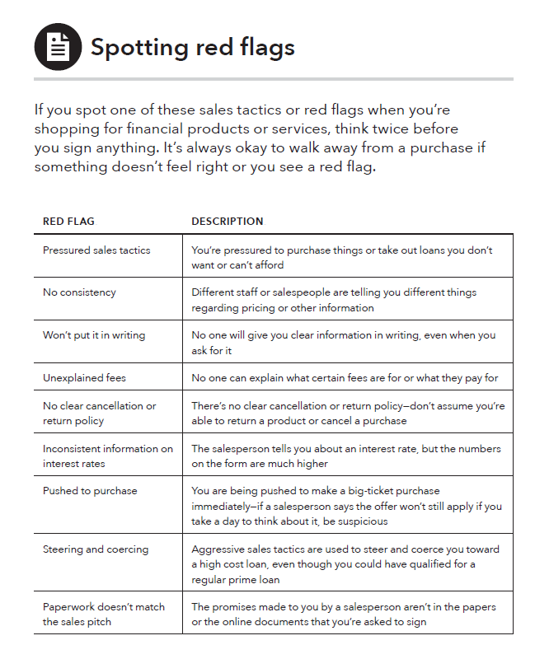
Handout: Spotting red flags
Prepare for skits!
Notes:
ACTIVITY - Module 9: Protecting your Money
Methodology: Skits
Corresponding section of the toolkit: The “Spotting red flags” handout in Module 9, pages 238-239
Instructions for facilitator:
ASK: What is a red flag?
Explain some background information about red flags:
A red flag is something to watch out for.
Sometimes when shopping for or using consumer financial products, you may encounter a red flag.
This does not mean something illegal is going on, but that you should ask more questions and get help to ensure you are not being subjected to something that is not fair or right.
Give teams of 3 or 4 participants red flags to turn into a skit (there are 3 skits on the following three slides, so not everyone will be able to act in a skit).
Explain that they should develop the products/services and use any props they feel may be necessary. Explain that they are to improvise the skit.
Instruct them to try to be specific to their red flag.
Instruct them to develop a short 1 to 3 minute skit that showcases the red flag(s).
Participants will have to guess the red flags using the “Spotting red flags” handout.
Thank skit performers and congratulate those who guess the red flags following each skit.
FACILITATION TIP: Consider organizing skits during breaks to give teams time to think about scenarios for acting out red flags.

Slide 162
Skit 1: Spotting red flags
Steering and coercing - Aggressive sales tactics are used to steer and coerce you toward a high cost loan, even though you could have qualified for a regular prime loan.
Prepayment penalties - fees lenders require a borrower to pay if the borrower pays off a loan early.
Unexplained fees - No one can explain what certain fees are for or what they pay for.
Incomplete paperwork - Never sign a contract with blank spaces to be filled in later.
Notes:
PRINT 1 COPY FOR 1 TEAM.
HIDE FOR PRESENTATION.

Slide 163
Skit 2: Spotting red flags
Paperwork doesn’t match the sales pitch - The promises made to you by a salesperson aren’t in the papers or the online documents that you’re asked to sign.
Confusing fine-print - A simple rule to follow is to refuse to sign anything that you don’t understand.
Pressure sales tactics - You’re pressured to purchase things or take out loans you don’t want or can’t afford.
Notes:
PRINT 1 COPY FOR 1 TEAM.
HIDE FOR PRESENTATION.

Slide 164
Skit 3: Spotting red flags
Additional insurance and other add-on products - Some lenders may insist on or imply that borrowers must buy unnecessary items like additional insurance, unneeded warranties, monitoring services, etc. They get incorporated into the loan amount, and the borrower pays interest on them over the life of the loan.
No consistency - Different staff or salespeople are telling you different things regarding pricing or other information.
Won’t put it in writing - No one will give you clear information in writing, even when you ask for it.
Notes:
PRINT 1 COPY FOR 1 TEAM.
HIDE FOR PRESENTATION.

Slide 165
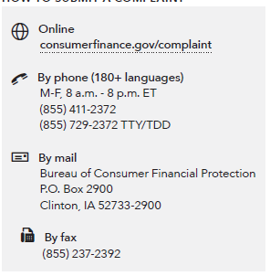
Handout: Submit a complaint
HOW TO SUBMIT A COMPLAINT
Notes:
Module 9: Protecting your Money
Methodology: Presentation and Facilitated Discussion
Corresponding section of the toolkit: The “Submitting a complaint” handout in Module 9, page 240
Instructions for facilitator:
Refer participants to the Bureau complaint contact information on slide and in their toolkit, on page 240
Explain the following:
An empowered consumer understands their rights. When you know you have rights, you can take steps to protect yourself. There are many laws that protect your rights when it comes to financial products and services. It is the Bureau’s job to enforce these laws and handle consumers’ complaints about financial products and services.
The Bureau has already handled over 1.5 million consumer complaints about:
Credit cards
Mortgages
Bank accounts and services
Student loans
Vehicle loans or leases
Payday loans
Other consumer loans (including installment loans, pawn loans, and title loans)
Debt collection
Money transfers or virtual currency
Credit reporting
Prepaid cards
Other financial services (including check cashing, money orders, cashier’s checks, credit repair, debt settlement, refund anticipation loans, foreign currency exchange, and traveler’s checks)
Every complaint the Bureau receives gives them insights into problems that people are experiencing in the marketplace and helps them to identify and prioritize problems for potential action.
Explain that you can submit a complaint on behalf of someone else following the directions on the site.
Explain that, you can also submit a complaint over the phone by calling the Bureau at 855-411-Bureau (2372), toll free. U.S.-based call centers can help you in over 180 languages and can also take calls from consumers who are deaf, have hearing loss, or have speech disabilities. Live operators in Spanish are available.

Slide 166
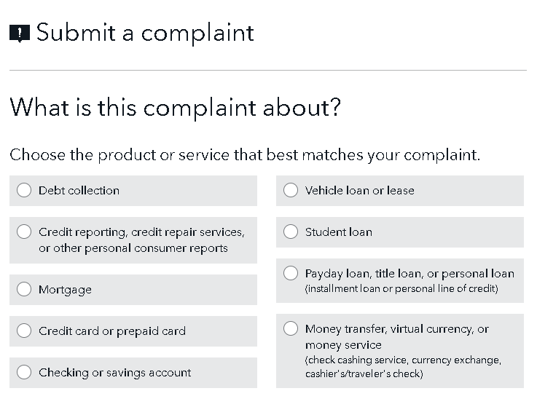
Submitting a complaint
Notes:
Module 9: Protecting your Money
Methodology: Presentation and Facilitated Discussion
Corresponding section of the toolkit: The “Submitting a complaint” handout in Module 9, page 240
Instructions for facilitator:
Review the steps in the complaint submission process:
Step 1: What is this complaint about?
Step 2: What type of problem are you having?
Step 3: What happened?
Step 4: What company is this complaint about?
Step 5: Who are the people involved?
Be sure to highlight that someone can submit a complaint on behalf of another.

Slide 167
Complaint process
Notes:
Module 9: Protecting your Money
Methodology: Presentation and Facilitated Discussion
Corresponding section of the toolkit: The “Submitting a complaint” handout in Module 9, page 240
Instructions for facilitator:
Explain the process for submitting a complaint:
Complaint submitted
You submit a complaint about an issue you have with a company about a consumer financial product or service. You will receive email updates and can log in to track the status of your complaint.
Review and route
We'll forward your complaint and any documents you provide to the company and work to get a response from them. If we find that another government agency would be better able to assist, we will forward your complaint to them and let you know.
Company response
The company reviews your complaint, communicates with you as needed, and reports back about the steps taken or that will be taken on the issue you identify in your complaint.
Complaint published
We publish information about your complaint—such as the subject and date of the complaint—on our public Consumer Complaint Database. With your consent we also publish your description of what happened, after taking steps to remove personal information.
Consumer review
We will let you know when the company responds. You’ll be able to review the company’s response and will have 60 days to provide feedback about the company's response.

Slide 168
Module 9: Opportunities for financial empowerment
Each handout takes 10 minutes to review
Read the "Protecting your identity" handout for ways to guard yourself against identity theft
Review the "How to handle identity theft" handout to learn what steps to take if your identity has been stolen
Study the "Spotting red flags" handout to see some of the warning signs that a sales deal might be a scam
Learn how "Submit a complaint" can help you if you’ve had a problem with a financial services company
Notes:
Module 9: Protecting Your Money
Methodology: Presentation and Discussion
Corresponding section of toolkit: Module 9, page 233
Highlight opportunities for introducing financial empowerment depending on the amount of time available.
If you have time during the training:
ASK: What other ways could you introduce the financial empowerment tools from this module in your work?
WRAP UP:
Remember, you have many rights when it comes to consumer financial products and services.
If you do feel like you have a complaint with a financial product, service or provider submit a complaint with the Bureau using the “Submitting a complaint” handout

Slide 169
Your Money, Your Goals
Closing
Notes:
Closing
Estimated Time: 20 Minutes
Methodology: Closing / Individual Activity

Slide 170
Closing
What is the most important thing you are taking away from this training?
What is something you would like to learn more about?
Notes:
Closing
Methodology: Closing / Individual Activity
Instructions for facilitator:
Ask each participant to share “the most important take away” from the training or “something they would like to learn more about.”
Write responses on flip chart.
Administer the post-training survey.
Conclude with thanks to host and participants.

